Slide 1
Workshop Report
Berryman - Carcassi - Kasmir - Shroff

Slide 2
Management Review Meeting
Review of the Quality
Management System
by management
regarding:
• suitability
• adequacy
• effectiveness
Opportunities for improvement
resources needed
Need for changes
including Quality Policy and Objectives
Meeting
Outcome

Slide 3
Quality Policy and Objectives
CS-Studio Quality Policy
Through a strategy of continuous improvement and teamwork, the Control System Studio Collaboration is dedicated to supplying tools for control systems, data integration and data visualization to enable our users to achieve their scientific objectives.
The foundation for achieving our commitment is based on:
understanding and meeting the requirements of our users,
continuously improving all processes related to the Control System Studio product,
effectively utilizing the creative talents in the collaboration

Slide 4
Quality Policy and Objectives
CS-Studio Objective
The fraction of releases per site deployed vs. releases considered for deployment will be a minimum of 75%

Slide 5
Process Performance and Product Conformity
Goals for 3.2 Release
We have made good progress of implementing a single connection management layer (pvmanager). BOY’s implementation still needs work. (stated at diamond)
We have created a single product, with standard features. SNS, KEK, NSLS2, FRIB and CS-Studio products have been updated to contain no java code. (stated as project)
We have coordinated monthly releases, with a monthly planning meeting (the last 5 months). (stated at diamond)
Moved to repo github
Moved to github issues
Moved wiki to github
Progress toward Feature build
Progress to extract 3rd party code from repository - Investigate 'Orbit'
Update Logbook API to support BNL/FRIB Olog
Autocomplete infrastructure {pv, pvmanager, channelfinder/db, logbook}

Slide 6
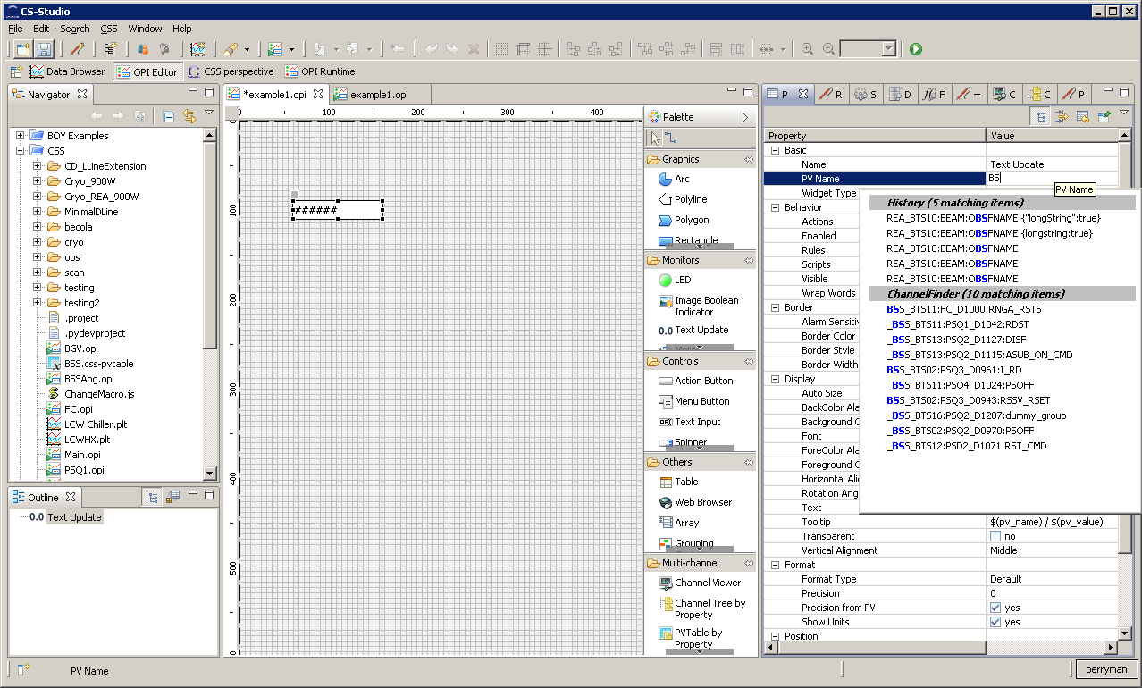
Process Performance and Product Conformity
Autocomplete

Slide 7
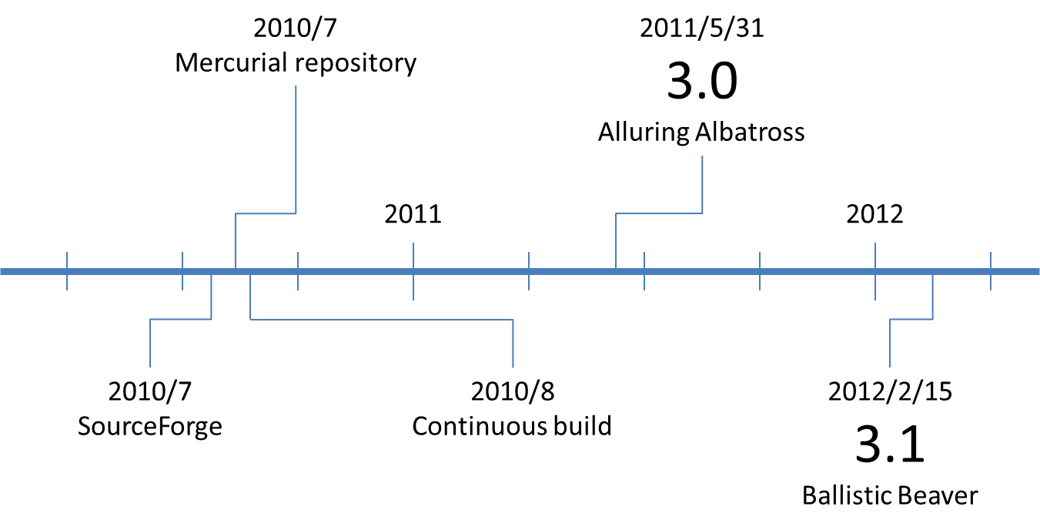
Status of Corrective and Preventative Actions

Slide 8
Status of Corrective and Preventative Actions
3.2.6: 7 closed (May)
3.2.7: 9 closed; 250 commits (Jun)
3.2.8: 11 closed; 135 commits (Jul)
3.2.9: 11 closed; 178 commits (Aug)
3.2.10: 13 closed; 218 commits (Sept)
3.2.11: 1 closed, 16 open; 7 new ← Oct release date
3.2.x release is a year late (September 2012)
Preventative action: Release Manager will be reviewed by the core developers every 6 months

Slide 9
Audits
Vasu Vuppula, Facility for Rare Isotope Beams, will perform the first internal audit

Slide 10
Customer Feedback Analysis
Website hits in September
402 people
739 visits
1548 actions
Census
16 developers
16 users
22 different institutions

Slide 11
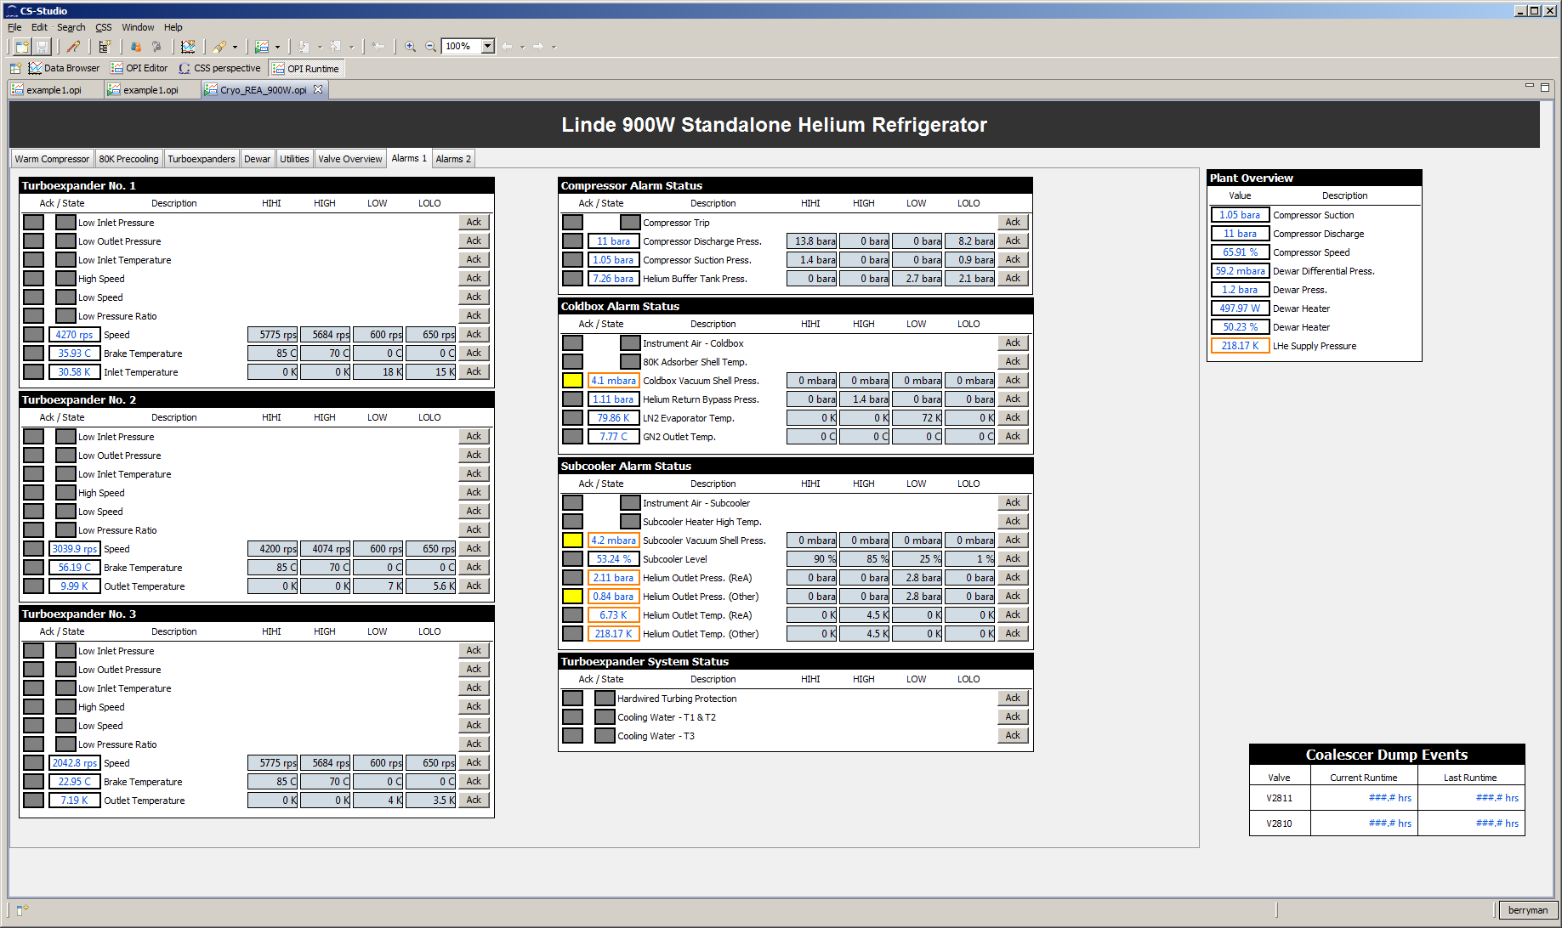
Customer Feedback
Custom OPIs to acknowledge alarms

Slide 12
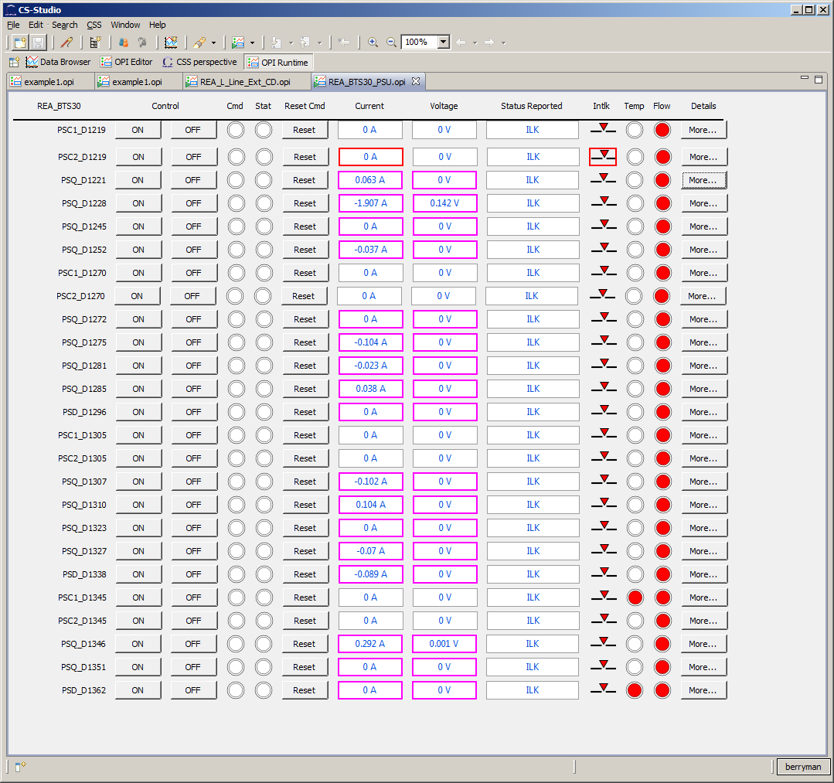
Customer Feedback

Slide 13
Customer Feedback
Simplify making OPIs that iterate a template

Slide 14
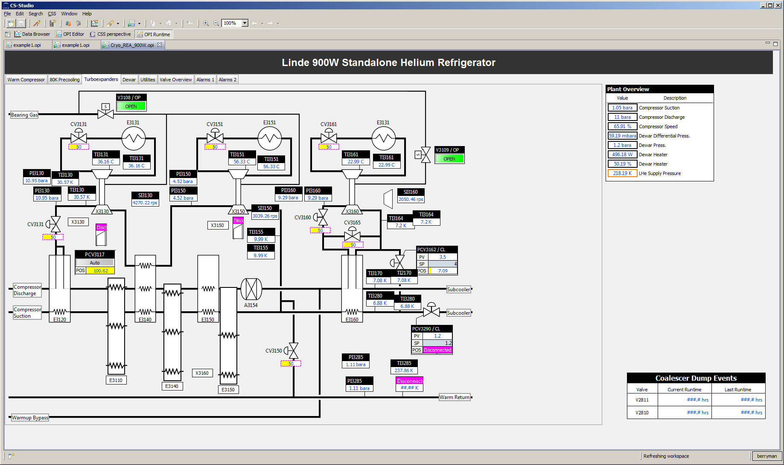
Customer Feedback
Screens can not depend on just color to relay information

Slide 15
Decisions and Actions for Improvement
At end of October
Close 3.2.x development and only allow hotfixes
Remaining requirements to mark 3.2.x as a stable release
Bug Fix and patches
BOY script performance (set 10Hz max update limit)
PVManager functions
Autocomplete
New repository rules
All commits will be done with a pull request
All commits must reference a issue number
Release Manager 6 month review

Slide 16
Decisions and Actions for Improvement
3.3.x Goals
Focus on BOY stability
Standardize GUI testing across labs
Prune the repository of plugins that; lack a maintainer or are unused
Simplify and improve project processes
Transparency
Iterations with audits
Take advantage of existing github features
Connecting issues and commits
Github pull request
Improve customer feedback
Survey

Slide 17
Resource Needs
Kunal Shroff (NSLSII) will be the interim maintainer for BOY RCP
RAP support
BOY script support

