Slide 1
EPICS Qt Update
Paul Martin

Slide 2
Australian Synchrotron
3GeV, 216m circumference synchrotron
8 Beamlines
12 Software Engineers
IMBL – Worlds Widest Beam - MRT Clinical Program – Safety Critical
Melbourne, Australia
Nearest other facilities: Taiwan, Thailand, Japan
16th Most Urbanized Country
World’s most livable cities
Hosting ICALEPCS in 2015

Slide 3
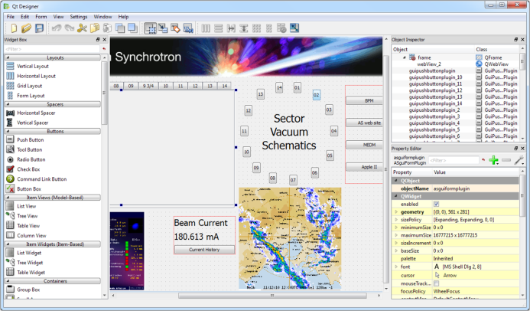
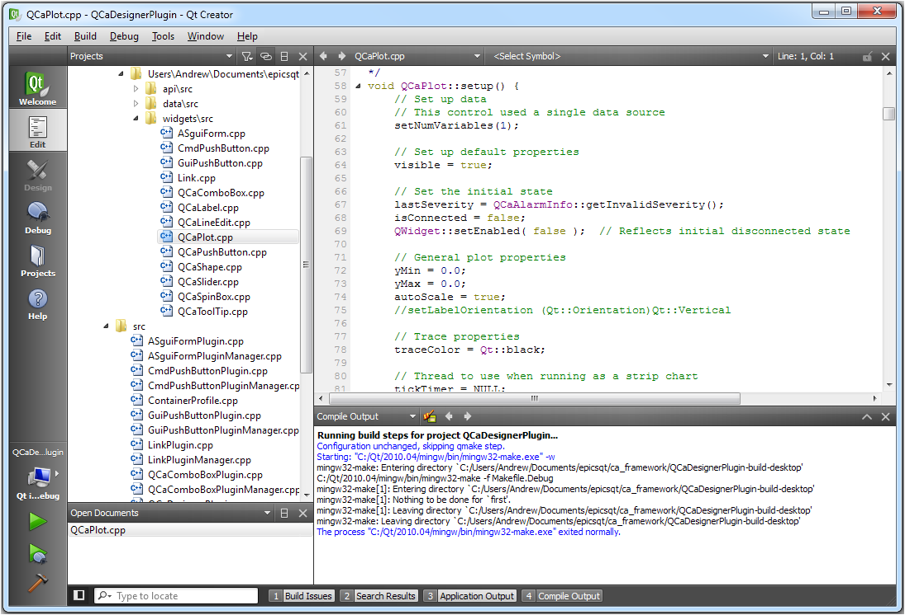
Qt
Qt is a cross-platform application and UI framework for developers using C++ – Windows,OS X, Linux, Embedded Linux, Android, iOS, vxWorks, Win CE, Amiga OS
Open Source (LPGL v2.1)
Trolltech -> Nokia -> Digia,
Development tools: Qt Creator, Qt Designer, Qmake, Qt Linguist, Qt Assistant, Integration into Visual Studio
Rich set of Widgets and other classes (1000+), Qwt (125+)
Very Good Documentation, help, examples
All Qt Objects contain powerful object communication mechanism (Signal+Slots)
GUI Layout widgets
Qt Project: www.qt-project.org
Qt Designer
Qt Creator

Slide 4
EPICS Qt – Team
Started 2009 – Anthony Owen, Andrew Rhyder, Glenn Jackson
Joined 2011 – Andy Starritt
Joined 2012 – Ricardo Fernandez
Joined 2013 – Zai Wang (1 year contract)

Slide 5
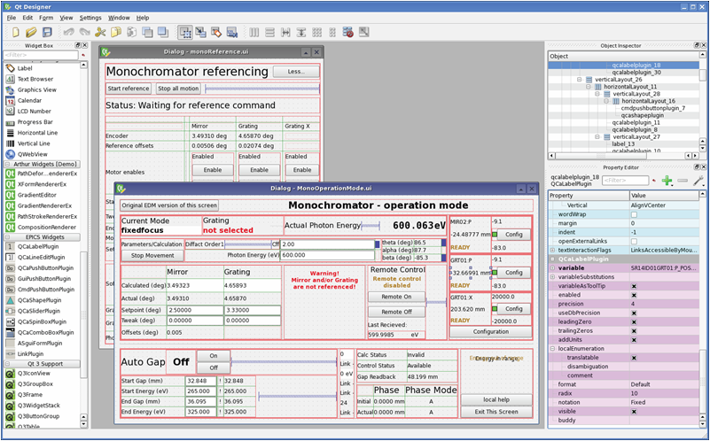
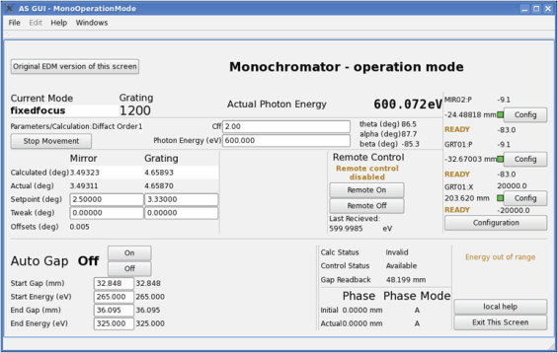
EPICS Qt – Rapid GUI Development
Adds Channel Access to standard Qt Widgets and Data Classes
Rapid GUI Dev – Drag and Drop EPICS aware components in Qt Designer
Macro Substitutions for PV names and other GUI functions
Qt Designer
Channel Access running at design time
.ui file – presented using QEGui on any platform (windows / linux)

Slide 6
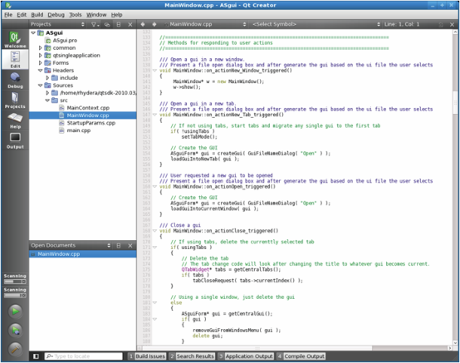
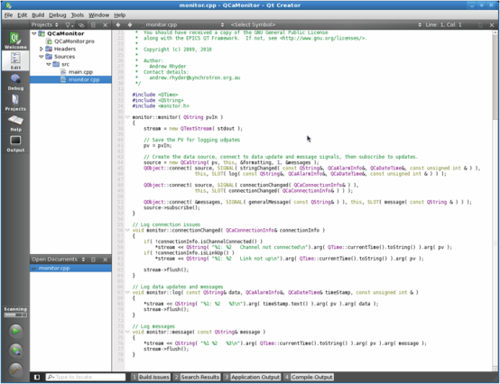
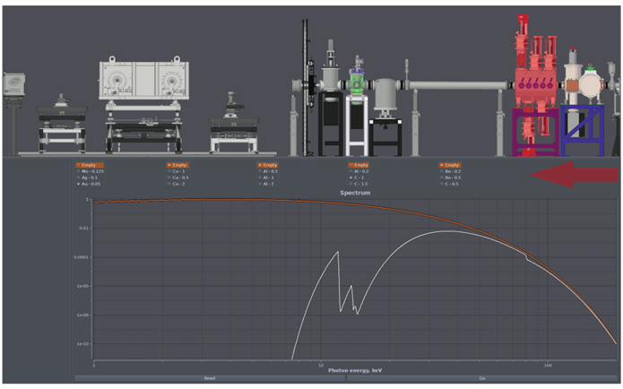
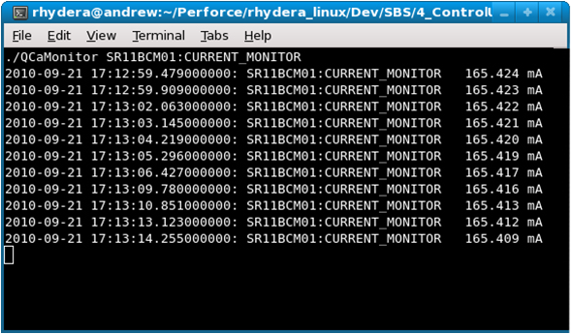
EPICS Qt – Other App Types
QCaString QCaInteger QCaFloating QCaByteArray
Qt Creator
Console Apps
Code Rich Apps
Apps for mobile platforms ?

Slide 7
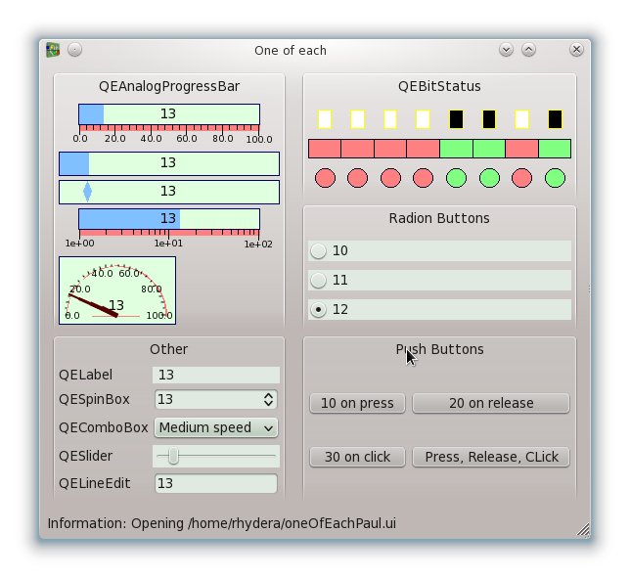
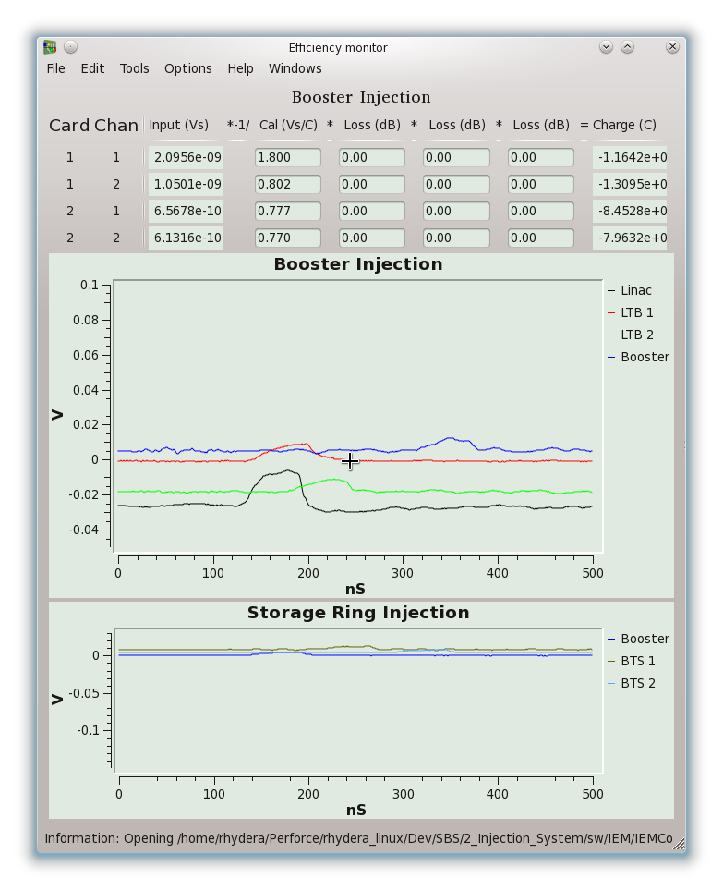
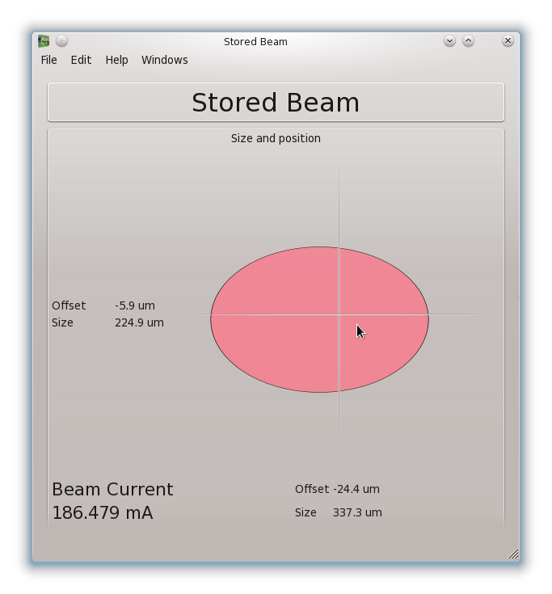
EPICS Qt – Core Widgets
Shape
Plot

Slide 8
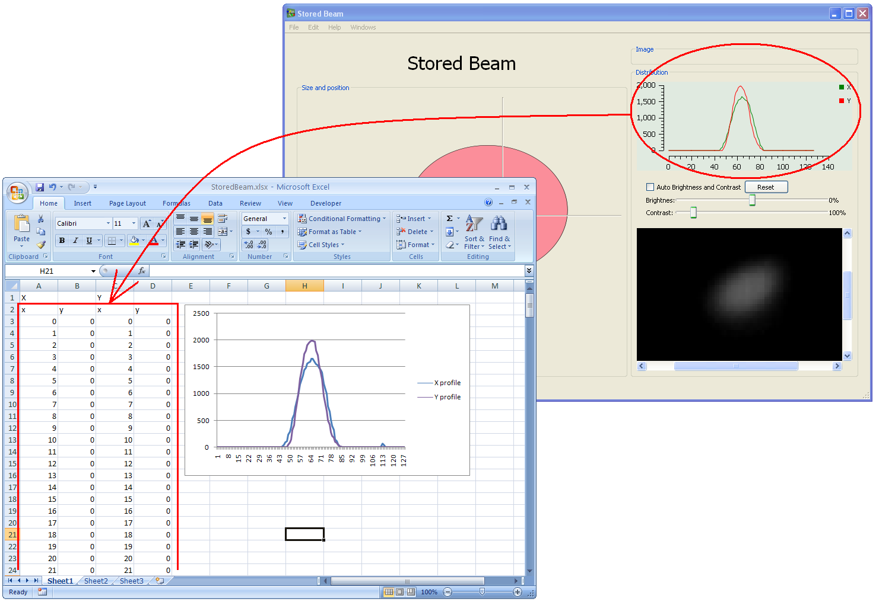
EPICS Qt – Improvement – Drag/Drop
Drag/Drop, Cut/Paste and context menus fully implemented

Slide 9
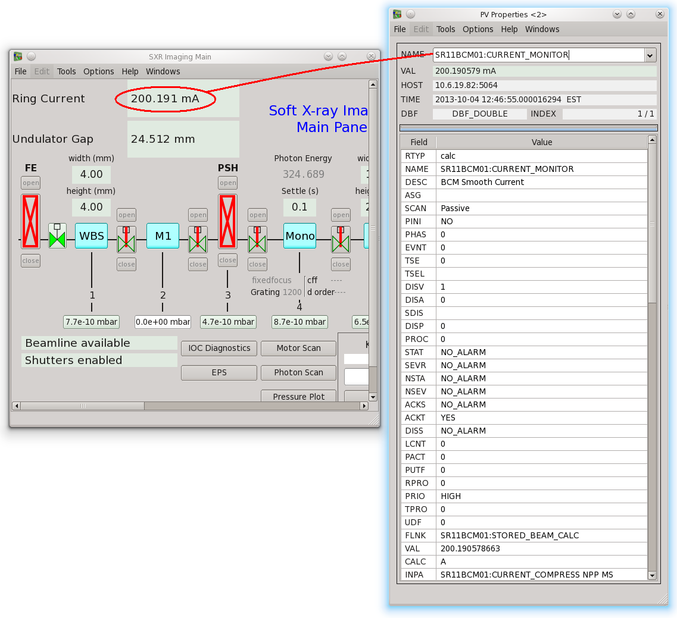
EPICS Qt – New Widgets - pvProperties

Slide 10
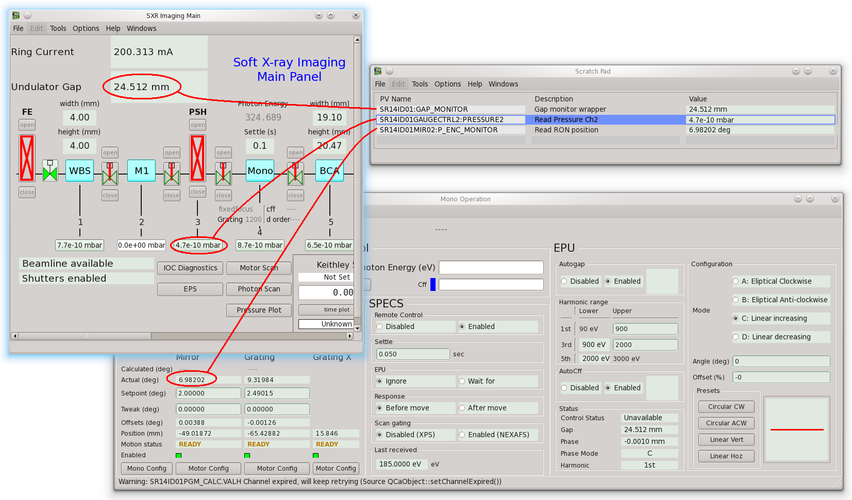
EPICS Qt – New Widgets – Scratch Pad

Slide 11
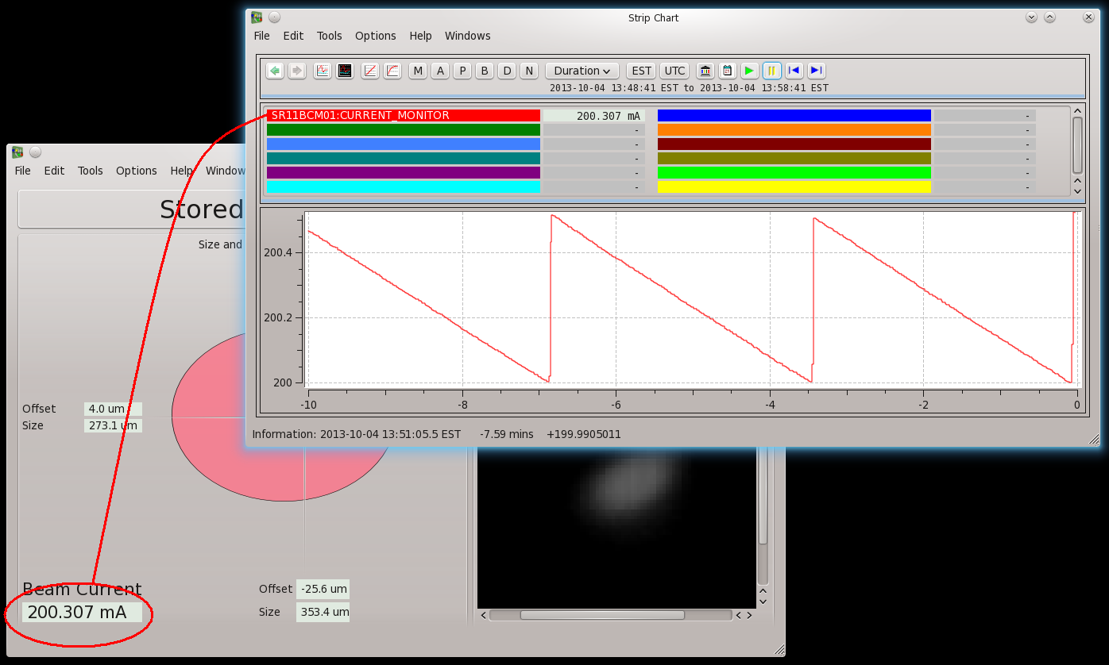
EPICS Qt – New Widget - Strip Chart

Slide 12
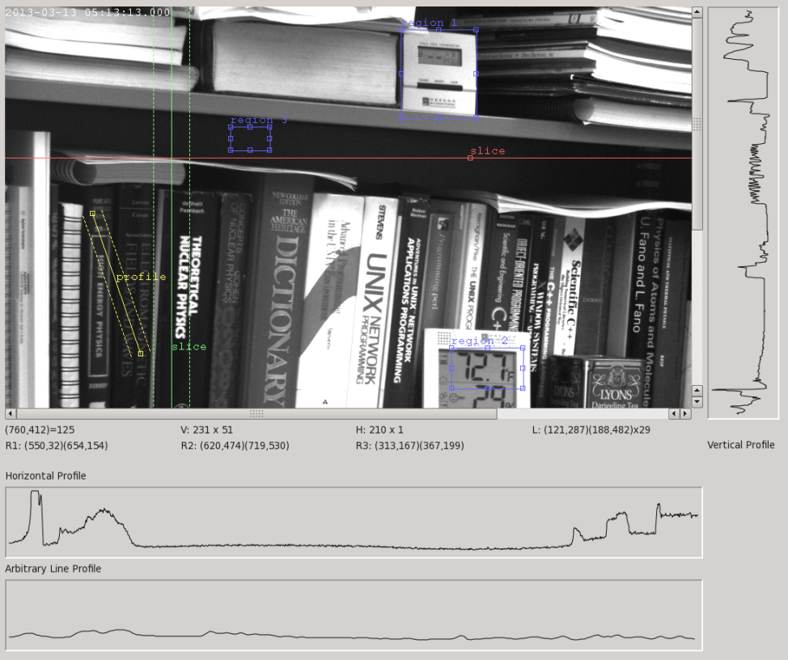
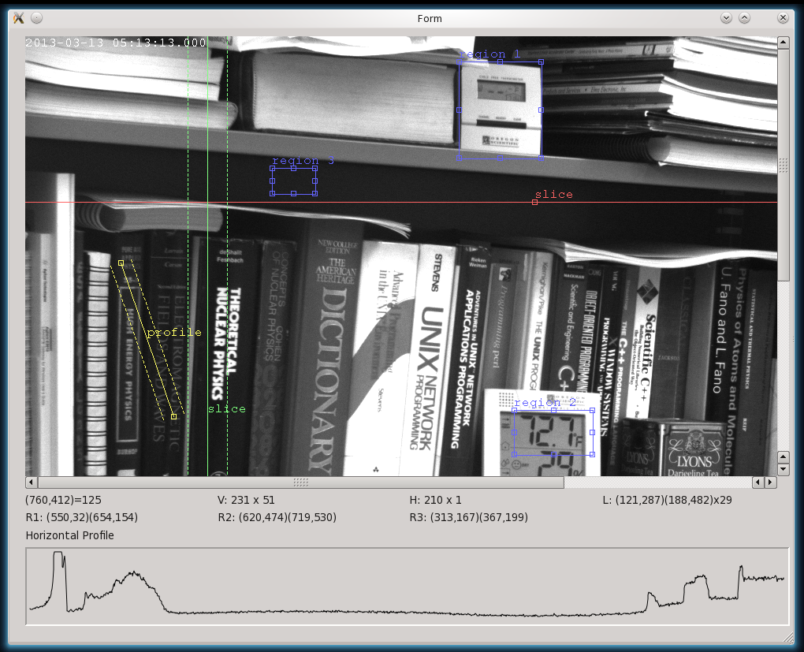
EPICS Qt – Under Improvement - Image
Current Development – Improved Area Detector Integration

Slide 13
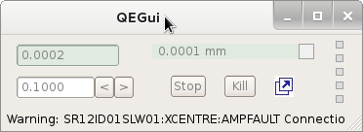
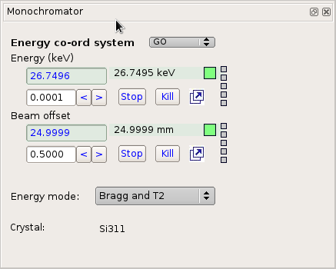
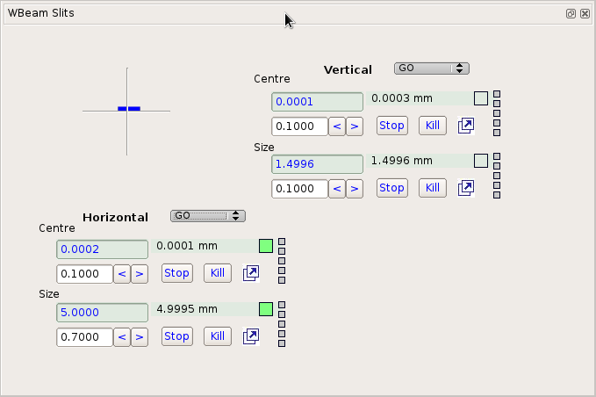
Current Development – Reusable components
Reusable component for Motor Record
Embedded in forms
Slits
Mono
Set MACRO for instance
Consistency
Build set of common components for Beamlines (eg Picoammeter)

Slide 14
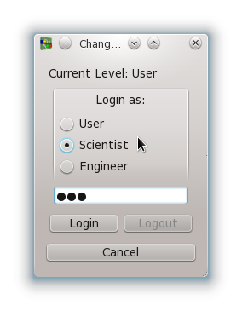
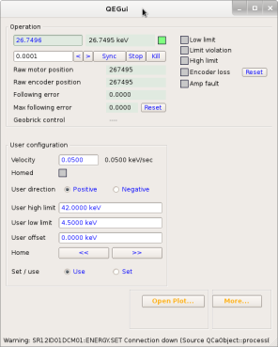
New Functionality - User Level
Logged in as Scientist
Logged in as User
Extra screen available

Slide 15
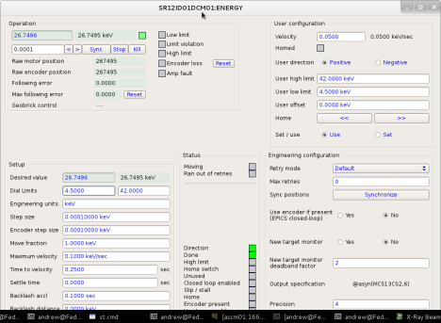
New Functionality - User Level
Logged in as Scientist
Logged in as Engineer
More…

Slide 16
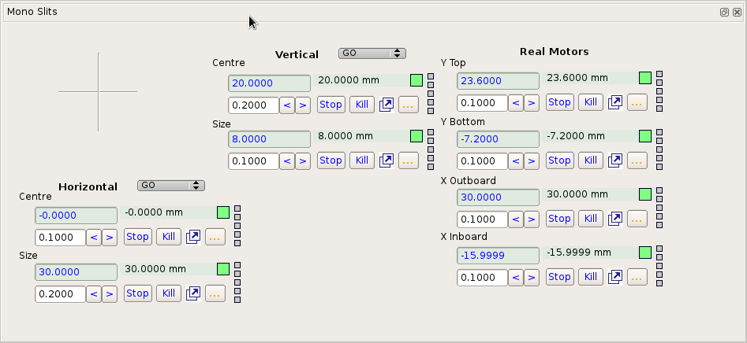
New Functionality - User Level
Log in as User
Log in as Scientist/Engineer
Virtual Motors
Same .ui file
Real Motors

Slide 17
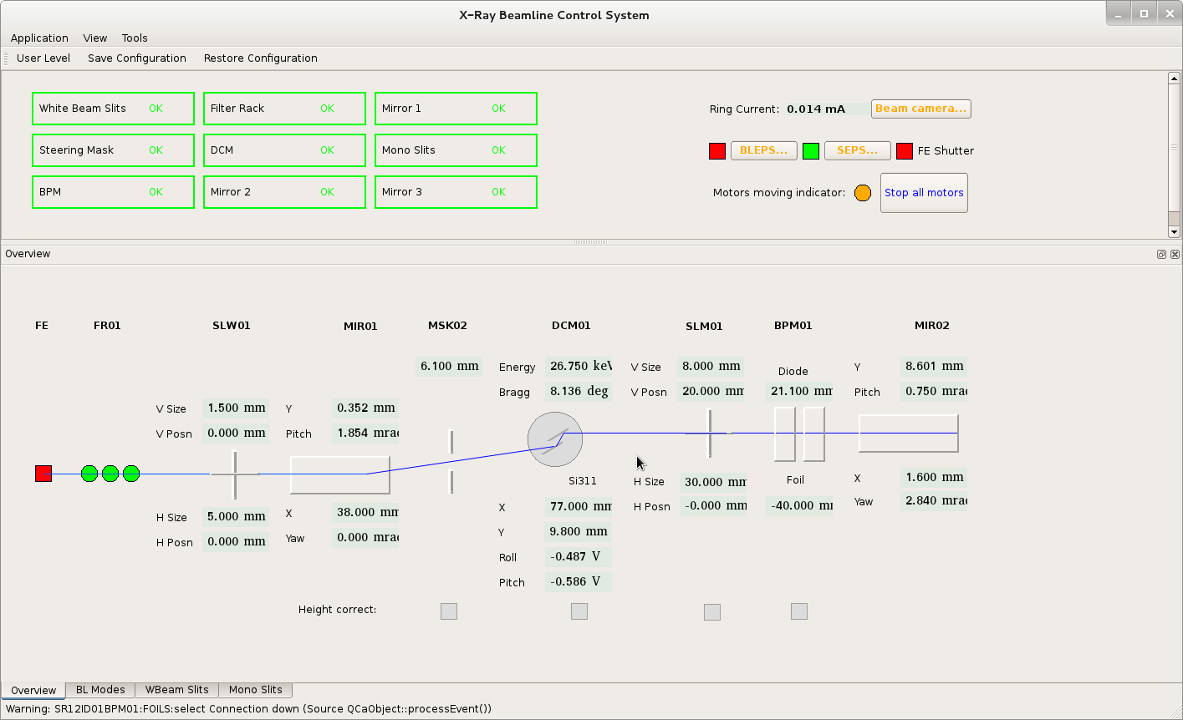
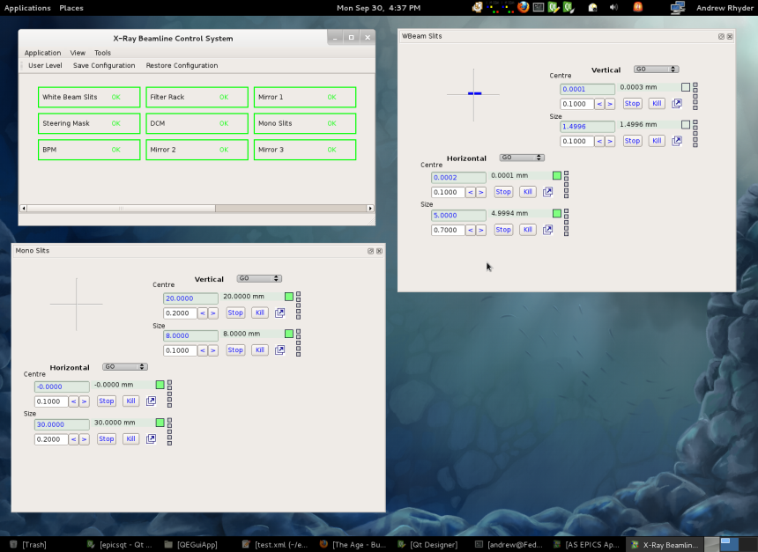
New Functionality – Save Configuration
Save Configuration
Now supports dockable forms!

Slide 18
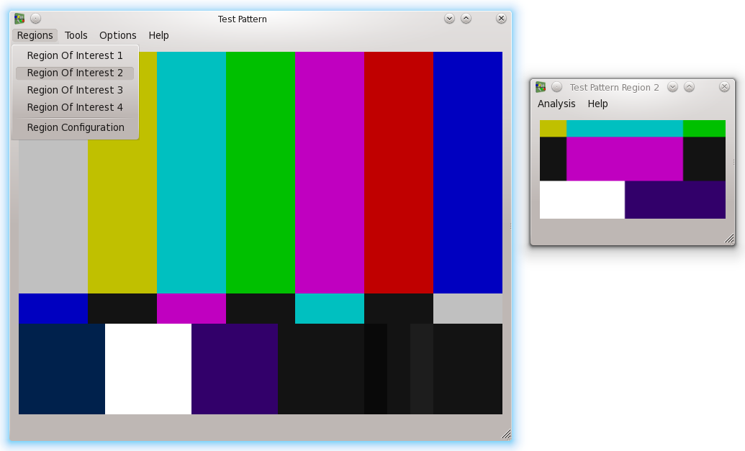
Under Development – Menu Customization

Slide 19
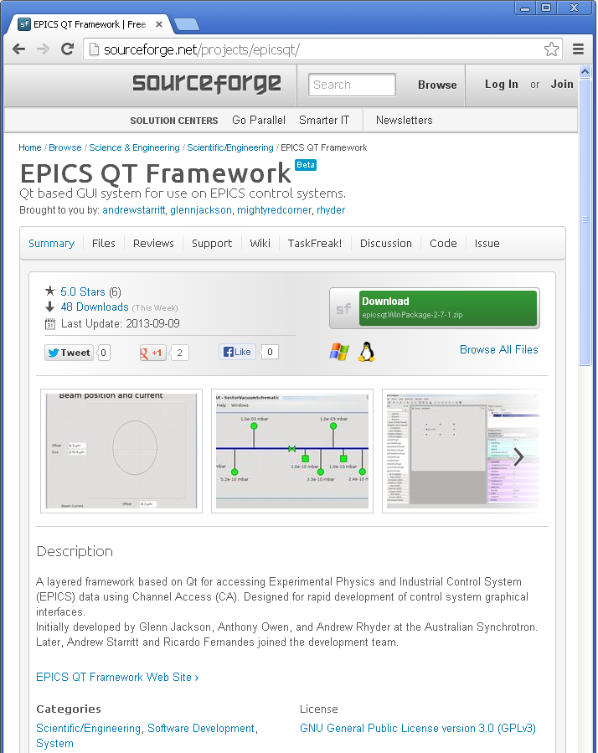
EPICS Qt – Website
http://sourceforge.net/projects/epicsqt/
Easy Installation
Documentation
Contact andrew.rhyder@synchrotron.org.au
See you in Melbourne - 2015

