Slide 1
Olog
Kunal Shroff
Eric Berryman
Dejan Dežman
Arman Arkilic

Slide 2
Publish/subscribe
Command/response
v3
v4
IOC
IOC
…
IOC
IOC
…
v4
CA client (JCA/CAJ)
pvA client
Masar
…
Core Client Technologies
Data Sources
CA
Sim
Test
pvA
Aggregation
pvManager
AccelUtils
Java/Python
Web based REST services
Data Definition
vTypes
API
ChannelFinder
Visualization
Graphene
API
Olog
CSS Core
ChannelFinder Integration
Olog Integration
…
...
Log Viewer
BEAST
BOY
Web UI and other clients
Scripts and utilities
DataBrowser
Logbook
pyOlog
…
CS-Studio
…
…
Notes:
To begin with this slides gives an overview of the various pieces that represent the architecture of our controls and high level physics applications, tools and services along and their relation ship with each other.
// maybe
Epics (both v3 and v4) is the control system we use
The core technologies provide the means to efficiently communicate with the Control system
CS-Studio is our primary user interface tool

Slide 3
Log Entry
Time
Owner
Text
Attachments
Logbooks
Tags
Properties
Notes:
It might be useful to start with describing what a log entry contains
Each log Entry has a create time, an owner, some text and may also contains some attachments – attachments can be any files
Additionally
Log entries have one or more logbooks and may have one of more tags – both logbook and tags provide a useful way of categorizing and grouping log entries into different logical groups.
Finally we have properties which can be seen as a set of key values pairs

Slide 4
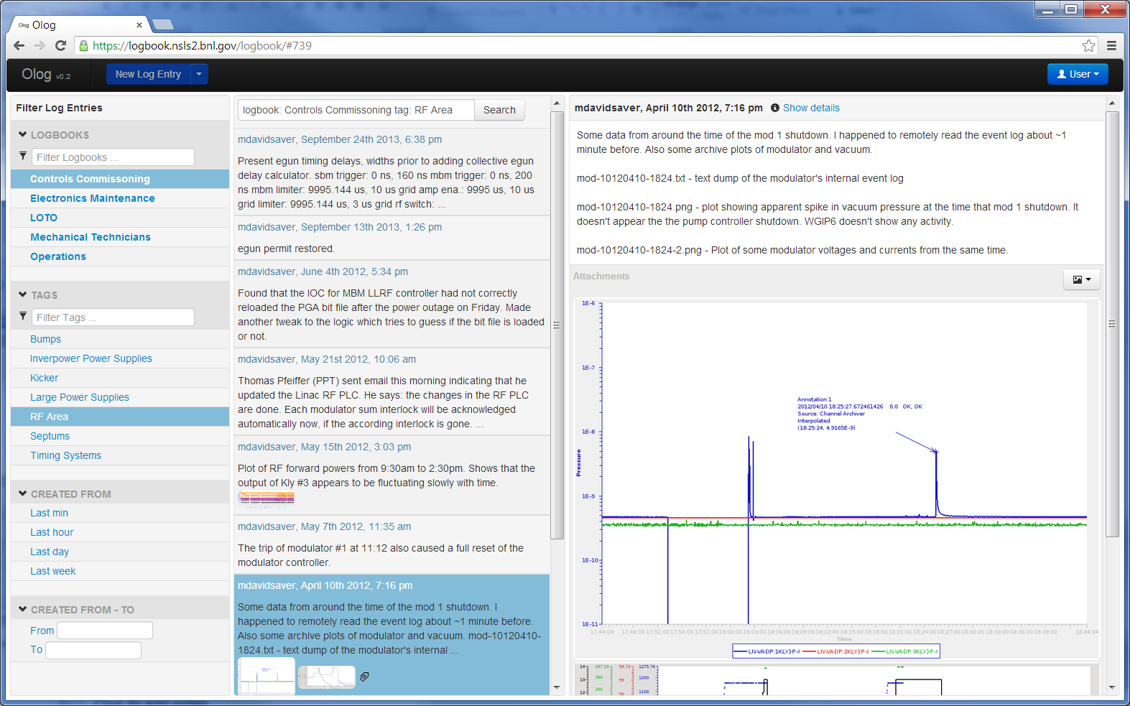
Webclient

Slide 5
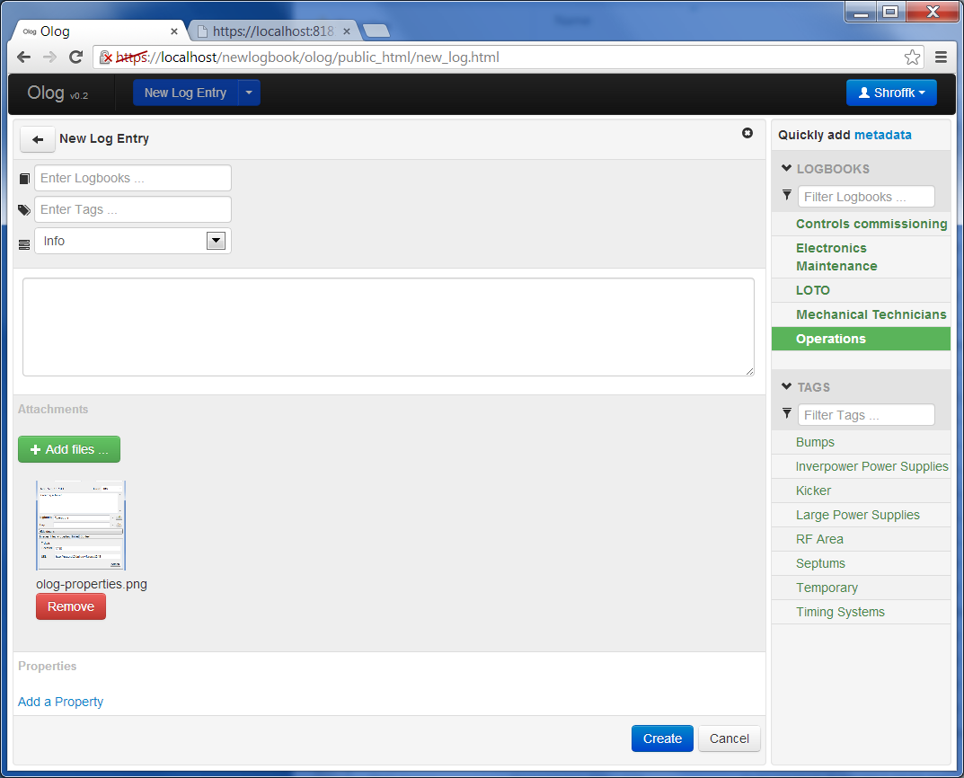
Webclient
Notes:
Screen shots

Slide 6
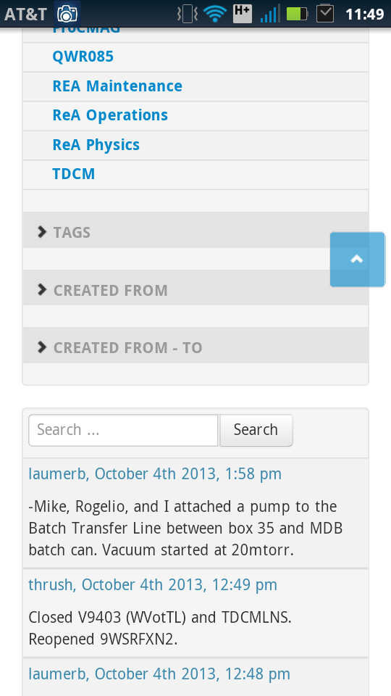
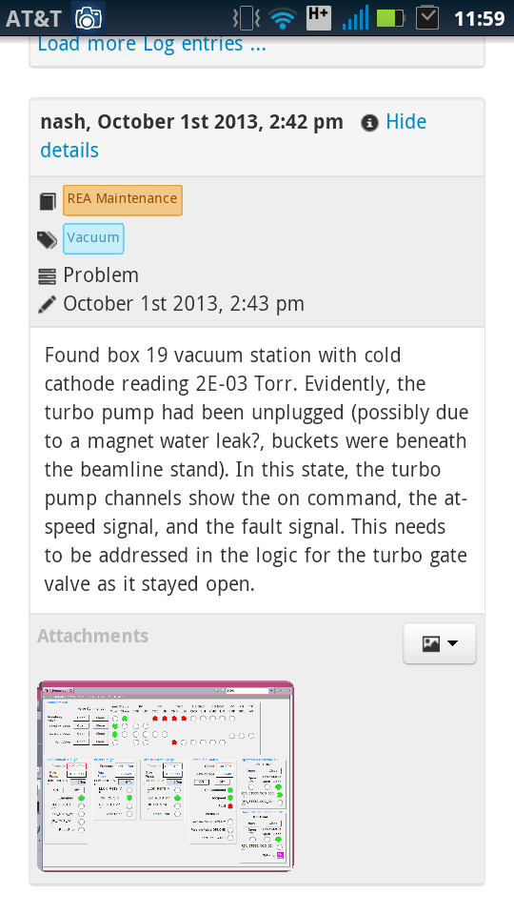
Webclient

Slide 7
Olog Clients – CS-Studio

Slide 8
Olog Clients – CS-Studio
Log Entries initialized with application specific information
Alarm server
PV name
Alarm status
Alarm time
Notes:
Cs-studio is a eclipse RCP for controls and physics tools
The integrated environment provides a
A use case
An alarm occurs, right click create log entry
The log entry dialog is initialized with the alarm pv, status etc.
Additionally you may also attach some time information so that when other people are reviewing the log entry they can easily bring up the other applications

Slide 9
Olog Clients – CS-Studio
Save Context
Configuration files for cs-studio applications (.plt)
Controls system data (List of process variables)
Information related to other services (Trac tickets , ChannelFinder queries)

Slide 10
Olog Clients – CS-Studio

Slide 11
Olog Clients – CS-Studio
Restore Context
Launch applications initialized to the state as described while making the log entry
Open archived data for associated pv’s
Run OPI screens
Query other services

Slide 12
Olog Properties
Integration with other services
Ticketing service
property
name: ticket
attributes
Id : 1234
URL : https://trac.cs.nsls2.bnl.gov/tickets/1234
Component directory (FRIB)

Slide 13
Olog properties
Integration with experimental processes and data
name: scanProcess
attributes
type: XPD
id: 1234
description: save reduced dataset
location: pyPXD.nsls2.bnl.gov/resources
attachments: reducedData.json

Slide 14
Olog Clients – pyOlog

Slide 15
Olog Clients – pyOlog

Slide 16
Questions

