Slide 1
Archive Engine for Large Data Sets
Nikolay Malitsky
EPICS Collaboration Meeting
San Francisco, USA
October 5, 2013
Notes:
1

Slide 2
Outline
Objectives: new scope, new scale, new applications
Incremental Approach: big picture, classic and HDF5 versions
Major techniques: type system, chunk model, HDF5 file format
Next Use Case: time series of frames

Slide 3
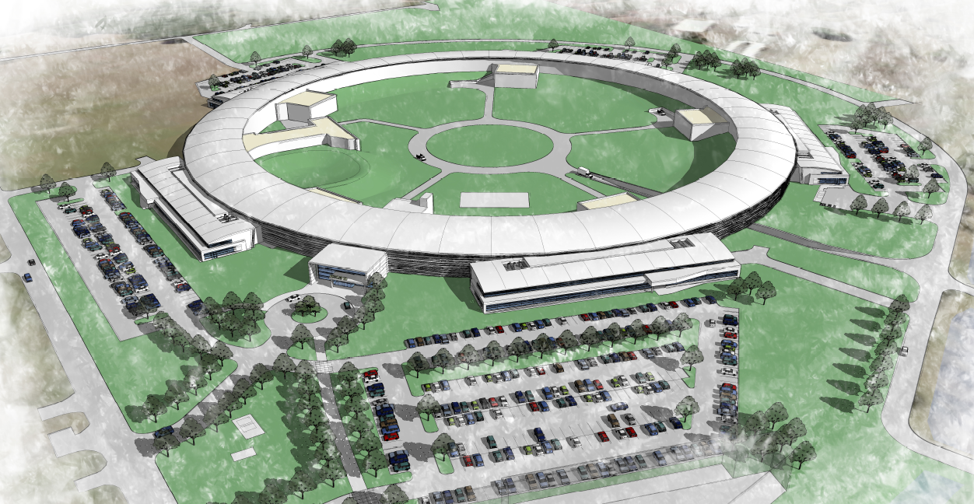
Objectives
2TB/day
New Scale: 1 M samples/s from 30,000 heterogeneous physical devices of power supplies, diagnostics, RF, vacuum system, etc
New Scope: Transition from EPICS 3 to EPICS 4 bringing the middle layer and support of the user-defined data types
New Applications: Beamline DAQ

Slide 4
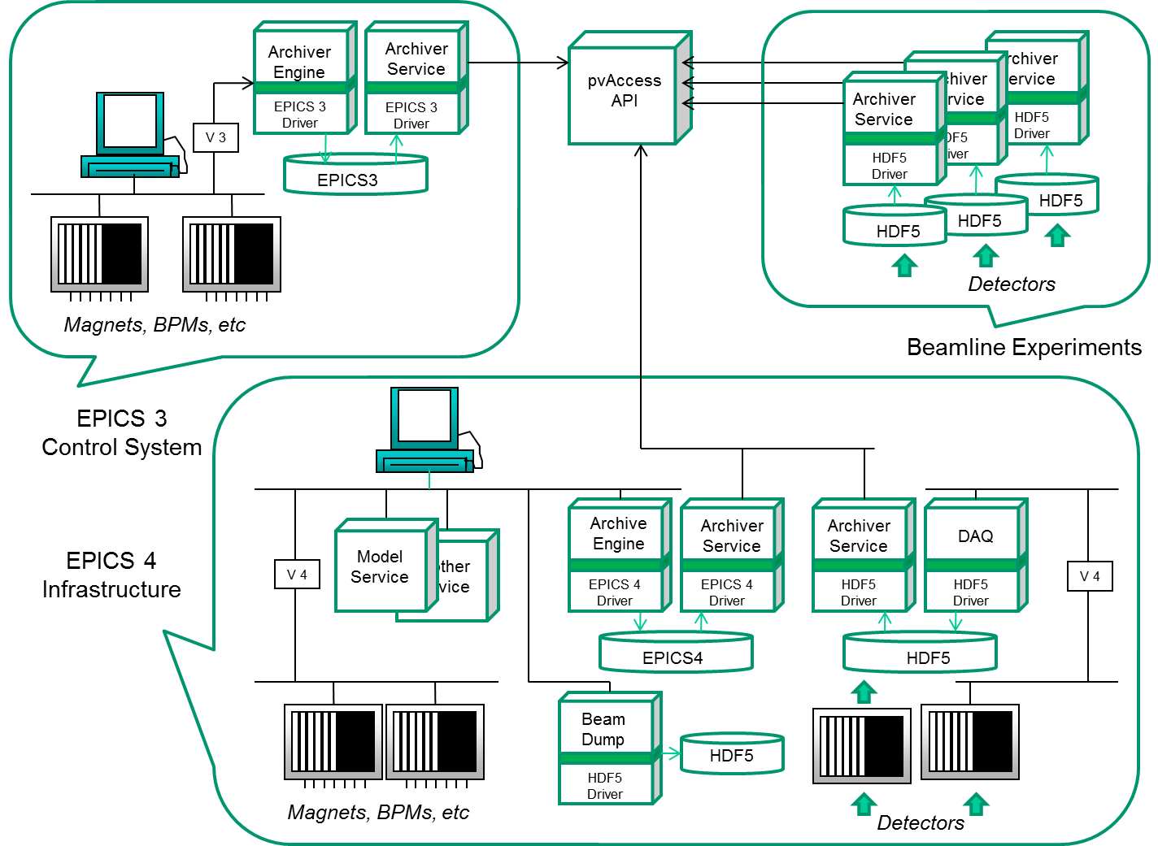
Integrated and Incremental Approach
Channel Archiver Framework:
Data Access: EPICS V4 RPC
Engine: generic type system, chunk model, lock-free approach
Backend: HDF5

Slide 5
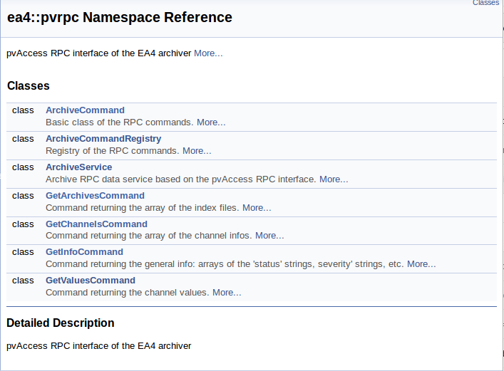
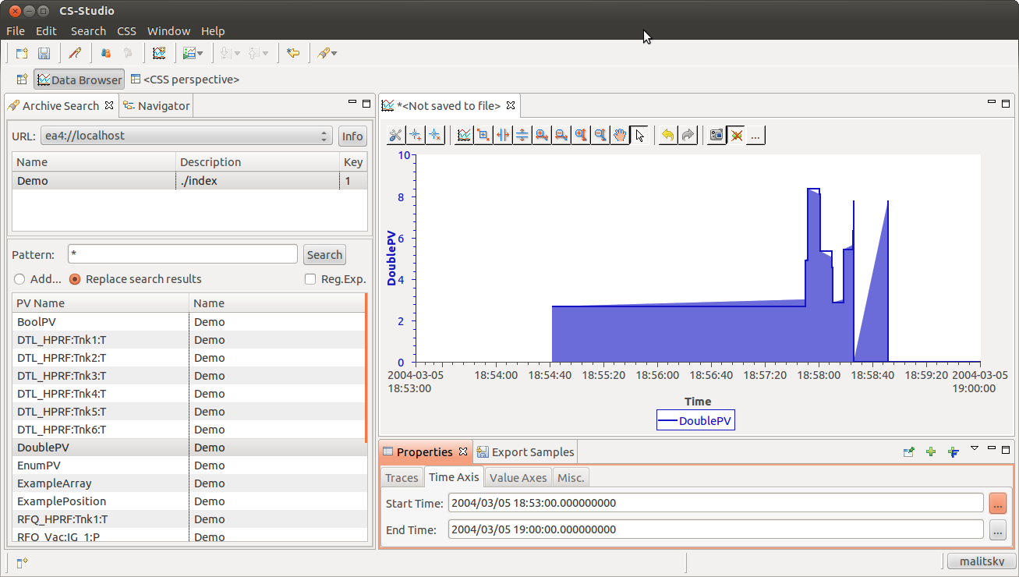
Classic Version
Data Access: XML-RPC and EPICS V4 RPC
Engine: Lock-free Circular Buffer => 100 K scalar samples/s
Backend: Index + original Data files => 300 K scalar samples/s
C++ RPC server: ea4:pvrpc
CSS Plug-in: org.csstudio.archiver.reader.ea4

Slide 6
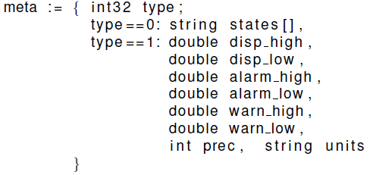
Data Access: Get Channel Values
Heterogeneous Array
Solution: EPICS 4 PVData-based dynamic structure of self-described members

Slide 7
HDF5 Version
Data Access: EPICS V4 RPC
Engine:
Lock-free everywhere => 0.3 – 0.5 M scalar samples/s
Generic Type catalog
Generic TS Chunk
Backend: Index + HDF5 files => 3 M scalar samples/s (HDD)
Extract, Transform, Load (ETL):
ETL
Index
Hard drive: SSD
HDF5 chunk: one TS Chunk
Hard drive: HDD
HDF5 chunk: many TS Chunks

Slide 8
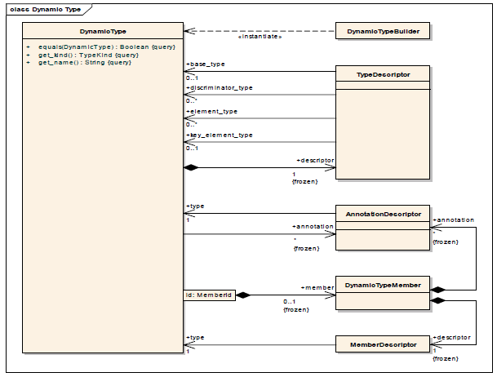
Open Type System
Structured Data Types
DBR Types
PV Data
HDF5
SciDB
…
OMG DDS Extensible and Dynamic Topic Types
Version 1.0: November 2012

Slide 9
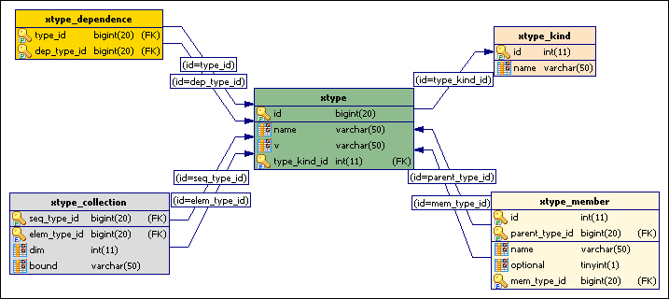
RDB-based Type Catalog
with D. Dohan
xtype_kind: enumeration values of int16, float, string, sequence, structure, etc.
xtype: collection of all type ids and versions
xtype_dependence: auxiliary table with the type dependencies
xtype_member: structure-member associations
xtype_collection: sequence-element associations

Slide 10
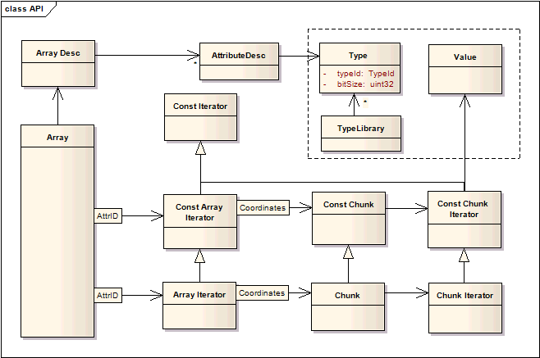
Chunk-Based Model
Array – Chunk – Sample
Channel is a sequence of the TS chunks
TS Sample:
TSSample
Type
Generic API
char*
Memory Buffer
TS Chunk:
Generic API
Type

Slide 11
HDF5 Backend
HDF5 Conceptual Data Model:
group: a folder of named objects, such as groups, datasets, and data types
dataset: a chunk-based multidimensional array of data elements with attributes, data space and data types
datatype: a description of a specific class of data element
Channel is a HDF5 group including the following datasets:
Channel Datasets | Datatype | Attributes | DBR Use Case | Original Channel Archiver
Intervals [chunk-based collection] | timestamps index of the first sample number of samples |  | Intervals associated with the index file | File offsets and buffer sizes of Data Headers
Info [one element] | Channel-specific | Type Name | CtrlInfo | CtrlInfo’s of Data Headers
Data [chunk-based collection] | Channel-specific | Type Name | One of the DBR scalar or waveform types | DBR type and count of Data Headers + Buffers

Slide 12
Next Use Case: Time Series of Frames
The proposed generic structure of the sparse multi-dimensional array is defined after the “natural” experiment-oriented representation built from the combination of two datasets: time series of detector-specific frames and time series of the frame positions in the scan-specific multi-dimensional space (angle, energy, pressure, etc)
TS Frames
array of
Timestamp
timestamps
mapped into EPICS 4 PVData and HDF5 representations
consistent with all (22) NeXus Application Definitions
1
pixel_meta
Coord Metadata
1 …*
Bin Metadata
frame meta
array of
Frame
frames
1 …*
Coord Metadata
position meta
array of
Position
positions

