Slide 1
Archiving Large Buffers and Supporting Data Types
Nikolay Malitsky
EPICS Collaboration Meeting
Rutherford Appleton Laboratory, UK
May 1, 2013
Notes:
1

Slide 2
Outline
Objectives: new scope, new scale, new applications
Incremental Approach: adding the type system, chunk model, HDF5
Status
Towards the Image Archiver

Slide 3
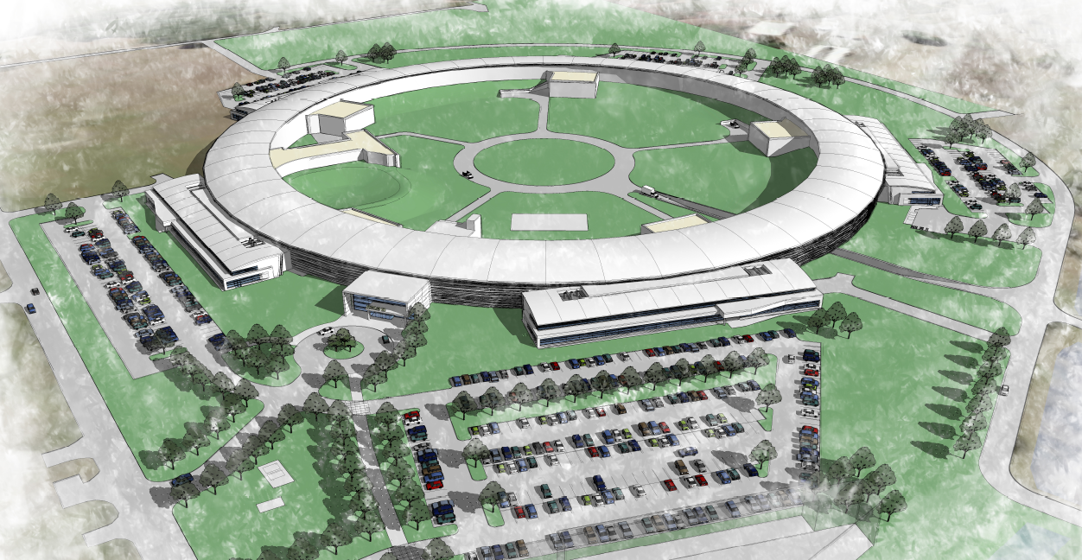
Objectives – 1 of 2
2TB/day
New Scope: Transition from EPICS 3 to EPICS 4 bringing the middle layer and support of the user-defined data types
New Scale: 1 M samples/s from 30,000 heterogeneous physical devices of power supplies, diagnostics, RF, vacuum system, etc

Slide 4
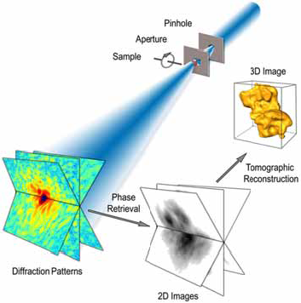
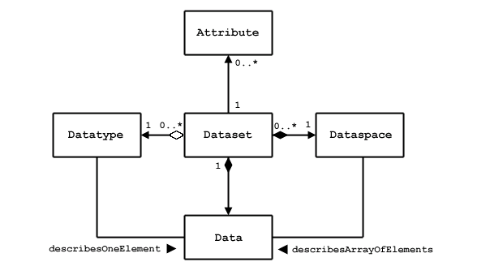
Objectives – 2 of 2
New Applications: Beamline DAQ
HDF5 Dataset
Courtesy of Qun Shen (NSLS-II)

Slide 5
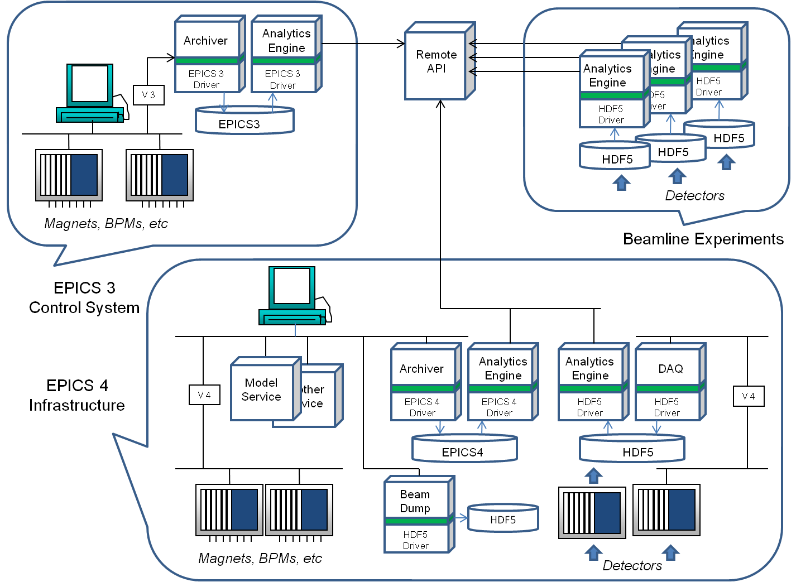
Incremental Approach
EPICS 3
Channel Archiver
Framework
New Scope: DDS Type System
New Scale: SciDB Chunk Model
New Applications: HDF5 Backend
EPICS 4

Slide 6
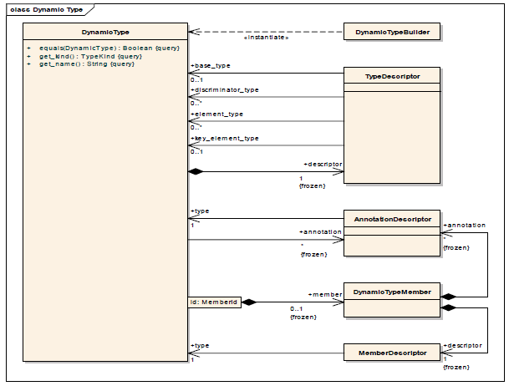
Open Type System
Structured Data Types
DBR Types
PV Data
HDF5
SciDB
…
OMG DDS Extensible and Dynamic Topic Types
Version 1.0: November 2012

Slide 7
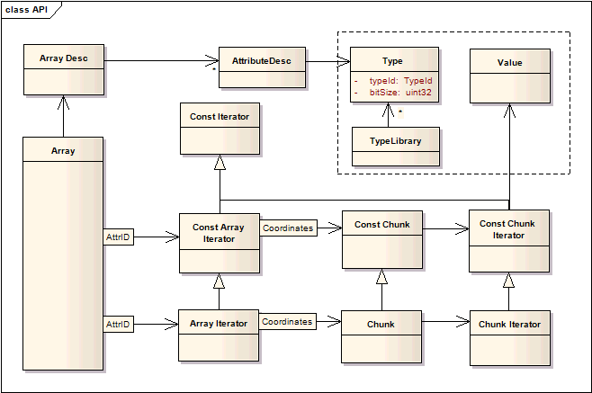
Chunk-Based Model
Channel is a sequence of the TS chunks
Array – Chunk – Sample
TS Sample:
TSSample
Type
Generic API
DbrTimeDouble
Implementation
char*
Memory Buffer
TS Chunk:
Generic API
Type
…
Sample
Sample

Slide 8
HDF5 Backend
HDF5 Conceptual Data Model:
group: a folder of named objects, such as groups, datasets, and data types
dataset: a chunk-based multidimensional array of data elements with attributes, data space and data types
datatype: a description of a specific class of data element
Channel is a HDF5 group including the following datasets:
Channel Datasets | Datatype | Attributes | DBR Use Case | Original Channel Archiver
Intervals [chunk-based collection] | timestamps index of the first sample number of samples |  | Intervals associated with the index file | File offsets and buffer sizes of Data Headers
Info [one element] | Channel-specific | Type Name | CtrlInfo | CtrlInfo’s of Data Headers
Data [chunk-based collection] | Channel-specific | Type Name | One of the DBR scalar or waveform types | DBR type and count of Data Headers + Buffers

Slide 9
Archive Engine: Bringing It All Together
Channel Writer
Channel Subscriber 1
Chunk Period
Time Period
…
EPICS 3
Engine
…
Channel Subscriber N
Chunk of the TS samples . The type description is associated with
the channel subscriber.
registry of the type-specific operators for serializing the EPICS 3 built-in data types. In EPICS 4, it will be replaced with one generic operator.
HDF5
Index
generic operator for writing the HDF5 data sets

Slide 10
Status
http://sourceforge.net/projects/epicschanarch/
Full integration of the original version and tools
Beta version: type library, chunk model, HDF5 backend, etc.
New scale of the chunk-based engine: 100 K scalar samples/s
Next Target:
Replacement of XML-RPC with one of the client front-ends:
Murali Shankar’s Archiver Appliance
EPICS V4 RPC
SciDB …
Replacement of guards with the ZeroMQ lock-free approach towards
500 K scalar samples/s
Adding the RDB-based type system (together with Don Dohan)
Image Archiver (next slides with a few proposals)

Slide 11
Proposal of the 2D Image Type
Image Header
width: image width in pixels
height: image height in pixels
depth: pixel depth in bits
nChannels: number of channels, 1-4
encoding: www.fourcc.org
channelSeq[4]: {‘b’, ‘g’, ‘r’} or {‘r’, ’g’, ‘b’}
Data type: byte, int16, uint16, etc.
OpenCV IplImage
areaDetector NDArray
Prosilica PvAPI
Java Buffered Image
SWT Image Data
QT Image
TINE Image
Image Buffer
Size: buffer size
Data: one-dimensional array of bytes

Slide 12
Proposal of the HDF5-based Time Series of 2D Images
Channel Datasets | Datatype | Attributes | DBR Use Case | Image Use Case
Intervals [chunk-based collection] | timestamps index of the first sample number of samples |  | Yes | Yes
Info [one element] | Channel-specific | Type Name | CtrlInfo | Image Header
Pointers | timestamp index of the first element number of elements |  | No | Yes
Data [chunk-based collection] | Channel-specific | Type Name | One of the DBR scalar or waveform types | Sequence of bytes *
*Sequence of the compressed or uncompressed chunks

