Slide 1
BNL Services
Guobao Shen
<shengb@bnl.gov>

Slide 2
Service Architecture
CSS
pvManager
CAC PVAC REST
Python Apps
CAC PVAC REST
MMLT
CAC PVAC REST
Matlab Apps
CAC PVAC REST
Channel Arch
CAC PVAC REST
Ethernet
pvAccess/channelRPC
MASAR
Python
PVAS
HTTP/REST
MUNICONV
Python
PVAS
HTTP/REST
Lattice/Model
Python
PVAS
HTTP/REST
Channel Finder
Java
SQLite/IRMIS
MySQL/IRMIS
MySQL/IRMIS
MySQL
Distributed Front-Ends
CAS PVAS
Diag db
CAS PVAS
PS db
CAS PVAS
RF db
CAS PVAS
VA db
CAS PVAS
JMS Service
Physical Device
Physical Device
Physical Device
Physical Device
Tracy Simulation

Slide 3
MASAR
Machine Snapshot Archiving & Retrieving
Scripting
CSS/BOY
Others
(Matlab)
PyQt
Scripting
High Level Scripting API
Low Level Python Client Library pvAccess/channelRPC Client (C++)
pvAccess Client API Library (Java)
pvAccess
pvAccess/channelRPC
Service Engine
DSL-PY Module
Channel Access Client
PYMASAR
(SQLite)
Channel Access
IOC
IOC
IOC
Finished
User Apps
Planning
Developing

Slide 4
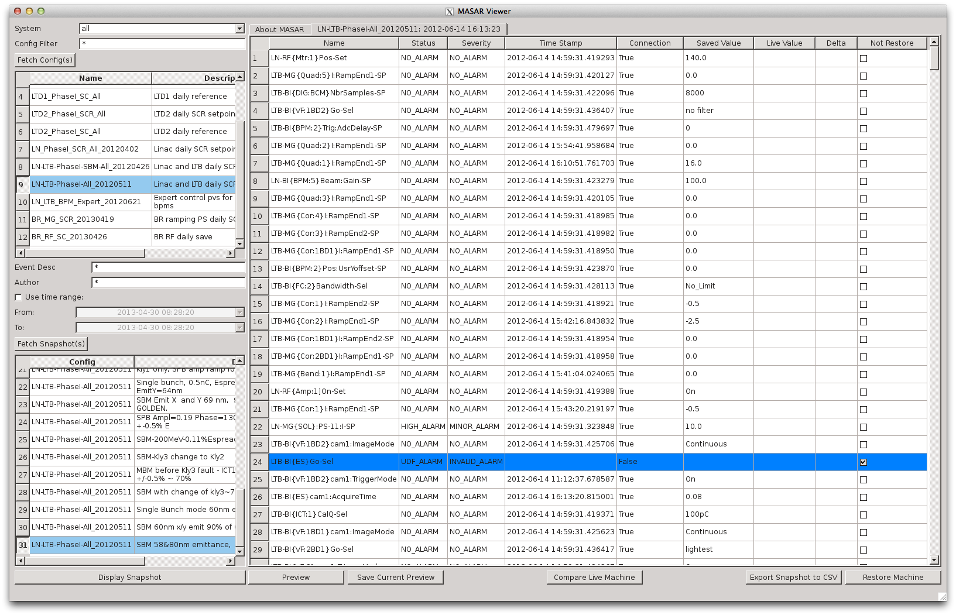
MASAR
PyQt

Slide 5
MUNICONV
Multiple unit conversion
First implementation targeting on magnets
Scripting
CSS/BOY
Others
(Matlab)
Python Client
Java Client
Browsers
RESTful
pvAccess
RESTful
pvAccess
RESTful
pvAccess
V4 channelRPC service
html
Django
V3 IOC
Conversion function
initialize
Conversion function
Python Data API
Python-MySQLdb
MySQL (IRMIS schema)
(installation, inventory, magnet measurement)
Finished
User Apps
Planning
Developing

Slide 6
Lattice/Model Service
Save lattice geometric info + strength
Save simulation results (Twiss, T-Matrix, …)
Scripting
CSS/BOY
Others
(Matlab)
Python Client
Java Client
Browsers
RESTful
pvAccess
RESTful
pvAccess
RESTful
pvAccess
V4 channelRPC service
html
Django
Online simulation
(Tracy for Phase 1)
Data processing
Python Data API
Python-MySQLdb
MySQL (IRMIS schema)
(Lattice: geo+strength, Model: TWISS, T-Matrix, Close Orbit, …)
Finished
User Apps
Planning
Developing

