Slide 1
Controls Database Collaboration
EPICS Meeting April, 2013

Slide 2
What is Controls Database Collaboration (CDB)?
Goal
Provide access to an Experimental Physics Facility’s data and knowledge
How?
By developing databases, services, interfaces, and applications
[Users can access the data through GUI, EPICS V4, REST, Java, and Python APIs]
Partners
Brookhaven National Lab, New York, USA
Cosylab, Slovenia
European Spallation Source, Sweden
Facility for Rare Isotope Beam, Michigan, USA
Institute for High Energy Physics, Beijing, China
Started in November 2011

Slide 3
CDB Scope
# | DB | Description | Status | Owner
1 | Logbook | Logbook entries | Done: 80% | Berryman
2 | Traveler | Production, test, design data | Done: 50% | Liu, Vuppala
3 | Configuration | Physical and logical information about the facility and its configuration | Done: 50%. | Vuppala
4 | Infrastructure | Cables, IOCs, Racks, Rooms etc | Done: 20% | Vuppala
5 | Lattice/Model | Elements and online model | Done 30% | Chu
6 | Inventory | Spare parts, stock items | Done: 20% | Liu, Berryman
7 | State | Save/restore state of FRIB segments | Done: 40% | Berryman
8 | Alarm | Set changes, set/read mismatches | Done: 40% | Berryman

Slide 4
CDB Scope 2
# | Database | Description | Status | Owner
9 | Operations | Beam statistics, run hours, beam on target, shift summary, downtime, bypass records | Done: 10% | Berryman
10 | FRIB Requirements | Parameter list, system and component requirements | Done: 20% | Vuppala
11 | MPS | Machine state dumps | Done: 0% | Vuppala
12 | Results | Results from physics experiments | Done: 0% | Vuppala
13 | Maintenance | Preventive maintenance data, failure analysis, lifetime analysis | Done: 0% | Vuppala
14 | Interlocks | Interlock hierarchy information [optional] | Done: 0% | Vuppala
15 | Physics Apps | Physics applications |  | Chu
16 | Unit Conversion | Current-Field Mapping |  | Shen

Slide 5
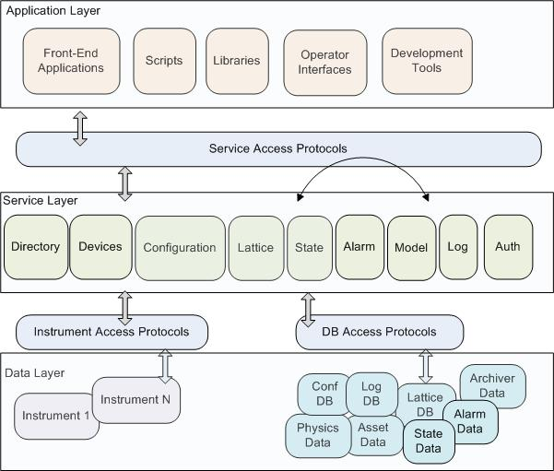
Application Architecture
Application layer
Operator interfaces
High-level applications
Libraries
Service layer
Access to data
Programming Interface
Data layer
Managed data
Instrument data
No direct access

Slide 6
Challenges To Development
Integration of myriad databases
Multiple teams from different labs
Geographically dispersed locations
Each team has different priorities
Labs have different schedules
Technology platforms are different at each lab
Differing software-engineering processes by each team

Slide 7
Development Approaches
Centralized
The entire schema (data layer) is developed by one team.
The database team understands requirements from every team, designs the schema, develops an access layer (stored procedures or data library) on top of data, and releases the schema.
All changes to schema go through the database team.
Database team is responsible for migrating data to new version of schema.
This can be extended to other functions: a service team for developing services, and a GUI team for developing user interfaces etc.
Decentralized
Entire system is divided into smaller subsystems.
A team is assigned for each subsystem; the team is responsible for all aspects of the sub-system: requirements, data design, services, GUI, packaging, release, and data migration.
Once the sub-systems are mature, they are integrated
Integration can be done at service layer, data layer, or schema layer

Slide 8
Comparison Criteria
Development Concurrency:
How independently can different teams work?
Differing Schedules:
How easy is to accommodate the schedules of different labs?
Iterations:
How quickly can new versions of sub-systems be released?
Data Integrity:
Will there be inconsistency in the database?
Integration:
How easily can different sub-systems be integrated?
Performance:
Time to access data
Schema Independence:
How easy is for a sub-system to change its schema?
Quality:

Slide 9
Comparison
 | Centralized | Decentralized | Comments
Development Concurrency | Low | High | Functional teams become bottlenecks
Diff Schedule | Low | High | Releases have to be coordinated among teams.
Iterations | Low | High | Any changes in schema have to go through the DB team
Data Integrity | High | Medium
Integration | High | Low - Medium
Performance | Medium | Medium
Schema Independence | Medium | High | Changes have to go through DB team
Quality | Medium – High | Low - High | Difficult. Due to multiple iterations, the overall quality of decentralized approach may turn out to be better.

Slide 10
Multiple Implementations
Entire system broken into sub-systems or ‘domains’
There can be multiple implementations for a domain
Current multi-implementations:
Configuration Domain: IRMIS and DISCS
Physics Domain: XAL, LSH, PSI
Cables Domain: IRMIS, DISCS
[IRMIS: Integrated Relational Model for Installed Systems]
[DISCS: Distributed Information Services for Control Systems]

Slide 11
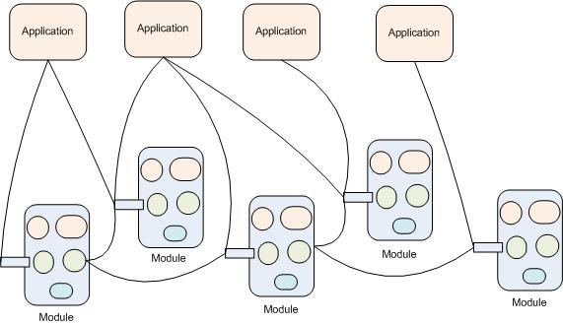
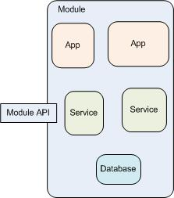
Decentralized Development Approach
Modules: Database, Services, Interfaces, Applications

Slide 12
Technologies
Layer | ESS, FRIB | BNL
Data Layer | MySQL | MySQL
ORM | JPA | Django ORM
Service Layer | Java EE, Java SE | Django REST, C++ (V4)
Service Architecture | EPICS V4, REST | EPICS V4, REST
API | Java, Python | Python
Web Interface | JSF, PHP | Django
GUI | CSS | CSS
Language | Java | Python

Slide 13
Last Collaboration Meeting
Dates: March 6-7, 2013
Venue: FRIB/NSCL, MSU
Participants: BNL, Cosylab, ESS, FRIB
15+ Presentations
Goals
Define goals for the next quarter for each domain
Ascertain performance of each domain for the last quarter
Recommend improvements

Slide 14
Performance For Last Quarter
# | DB | Last Quarter
1 | Logbook | Released CSS Viewer, CSS general logbook interface, Python API
2 | Traveler | Hired new resource. Dong leading the domain.
3 | Configuration | Productize; REST, Java, Python APIs; Measurement data; V4 Service (proto)
4 | Infrastructure | Cables under development
5 | Lattice/Model | Simple Service, Data loading, Preliminary GUI
6 | Inventory | Not yet initiated
7 | State | CSS GUI Under Development
8 | Alarm | 900W Cryo, D-Line

Slide 15
Performance 2
# | Database | Description | Status
9 | Operations | Beam statistics, run hours, beam on target, shift summary, downtime, bypass records | Not yet initiated
10 | FRIB Requirements | Parameter list, system and component requirements | Evaluate Cosylab/ESS Tool
11 | MPS | Machine state dumps | Not yet initiated. Work with Group at BNL
12 | Results | Results from physics experiments | Not yet initiated
13 | Maintenance | Preventive maintenance data, failure analysis, lifetime analysis | Not yet initiated
14 | Interlocks | Interlock hierarchy information [optional] | Not yet initiated
15 | Physics Apps | Physics applications | Migrating to OpenXAL
16 | Unit Conversion | Current-Field Mapping

Slide 16
Collaboration Information
Weekly Meetings
Every Wednesday, 9:00-9:45am Eastern USA
Google Hangout
Mailing List: discs-group@googlegroups.com
Website
Under development (http://openepics.sourceforge.net/)
Contact Information
Bob Dalesio, Co-Chair: dalesio@gnl.gov
Vasu Vuppala, Co-Chair: vuppala@frib.msu.edu

Slide 17
Presentations

Slide 18
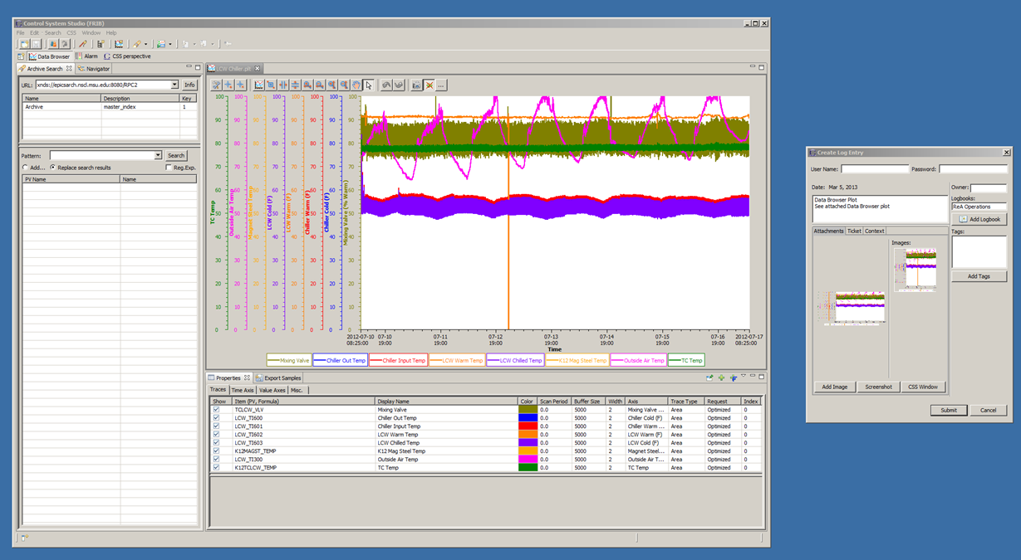
CSS Logbook Interface (Databrowser)

Slide 19
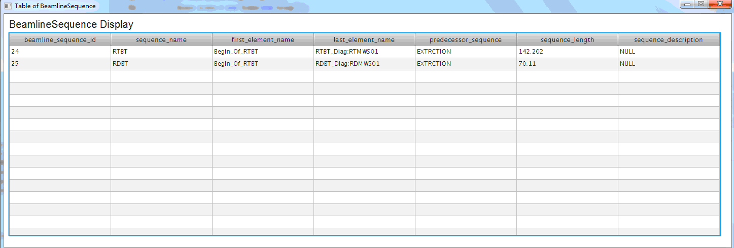
Lattice/Model: Prototype
Entity classes generated from MySQL
Database API via JPA
EJB project in NetBeans to call the database API
This EJB can drop to GlassFish container, for example
JavaFX client project to call the EJB
Update from Huihui Lv

Slide 20
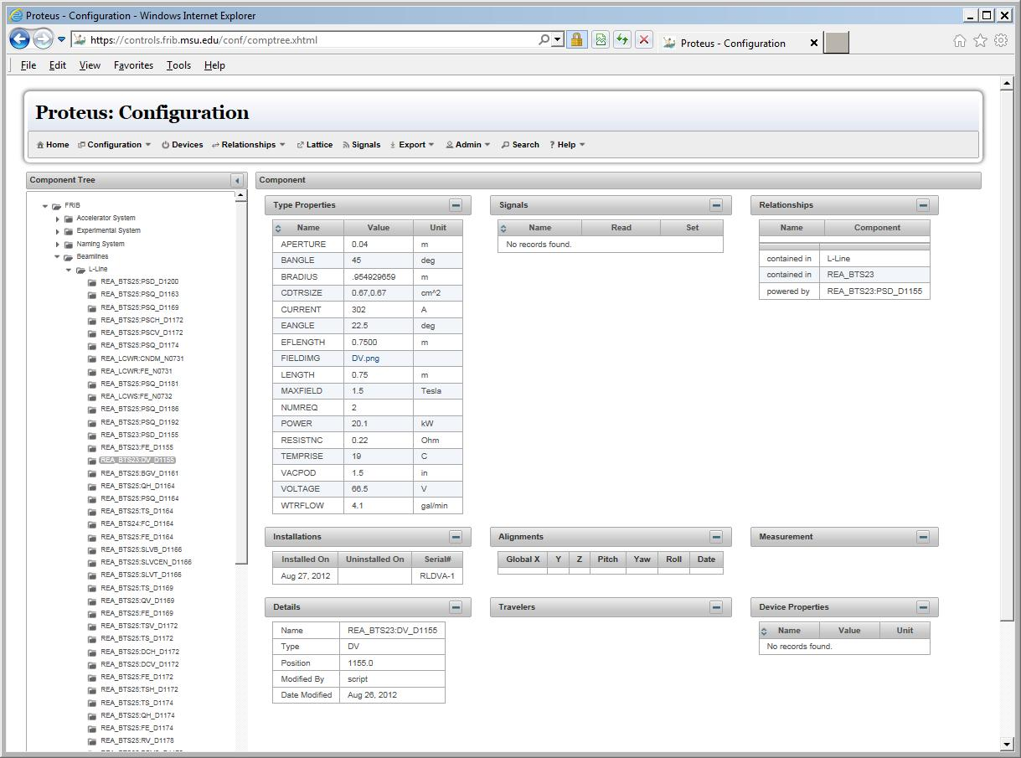
Configuration: Component Tree

Slide 21
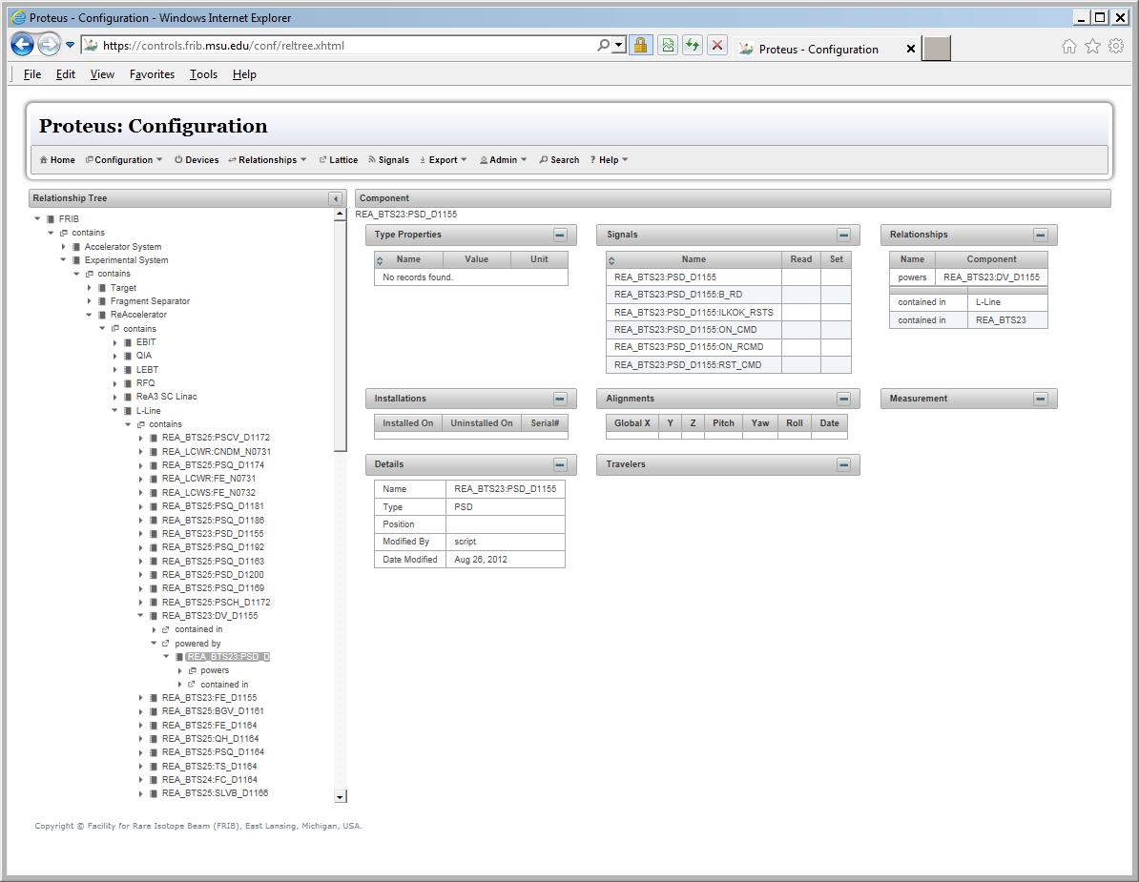
Configuration: Component Relationships

Slide 22
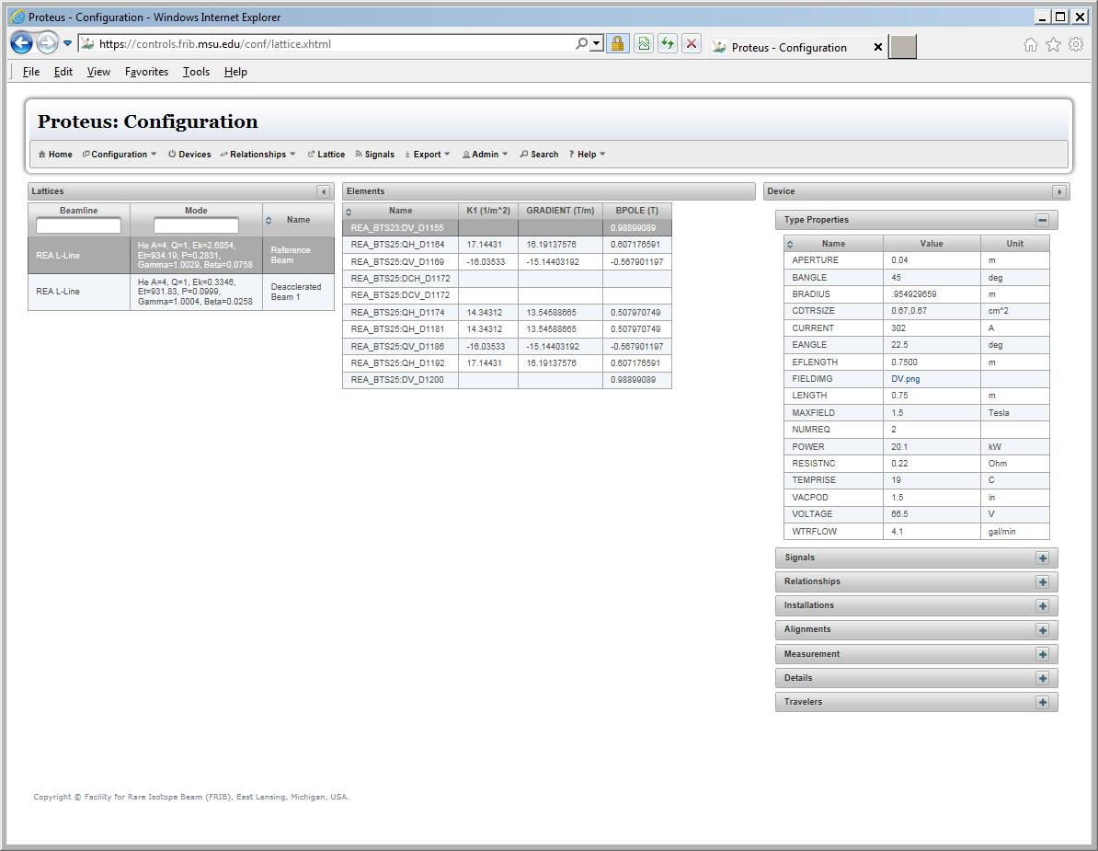
Configuration: Lattice

Slide 23
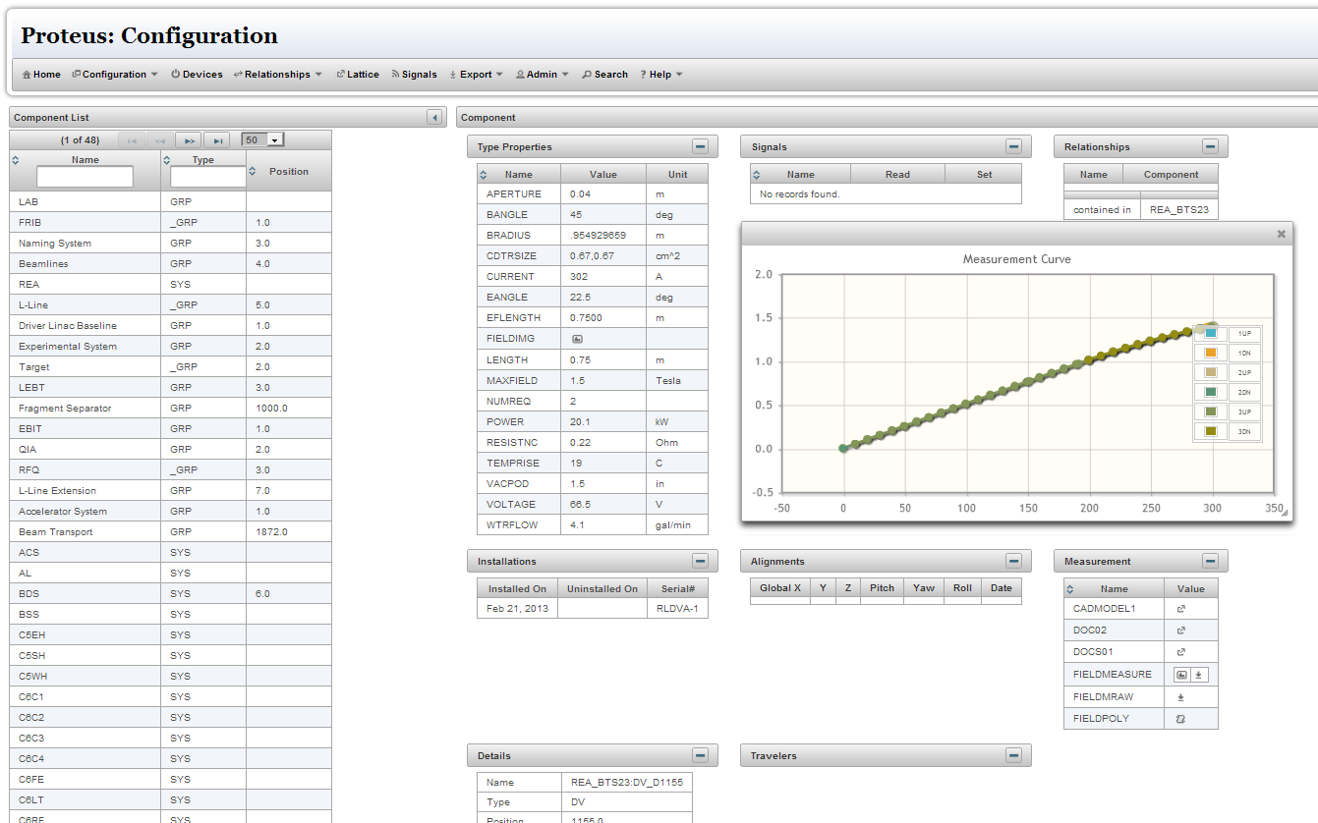
Configuration: Measurement

Slide 24
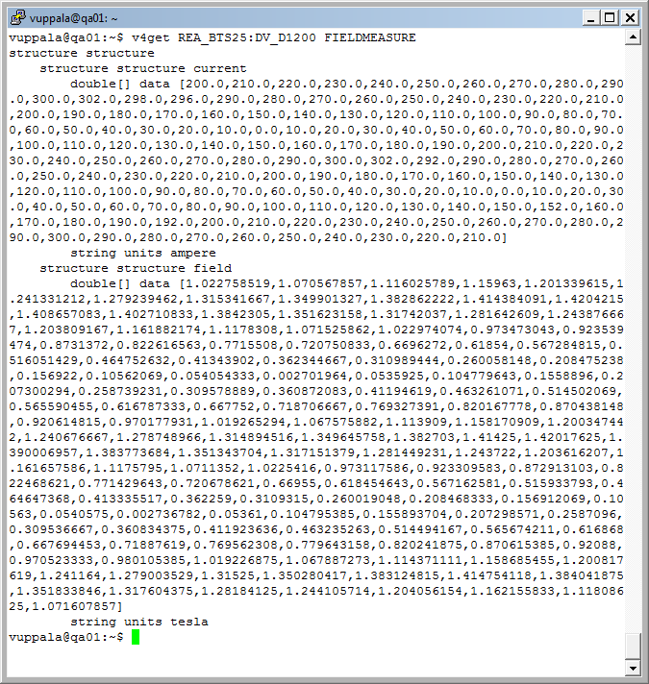
Configuration: EPICS V4 Service

Slide 25
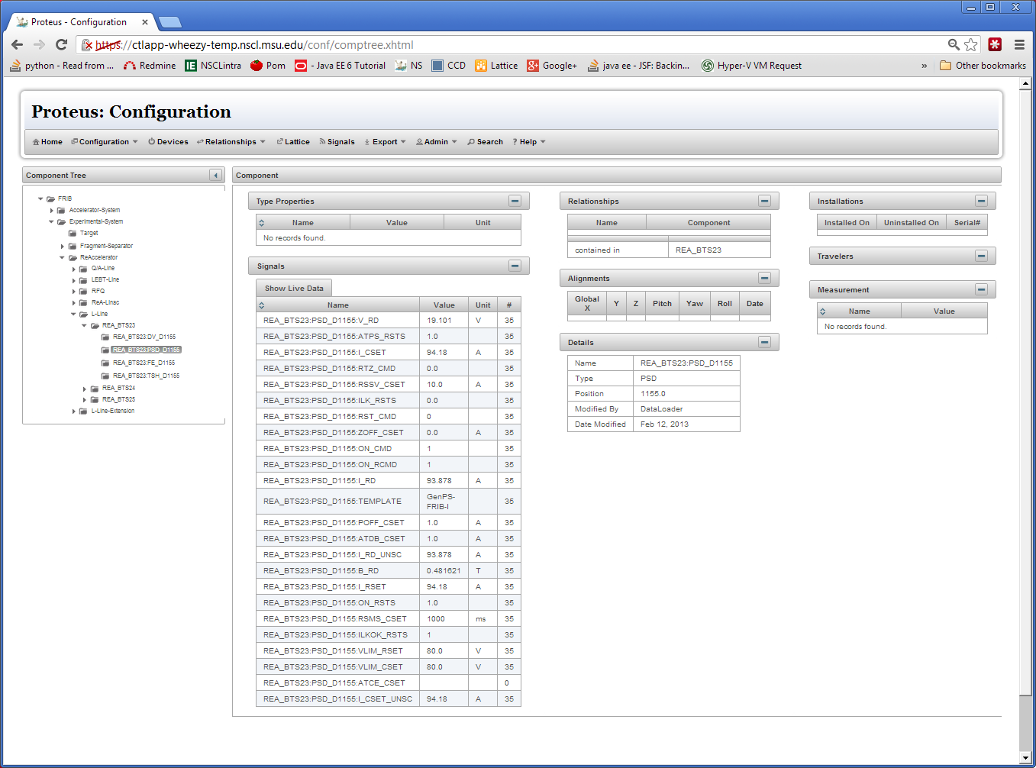
Configuration: Signals
Integration with ChannelFinder and PVManager

Slide 26
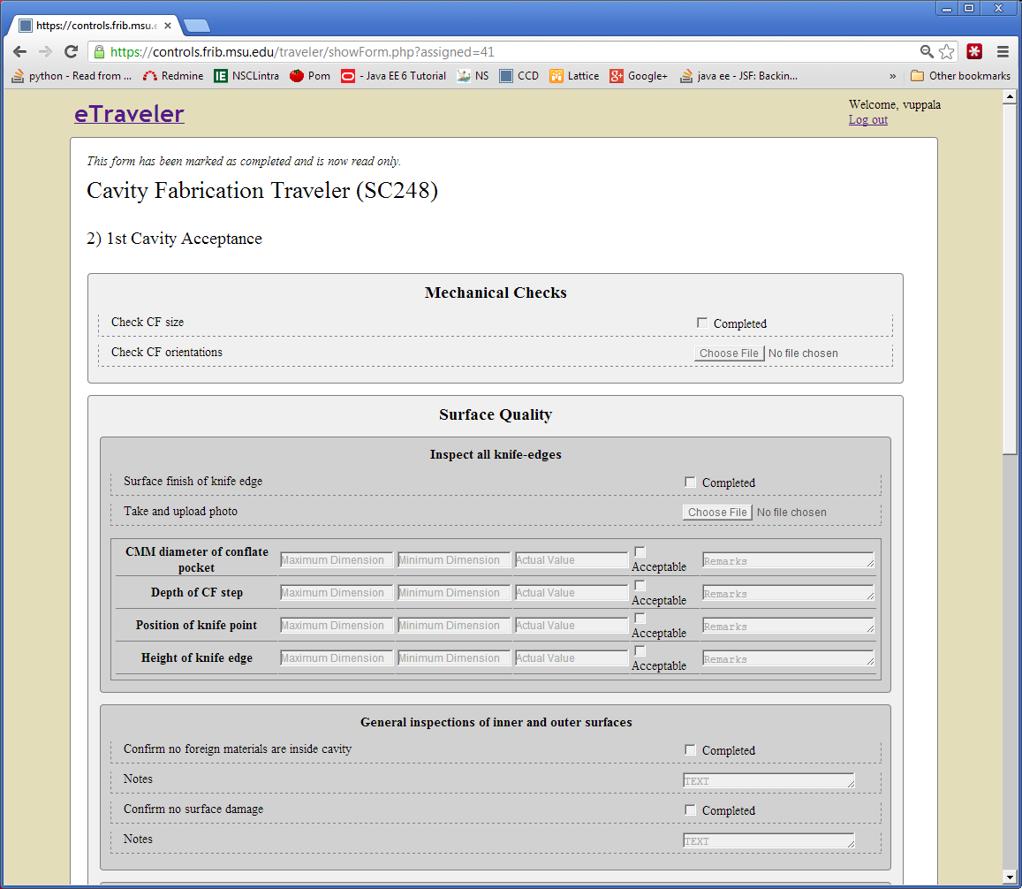
Traveler

Slide 27
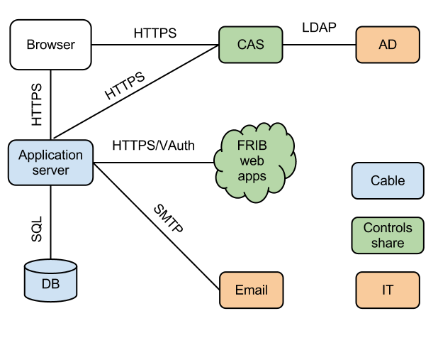
Cables: Architectural design

Slide 28
Technologies used and planned in FRIB web Applications
 | Configuration | Olog | Lattice | eTraveler | Cable
Web User interface | JavaServer Faces (HTML/CSS), JavaScript | CakePHP, JS → BootStrap (HTML/CSS/JS), jQuery | HTML, JSP | PHP, jQuery → BootStrap (HTML/CSS/JS), jQuery | BootStrap (HTML/CSS/JS), jQuery
Application interface | JSON/XML over HTTP | JSON/XML over HTTP | JSON/XML over HTTP | JSON over HTTP | JSON over HTTP
Web Controller | Servlet | Servlet | Servlet | PHP → node.js | node.js
ORM | JPA | JPA | JPA | SQL → node.js | node.js
Database | MySQL | MySQL | MySQL | MySQL | MySQL
User auth | GF JAAS | GF JAAS | GF JAAS | GF JAAS → CAS | CAS
Application auth | V. auth | V. auth | V. auth | V. auth | V. auth
Management | WAR/GF admin tool | WAR/GF admin tool | WAR/GF admin tool | WAR/GF admin tool → node.js | node package manager

Slide 29
BLED databases

Slide 30
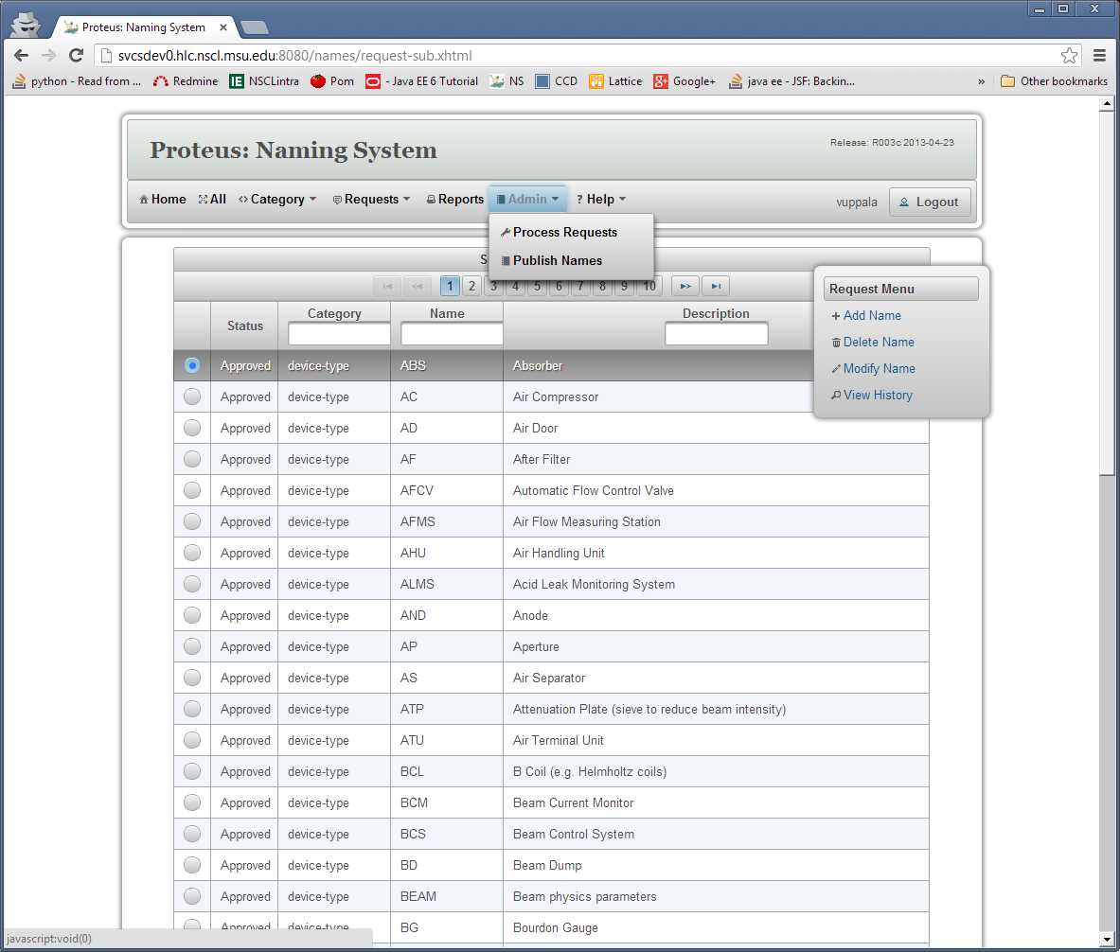
Authentication Service (Naming System)

Slide 31
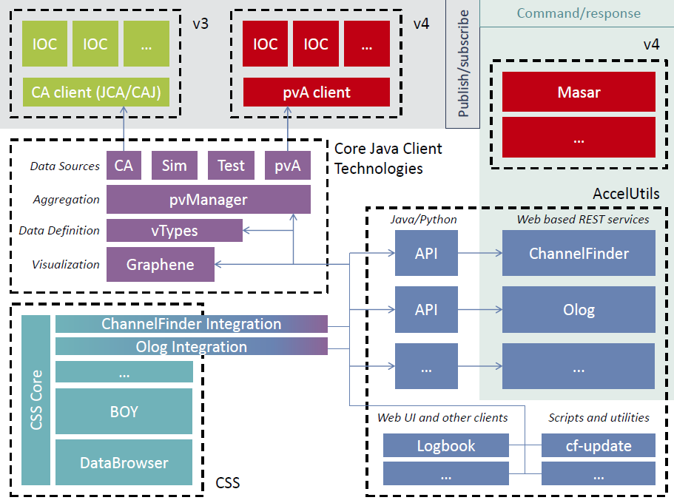
CSS: Reliability – Plugin Infrastructure

Slide 32
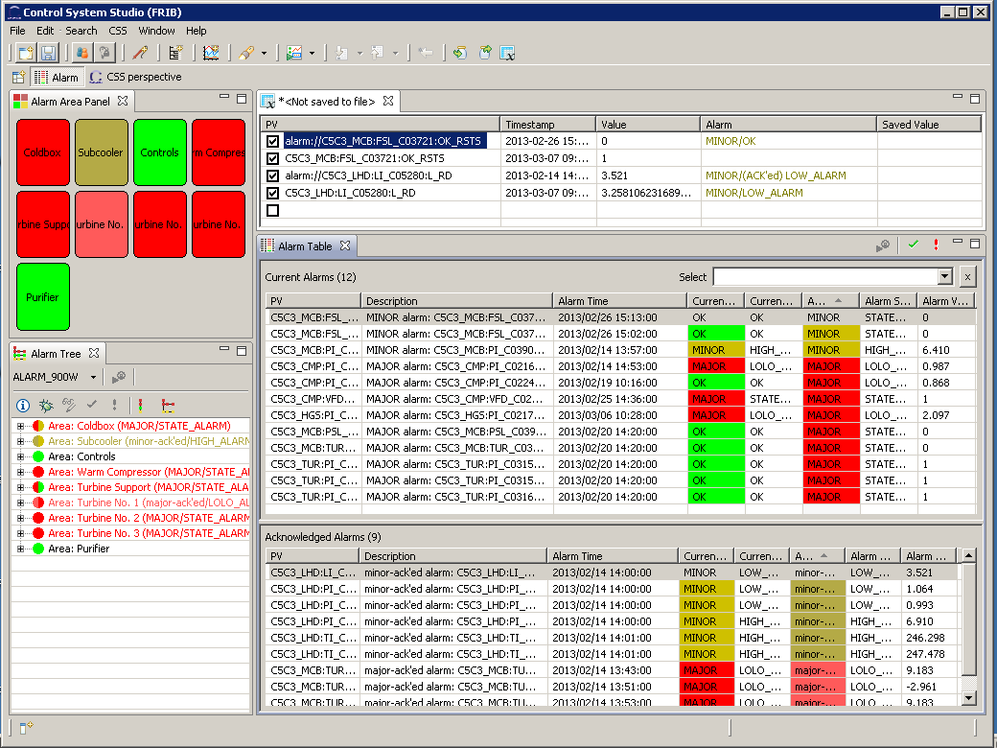
PVManager - BEAST

Slide 33
Goals for Next Quarter
# | DB | Next Quarter
1 | Logbook | ITER is a new user, collect requirements Agree on the next iteration of logbook viewer Bootstrap web client
2 | Traveler | Clean items in backlog scheduled for the period (to May) Support new traveler requests Add rich editor support (by end of March) Improve the whole UI by shifting to Bootstrap (by mid-April)
3 | Configuration | Authorization, Online updates Implement Repository (JCR etc) Improve: EPICS V4 Service Integrate with PVManager Release another version Integration with Olog?
4 | Infrastructure | Cable meta information MVC and API (end of March) Cable information MVC and API (end of April) • Excel import and export (mid-May) • Label (end of May) • Integration test (mid-June) • First release (end of June)
5 | Lattice/Model | First-order Lattice/Model Service with basic data access (mainly forLattice), Deployment packaging
6 | Inventory
7 | State
8 | Alarm

Slide 34
Goals 2
# | Database | Next Quarter Goals
9 | Operations | None
10 | FRIB Requirements | Evaluate ESS/Cosylab Design Parameter Tool
11 | MPS | Initiate collaboration with BNL Group
12 | Results | None
13 | Maintenance | None
14 | Interlocks | None
15 | Physics Apps | Continuing Open XAL migration Resume Linac Energy Management “Application” Study Save/Restore and Scan applications
16 | Unit Conversion

Slide 35
Integration
Integration Plan
Integrate Configuration with channelFinder (PV Domain): Configuration module gets list of channels from ChannelFinder (via REST/V4) for a selected device.
Integrate Configuration Module with Lattice/Model Module: Explore at what level the integration can be done (service, data layer, tables etc)
Use the central portal for integration

Slide 36
Conclusion
Ecosystem
Data/Information Services
Controls System Studio
EPICS V4
Physics/Knowledge Services
Synergy among labs
Challenges
Integration
Commitments

