Slide 1
NSLSII Control System Overview
The Control Group – presented by Bob Dalesio
EPICS Meeting
April 24, 2010

Slide 2
Outline
System Status
Fast Orbit Feedback Component Development
High Level Application Status
Documentation of Facility in an Relational DataBase - IRMIS
EPICS Extensions
Control System Studio (CSS) Tools
Conclusions

Slide 3
NSLS II Status
Conventional Construction is complete (ring building, 5 Lab Office Buildings (LOB))
3.5 LOBs are completed with offices populated
1 LOB has electrical, control, and wet laboratories operational.
LINAC is installed and commissioned
LINAC to Booster is installed. It is commissioned to the first beam stop
Booster (Budker Institute) is installed and tested. It is ready for commissioning
Booster to Storage Ring is ready for booster ring commissioning.
Storage Ring installation and equipment test is approximately 80% complete.
We have not been operational due while performing a safety review.
Restart is expected June 2013.
Early project completion has been pushed back from March 2014 to June 2014.
This completion date is 6 months early.

Slide 4
NSLS II Control Status
Timing IOCs – over 34 Weiner VME Crates, MVME 3100, MRF Timing
Diagnostics IOCs – 6 cPCI Crates GE CT11 with Struck and Aqiris Digitizers
BPM IOCs – 30 IBM x3550 PCs each connecting to up to 10 BPMs over Etherrnet
Cell Controller IOCs – 30 IBM x3550 PCs each connecting to one controller over Ethernet
Power Supply IOCs – 30 IBM x3550 PCs each connecting to up to xxx controllers over Ethernet
Vacuum IOCs – 5 IBM x3550 Pcs connecting over Ethernet to xx A/B Control Logix PLCs
Facility Control IOC s – 1 IBM x3550 PC connecting to 8 ACL bridge Ethernet bridges
Brocade Network Switches – 2 MLX16 core with 16 10Gb and 120 1Gb lines, 32 FCX648S distribution layer, and 135 FWS624G edge deployed
Beamline IOCs – 2 IBM x3550 PCs connecting over Ethernet to A/B Control Logix PLC, up to 20 Delta Tau motor controllers, and up to 30 cameras.
Beamline Timing IOC – 1 VME crate as in the machine. Struck scalers may also be used here.

Slide 5
NSLS II Control Lesson Learned (1 of 4)
LINAC Beam Dump
Faraday Cup
Bending Magnet
Linac
Booster Tunnel
Restricted Area
Second Dump
Faraday Cup
Radiation
Monitor

Slide 6
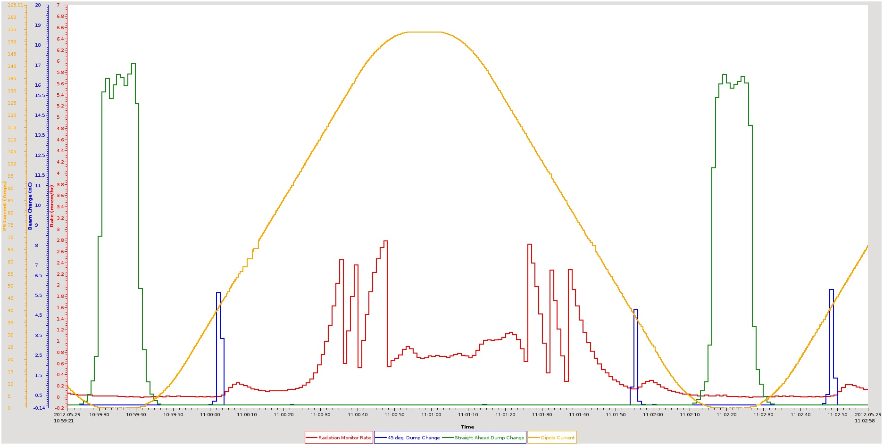
NSLS II Control Lesson Learned (2 of 4)

Slide 7
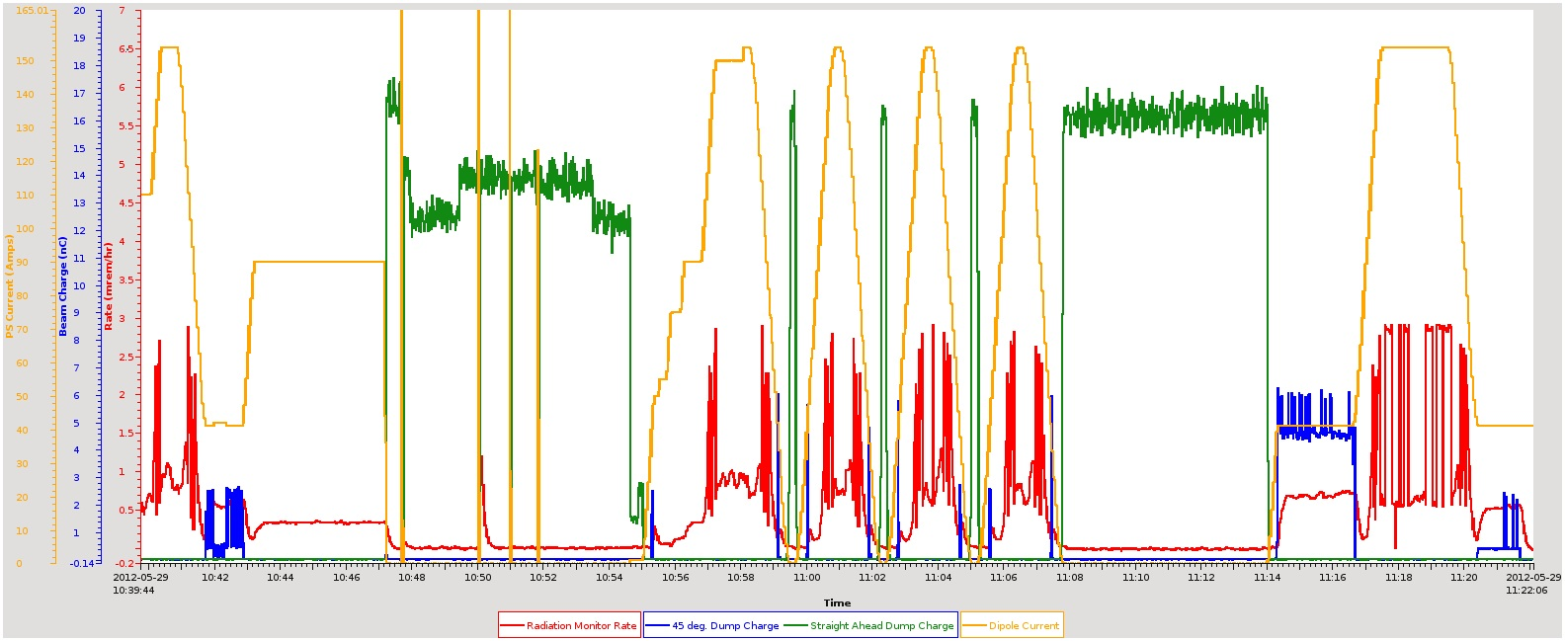
NSLS II Control Lesson Learned (3 of 4)

Slide 8
NSLS II Control Lesson Learned (4 of 4)
Archiving important control and monitor channels during commissioning is very important.
Radiation Monitor Integration into the control system was tested for end to end communication, however it was not tested with a know radiation source for conversion and alarm accuracy.
Although we have had a subsystem engineer embedded with each of the equipment groups, we did not include an embedded engineer with the physics group to understand the modes of operations. Although we do have an engineer embedded in the Personnel Protection System engineering group, this did not give us the insight into how the system in this area was working.
We have since worked with the physics group to document the standard modes of operation for the accelerator. For each operational mode, the parameters that define the state and the main optics control ranges have been identified. The cognizant engineer is now working with each of the subsystem engineers to define the process variables (PVs) that are involved to stay in a given state and the control range for the subsystem PVs in that mode.
The overall state work will be used directly to inform the alarm states that will be set in the alarm limit fields and the creation of composite alarms such as storage ring vacuum OK.
The state machine will also drive the soft limits in the DRVH and DRVL fields for the PVs that have limited range in given modes.

Slide 9
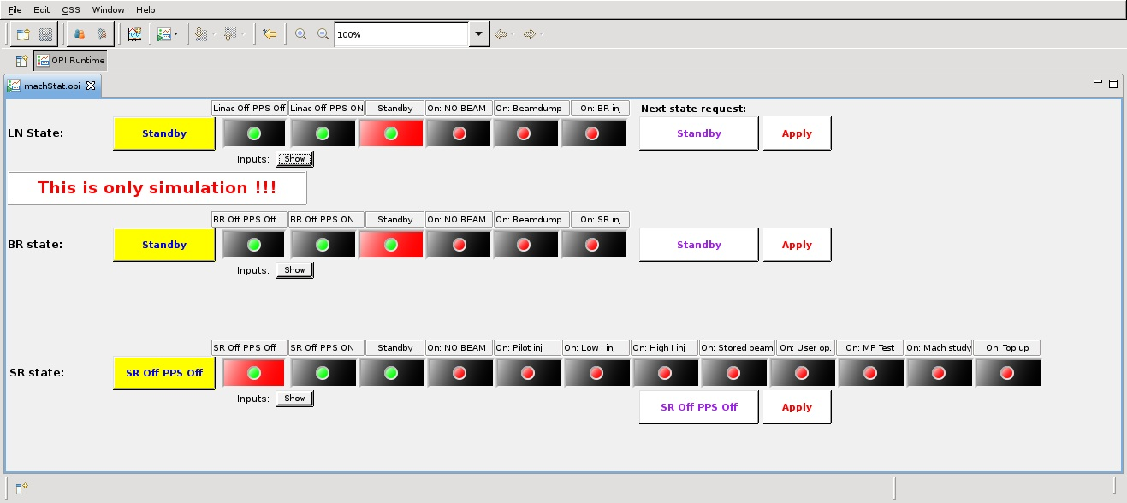
Machine States

Slide 10
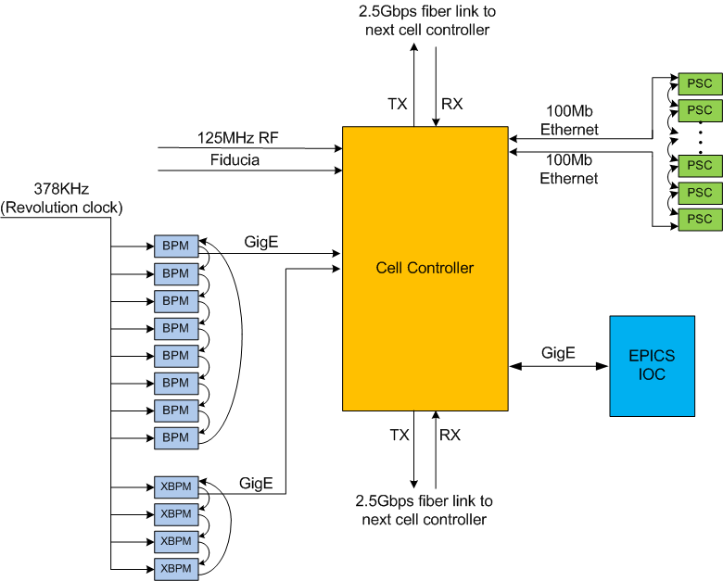
Orbit feedback system architecture
Fast orbit feedback system in one cell

Slide 11


Orbit feedback system is built, installed, tested
NSLS-II two tier device controller architecture
Cell 1
Cell 30
Cell 2
Cell 29
Cell 3
Storage Ring
SDI link
SDI link
Cell 17
Cell 15
Cell 16

Slide 12
Fast Orbit Feedback – Time Budget
6.7 µs for BNL BPM Electronics delay to pipeline
  3.7 µs for analog value averaged from raw data
  3 µs estimated for BNL BPM Electronics
  57 µs measured on Libera BPM Electronics with minimum filter
7 µs measured BPM data distribution by Redundant Data Link
  14 µs measured when one of the redundant links not operational
4 µs measured for FOFB calculation with separate mode compensation
5 µs measured for set power supply by PS Shared Memory link
8 KHz measured for fast corrector PS bandwidth w 10 deg phase shift.
1 KHz measured for corrector magnet/chamber bandwidth.
  Measured on with Inconel beam pipe. This value is at 10 degree phase shift.
  New magnet/chamber set up will be tested when they are available.
Fast machine protection data is provided to a dedicated cell controller that uses ancillary IOC and BPM data to determine mitigation at the RF.

Slide 13
High Level Applications (HLA)
High level application architecture is client/server based on the EPICS version 4 network protocol, PVAccess
  One server provides results to all clients
Tables are used to serve database results
These are being implemented in PVAccess
Servers are completed that provide:
  Model Results
  List of process variables based on function and attributes
  Synchronous vector of data given a list of process variables.
Other Services are under development.
Developer document for thin clients is being written in conjunction with the physics group.
Standard clients in CSS can be used to display HLA data

Slide 14
Client-Server Architecture for HLA
MMLT Client
Scripting HLA Client
Control System Studio
Completed
Early Development
Being Extended
PVAccess/CAC
PVAccess/CAC
PVAccess / CAC
Ethernet
PVAccess
PVAccess
PVAccess
PVAccess/CAC
PVAccess/CAC
PVAccess/CAC
Multi-Channel Arrays Svr
Save/Retrieve Server
Magnet, Resp Mtx, etc..
Middle Layer Servers
Model Server
Lattice Server
Channel Finder Svr
Save/Compare Restore Svr
Elegant/Tracy
SQL
SQL
Serves orbit, magnets, any array of channels
SQL
SQL
RDB
RDB
RDB
RDB
PVA
CAS
PVA
CAS
PVA
CAS
PVA
CAS
PVA
CAS
PVA
CAS
Utilities etc..,
Diag & PS
Distributed Front-Ends
Diagnostics
Power Supplies
RF
Vacuum
Physical Device
Physical Device
Physical Device
Physical Device
Physical Device
LS2 Simulation

Slide 15
Relational Database Applications
IRMIS table evolution and application development conflicted
IRMIS table redesign broke all JDBC production code
New IRMIS tools are being developed for
  Component type editor
  Component editor
  Component Browser
  Wiring Editor
Many applications used IRMIS tables as a starting point
Channel Finder application uses mySQL
Lattice development starts soon.
Electronic log uses mySQL
Save Retrieve uses mySQL
Unit conversion uses mySQL for Magnet Measurements
No deployment of IRMIS crawler yet

Slide 16
Relational Database Applications Lessons
One large database with all of the facility data in it were not possible as the requirements evolve and the table designs change to meet it, application development is made very difficult. We resolved this by dividing the data domains. There are around 19 identified and we are working in a collaboration with MSU, ITER, ESS, and others to develop applications that require database technology. We have converged on few technologies. We have serious questions to answer on cross domain queries and technology evaluations that are ongoing.
The division of the domains was required for different applications to complete development. As application developers required a stable database API for their development, the need to have control over the database and data management became apparent. Prior to this division, we stopped making progress on any database applications.

Slide 17
EPICS Extensions
EPICS core extensions previously reported
  Client specified filtering for rate limiting, dead bands, and sub arrays.
  State record primitive to provide modular solution to motion and multistate devices such as valves that need to capture transition times and timeouts.
  New modular interface to event generator and event receiver
  C++ Implementation of PVAccess servers to serve V3 databases
New extensions to core
  Changes to waveformRecord to allow a device support to avoid one array copy (BPTR can be replaced). This is now merged and will be in the next 3.15.X release Improvement are being made to pvAccess to optimize for large data sets.
  Develop processing records for areaDetector type functions planned.
  Use NT types in the IOC records to simplify pvAccess handling of complex data types planned.
  Changes to locking API to facilitate V4 interface. This allows synchronous get and put across lock sets.

Slide 18
Control System Studio
Adopted CSS for our user interface after evaluation
Redeveloped build environment and had it adopted by the collaboration
Developed a name server to return process variables by function
Developed a channel access package to provide all client functions and time synchronous vectors from an arrays of process variables.
Developed multichannel visualization tools
Developed an Integrated Log Book
Developed a multi-controller application
Developed a save/restore application
Developed standard extension points in CSS for services such as log book and directory service.
Developed standard extension points in CSS for plots
These developments are covered later in this meeting.

Slide 19
Conclusions
  NSLS II have leveraged off of years of development from the community.
  We greatly benefit by collaborations in CSS, database applications, and middle layer service architecture and service development.
  Our hardware was not made open source as the BPM developers are not willing. We are working with MSU to determine if a second generation of this hardware can be developed as open source and standard I/O interface. We did make all of our fpga code for communication and event decoding available to the community.
  Embedding control engineers into equipment groups is effective, but the lack of a control engineer to oversee the system for commissioning and operation was an oversight that brought about a less than desirable situation We have since corrected this.
  The control group has taken on beam line responsibility and there are are at least an equal number of challenges now facing us in data acquisition, online data analysis and data ,management.
  Working in science facilities as a control engineer is never boring…..

