Slide 1
An introduction to areaDetector
Tom Cobb
Notes:
1

Slide 2
What is areaDetector?
C++ framework for detectors in EPICS
Drivers produces NDArrays of data
Plugins consume data, do some calculations on it, and possibly produce data too
Can be rewired on the fly
Bandwidth throttling for efficient CPU
Plugins can run in their own threads

Slide 3
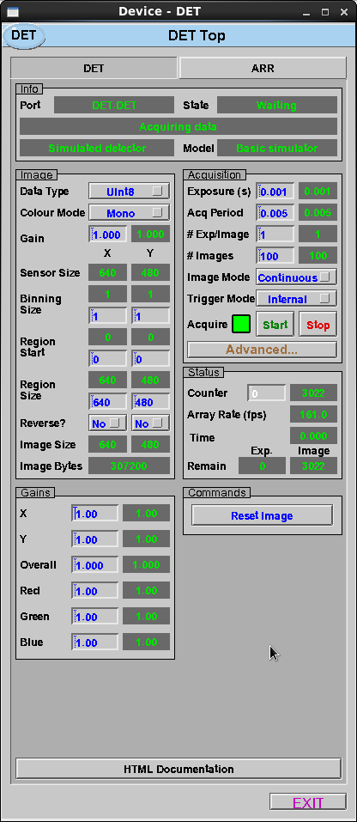
simDetector
Minimal simulator
Implements basic features of an areaDetector driver
Good starting place to develop a new detector driver

Slide 4
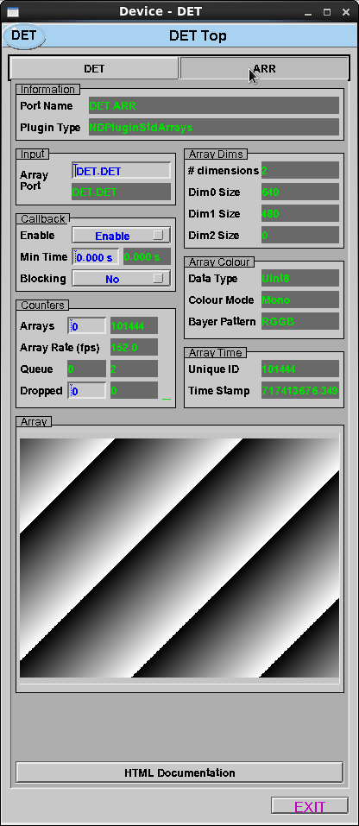
NDStdArrays
Minimal plugin
Takes an NDArray and publishes to a standard EPICS waveform record
Simple display tool, not very efficient as waveform is uncompressed

Slide 5
Demo
DET (simDetector)
ARR (NDStdArrays)

Slide 6
simDetector class
/** Simulation detector driver; demonstrates most of the features that areaDetector drivers can support. */
class simDetector : public ADDriver {
public:
simDetector(const char *portName, int maxSizeX, int maxSizeY, NDDataType_t dataType,
int maxBuffers, size_t maxMemory,
int priority, int stackSize);
/* These are the methods that we override from ADDriver */
virtual asynStatus writeInt32(asynUser *pasynUser, epicsInt32 value);
virtual asynStatus writeFloat64(asynUser *pasynUser, epicsFloat64 value);
void simTask(); /**< Should be private, but gets called from C, so must be public */

Slide 7
simDetector parameters
/** Define the additional properties that simDetector supports. */
protected:
int SimGainX;
#define FIRST_SIM_PARAM SimGainX
int SimGainY;
...
int SimPeakHeightVariation;
#define LAST_SIM_PARAM SimPeakHeightVariation
#define NUM_SIM_PARAMS (&LAST_SIM_PARAM - &FIRST_SIM_PARAM + 1)
/** Define the strings for these properties that the EPICS records use. */
#define SimGainXString "SIM_GAIN_X"
#define SimGainYString "SIM_GAIN_Y"
...
#define SimPeakHeightVariationString "SIM_PEAK_HEIGHT_VARIATION"

Slide 8
simDetector constructor
simDetector::simDetector(const char *portName, int maxSizeX, int maxSizeY,
NDDataType_t dataType, int maxBuffers, size_t maxMemory,
int priority, int stackSize) : ADDriver(portName, ...) {
/* Create the epicsEvents for signalling to the simulate task */
this->startEventId = epicsEventCreate(epicsEventEmpty);
...
/* Create some parameters */
createParam(SimGainXString, asynParamFloat64, &SimGainX);
createParam(SimGainYString, asynParamFloat64, &SimGainY);
...
/* Set some default values for parameters */
status = setStringParam (ADManufacturer, "Simulated detector");
status |= setStringParam (ADModel, "Basic simulator");
...
/* Create the thread that updates the images */
status = (epicsThreadCreate("SimDetTask",
epicsThreadPriorityMedium,
epicsThreadGetStackSize(epicsThreadStackMedium),
(EPICSTHREADFUNC)simTaskC,
this) == NULL);
}

Slide 9
simDetector set parameter
asynStatus simDetector::writeInt32(asynUser *pasynUser, epicsInt32 value) {
int function = pasynUser->reason;
...
status = setIntegerParam(function, value);
/* For a real detector this is where the parameter is sent to the hardware */
if (function == ADAcquire) {
if (value && ((adstatus == ADStatusIdle) || adstatus == ADStatusError)) {
/* Send an event to wake up the simulation task.
epicsEventSignal(this->startEventId);
}
...
} else if ((function == NDDataType) || (function == NDColorMode)) {
status = setIntegerParam(SimResetImage, 1);
} else {
/* If this parameter belongs to a base class call its method */
if (function < FIRST_SIM_DETECTOR_PARAM)
status = ADDriver::writeInt32(pasynUser, value);
}
/* Do callbacks so higher layers see any changes */
callParamCallbacks();
...
}

Slide 10
simDetector sim task
void simDetector::simTask() {
while (1) {
/* Update the image */
status = computeImage();
...
if (!aborted) {
pImage = this->pArrays[0];
/* Put the frame number and time stamp into the buffer */
pImage->uniqueId = imageCounter;
pImage->timeStamp = startTime.secPastEpoch + startTime.nsec / 1.e9;
...
/* Call the NDArray callback */
doCallbacksGenericPointer(pImage, NDArrayData, 0);
...
/* Call the callbacks to update any changes */
callParamCallbacks();
/* If we are acquiring then sleep for the acquire period minus elapsed time. */
if (acquire) {
...
status = epicsEventWaitWithTimeout(this->stopEventId, delay);
}
}
}
}

Slide 11
simDetector compute image
/* This is spread over a few different functions to deal with the different types */
int simDetector::computeImage() {
/* Alloc an image from the array pool */
int dims[3];
int ndims = 2;
dims[0] = maxSizeX;
dims[1] = maxSizeY;
this->pRaw = this->pNDArrayPool->alloc(ndims, dims, dataType, 0, NULL);
...
/* Fill in the image with dummy data */
pMono = (epicsUInt8 *)this->pRaw->pData;
incMono = (epicsUInt8) (gain * exposureTime * 1000.);
...
for (i=0; i<sizeY; i++) {
for (j=0; j<sizeX; j++) {
(*pMono++) = (epicsUInt8) (incMono * (gainX*j + gainY*i));
}
...
}
}

Slide 12
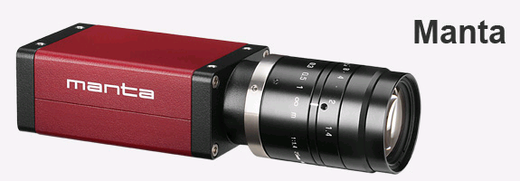
Diagnostic camera setup
Standard group of plugins used at Diamond
Detector is usually Firewire or GigE camera

Slide 13
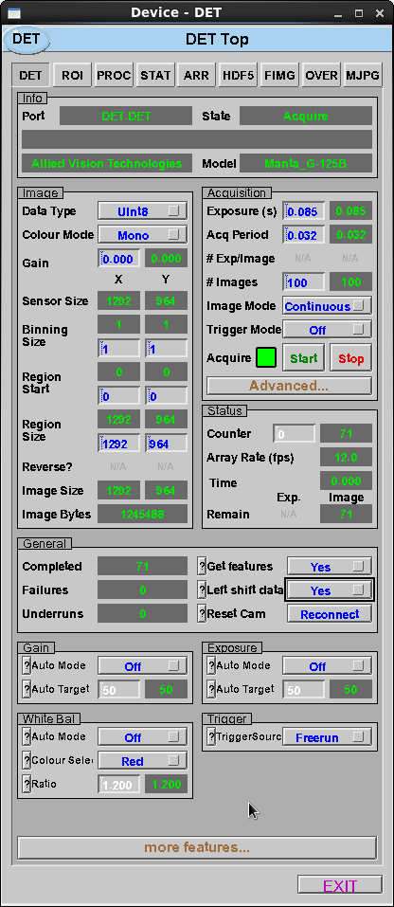
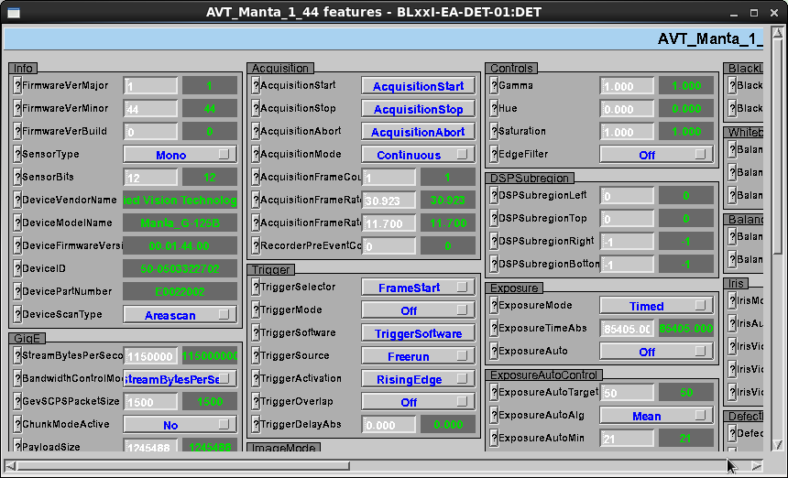
aravisCamera
Generic GigE driver
Feature get/set

Slide 14
Adding Metadata
<Attributes>
<Attribute addr="0"
datatype="INT"
description="Statistics: enable statistics computation"
name="StatsComputeStats"
source="COMPUTE_STATISTICS"
type="PARAM"/>
<Attribute addr="0"
datatype="DOUBLE“
description="Statistics: minimum value"
name="StatsMin"
source="MIN_VALUE"
type="PARAM"/>
...
</Attributes>
Can be internal param or EPICS PV
Stored with frame then put in output file

Slide 15
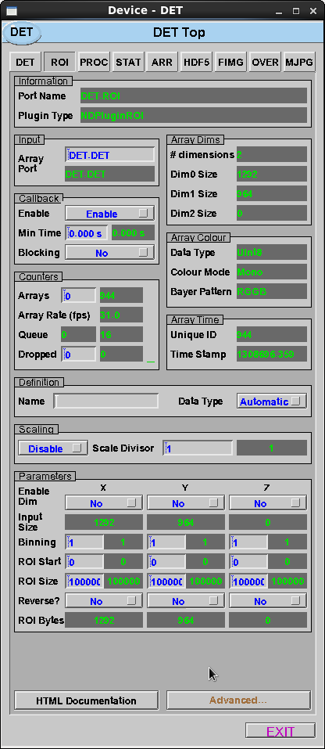
NDROI
Region of Interest
Scale divisor
Binning
Some of these functions available in hardware also

Slide 16
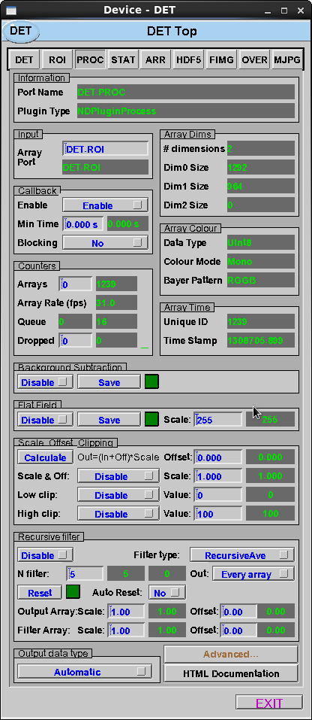
NDProcess
Background Subtraction
Flat field
Scale and offset
Clipping
Recursive filter

Slide 17
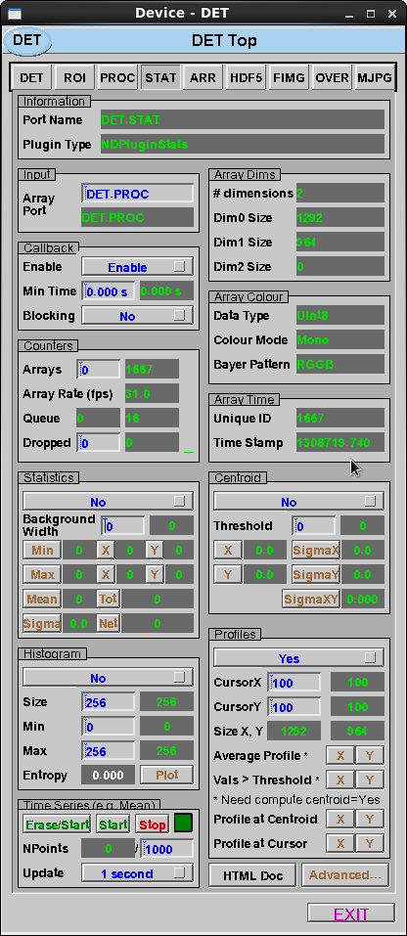
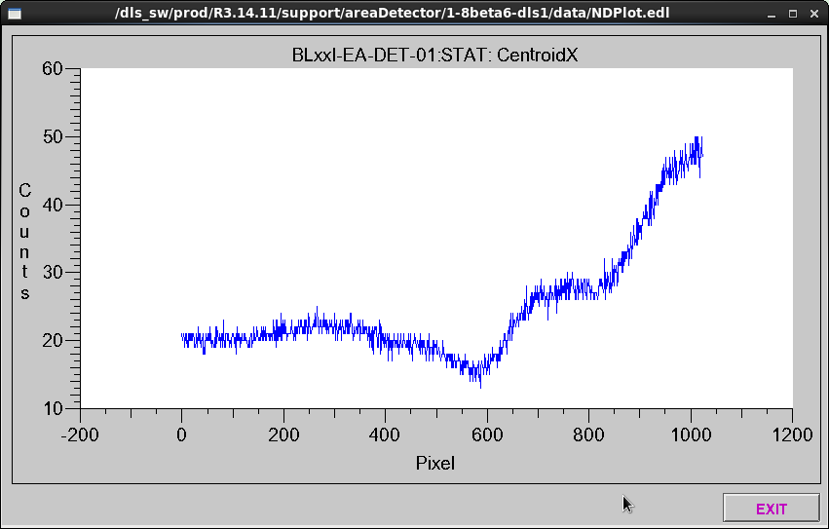
NDStats
Min, Max, Mean
Centroid + Profiles
Histogram

Slide 18
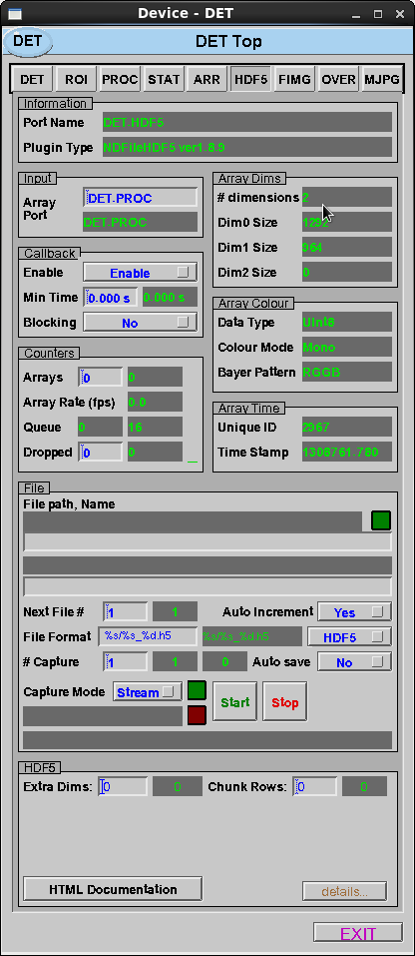
NDFileHDF5
HDF File writing
Supports writing of metadata

Slide 19
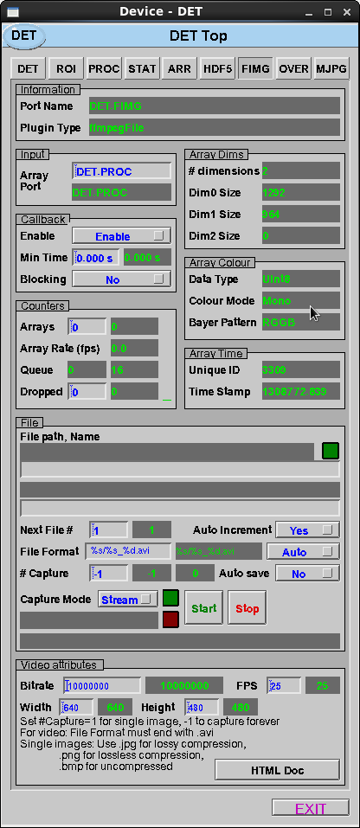
ffmpegFile
Image and video writing
Supports PNG, TIFF, BMP, AVI, and anything else ffmpeg can write

Slide 20
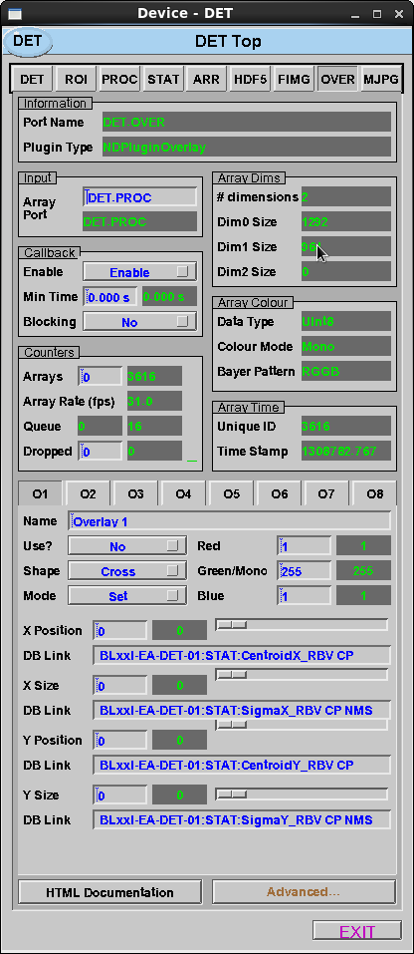
NDOverlay
Draw overlay on image
Cross or Rectangle

Slide 21
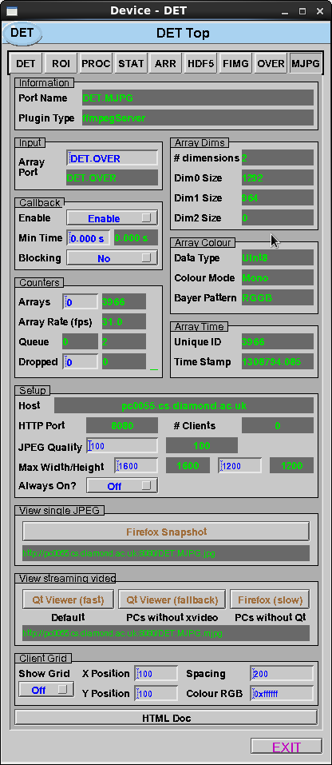
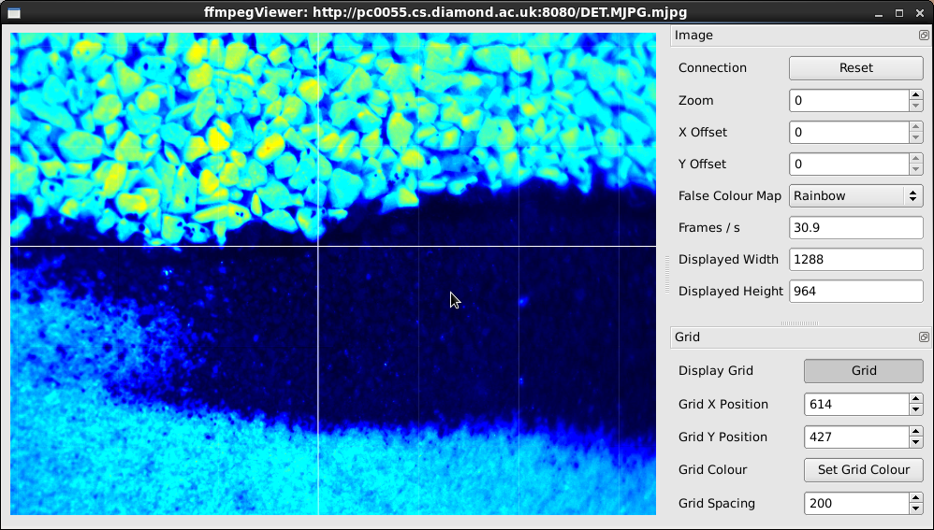
ffmpegServer
Compress to mjpg
Qt Viewer

Slide 22
Demo
DET
ROI
STAT
PROC
HDF5
FIMG
OVER
MJPG
ARR

