Slide 1
Asyn A recipe for driver implementation using the C++ API
Jon Thompson
For the 2013 EPICS for experiment control workshop,
Diamond Light Source, April 2013.

Slide 2
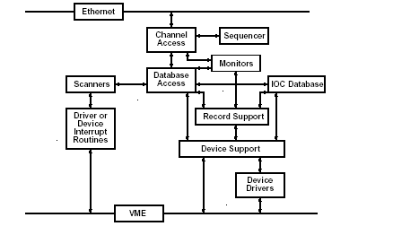
Introduction
Standard EPICS interface between device support and drivers is only loosely defined
Needed custom device support for each driver
asyn provides standard interface between device support and device drivers
And a lot more too!

Slide 3
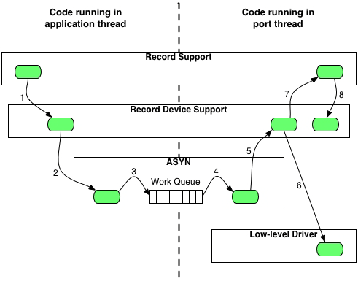
Asynchronous Control Flow
Note the thread breaking work queue.
Low level driver may block.

Slide 4
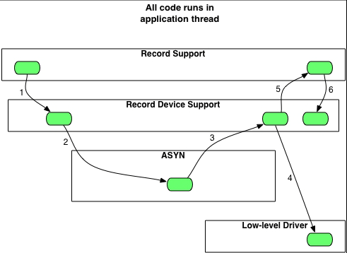
Synchronous Control Flow
No thread break in asyn.
Low level driver code may not block.

Slide 5
Port Drivers
Port drivers already exist for:
Local Serial Port
TCP/IP or UDP/IP Port
TCP/IP or UDP/IP Server
VXI-11
Linux-Gpib
Green Springs IP488
National Instruments GPIB-1014D
Use them by chaining to custom port drivers.

Slide 6
The C++ API
Consists of the asynPortDriver base class.
Manages ‘parameters’.
Override the readXXX and writeXXX to handle requests from EPICS records.
Connect to a port driver to communicate with the device.

Slide 7
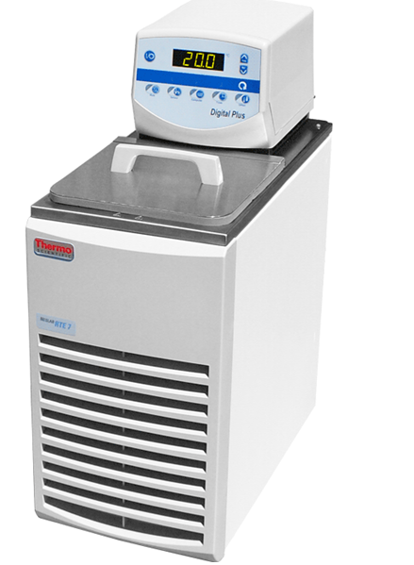
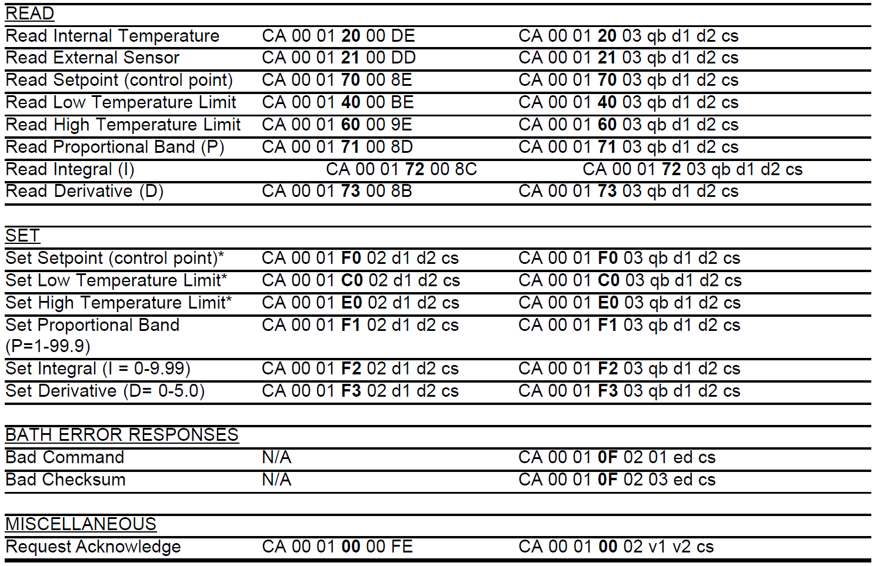
An Example
Neslab RTE211 Chiller
The protocol (from the manual):

Slide 8
An Example
Derive from asynPortDriver.
Implement writeFloat64.
All device parameters are decimals.
Create a polling thread.
Periodically reads current state.

Slide 9
Code Required
Dependency definition in the ‘RELEASE’ file.
C++ code in the ‘src’ directory.
Database template code in the ‘Db’ directory.
NeslabRte
NeslabRteApp
src
Db
configure
RELEASE
NeslabRte.template
NeslabRte.h
NeslabRte.cpp
NeslabRte.dbd
Makefile
Makefile

Slide 10
Class Declaration
class neslabRte : public asynPortDriver
{
public:
enum {FN_GETTEMPERATURE=0x20, …};
public:
class pollThread: public epicsThreadRunable
{
private:
neslabRte* owner;
epicsThread thread;
public:
pollThread(neslabRte* owner);
virtual ~pollThread() {}
virtual void run() {owner->pollRun();}
};
Constants for the message parsing.
Nested class provides the poll thread.

Slide 11
Class Declaration
public:
neslabRte(const char *portName, const char* serialPortName, int serialPortAddress);
virtual ~neslabRte();
/* These are the methods that we override from asynPortDriver */
virtual asynStatus writeFloat64(asynUser *pasynUser, epicsFloat64 value);
/* These methods implement the thread functions */
void pollRun();
protected:
/* These are helper methods for the class */
bool transmitReceive(int function, double txValue, int rxIndex);
Constructor and overrides.
Helper functions

Slide 12
Class Declaration
Parameter indices.
protected:
/* Our data */
pollThread* pollIt;
asynUser* serialPortUser;
/* Parameter indices */
int FIRST_PARAM;
int indexConnected; // Boolean
int indexTemperature; // Float
int indexSetPoint; // Float
int indexLowLimit; // Float
int indexHighLimit; // Float
int indexProportional; // Float
int indexIntegral; // Float
int indexDerivative; // Float
int LAST_PARAM;
};

Slide 13
Asyn Parameter Names
#define indexConnectedStr "CONNECTED"
#define indexTemperatureStr "TEMPERATURE"
#define indexSetPointStr "SETPOINT"
#define indexLowLimitStr "LOWLIMIT"
#define indexHighLimitStr "HIGHLIMIT"
#define indexProportionalStr "PROPORTIONAL"
#define indexIntegralStr "INTEGRAL"
#define indexDerivativeStr "DERIVATIVE"
#define NUM_PARAMS( &LAST_PARAM - &FIRST_PARAM - 1)
Define the parameter names.
Also useful to work out how many parameters have been declared.

Slide 14
Constructor
neslabRte::neslabRte(const char* portName, const char* serialPortName, int serialPortAddress)
: asynPortDriver(portName, 1 /*maxAddr*/, NUM_PARAMS,
asynInt32Mask | asynFloat64Mask | asynDrvUserMask /*interfaceMask*/,
asynInt32Mask | asynFloat64Mask /*interruptMask*/,
ASYN_CANBLOCK, /*ASYN_CANBLOCK=1, ASYN_MULTIDEVICE=0 */
1, /*autoConnect*/ 0, /*default priority */ 0 /*default stack size*/ )
{
Pass in the name of the serial asyn port.
Parameters to the base class constructor
The number of asyn parameters we are going to define
Define which asyn interfaces we are using
Various flags

Slide 15
Constructor
createParam(indexConnectedStr, asynParamInt32, &indexConnected);
createParam(indexTemperatureStr, asynParamFloat64, &indexTemperature);
createParam(indexSetPointStr, asynParamFloat64, &indexSetPoint);
createParam(indexLowLimitStr, asynParamFloat64, &indexLowLimit);
createParam(indexHighLimitStr, asynParamFloat64, &indexHighLimit);
createParam(indexProportionalStr, asynParamFloat64, &indexProportional);
createParam(indexIntegralStr, asynParamFloat64, &indexIntegral);
createParam(indexDerivativeStr, asynParamFloat64, &indexDerivative);
setIntegerParam(indexConnected, 0);
Create the asyn parameters
Usually one per PV.
Binds the name to the parameter.
Returns an integer handle to the parameter.
Initialise parameters if necessary.

Slide 16
Constructor
/* Connect to the device port */
asynStatus asynRtn = pasynOctetSyncIO->connect(serialPortName,
serialPortAddress, &serialPortUser, NULL);
if(asynRtn != asynSuccess)
{
printf("Connect failed, port=%s, error=%d\n", serialPortName, asynRtn);
return;
}
pasynOctetSyncIO->flush(serialPortUser);
/* Start the thread */
pollIt = new pollThread(this);
}
Connect up to the asyn serial port.
Start the polling thread.

Slide 17
Polling State
void neslabRte::pollRun()
{
while(true)
{
// Get the connection state
int connected;
lock();
getIntegerParam(indexConnected, &connected);
unlock();
// Wait for the next poll (slowly for disconnected devices)
epicsThreadSleep(connected ? 1.0 : 4.0);
Poll function does not terminate.
Poll devices that are not connected at a slower rate.

Slide 18
Polling State
// Poll instrument state
bool ok = true;
ok = ok && transmitReceive(FN_GETTEMPERATURE, 0.0, indexTemperature);
ok = ok && transmitReceive(FN_GETSETPOINT, 0.0, indexSetPoint);
ok = ok && transmitReceive(FN_GETLOWLIMIT, 0.0, indexLowLimit);
ok = ok && transmitReceive(FN_GETHIGHLIMIT, 0.0, indexHighLimit);
ok = ok && transmitReceive(FN_GETPROPORTIONAL, 0.0, indexProportional);
ok = ok && transmitReceive(FN_GETINTEGRAL, 0.0, indexIntegral);
ok = ok && transmitReceive(FN_GETDERIVATIVE, 0.0, indexDerivative);
Often useful to write a transmitReceive function to communicate with the device.
Record whether the device responds.

Slide 19
Polling State
// Has the connection state changed
lock();
if(ok && !connected)
{
setIntegerParam(indexConnected, 1);
}
else if(!ok && connected)
{
setIntegerParam(indexConnected, 0);
}
// Update EPICS
callParamCallbacks();
unlock();
}
}
Determine connection state.
Make any callbacks to EPICS.

Slide 20
Handling PV Writes
asynStatus neslabRte::writeFloat64(asynUser *pasynUser, epicsFloat64 value)
{
/* Base class does most of the work, including writing to the parameter
* library and doing call backs */
asynStatus status = asynPortDriver::writeFloat64(pasynUser, value);
/* Any work we need to do */
int parameter = pasynUser->reason;
if(parameter == indexSetPoint)
{
transmitReceive(FN_SETSETPOINT, value, indexSetPoint);
}
else if …
return status;
}
Base class writes parameter and does call backs.
We just send information to the device.

Slide 21
Communicating With the Device
bool neslabRte::transmitReceive(int function, double txValue, int rxIndex)
{
// Create the transmit message
…
// Send it and receive the reply
…
stat = pasynOctetSyncIO->writeRead(serialPortUser, …
if(stat == asynSuccess)
{
// Decode the result message
…
if(result)
{
lock();
setDoubleParam(rxIndex, rxValue);
unlock();
}
}
return result;
}
Useful to have a tranceiver function.
Reply data stored in asyn parameter indicated by rxIndex.

Slide 22
Explaining to EPICS
/** Configuration command, called directly or from iocsh */
extern "C" int neslabRteConfig(const char *portName, const char* serialPortName, int serialPortAddress)
{
new neslabRte(portName, serialPortName, serialPortAddress);
return(asynSuccess);
}
/** Code for iocsh registration */
static const iocshArg neslabRteConfigArg0 = {"Port name", iocshArgString};
static const iocshArg neslabRteConfigArg1 = {"Serial port name", iocshArgString};
static const iocshArg neslabRteConfigArg2 = {"Serial port address", iocshArgInt};
static const iocshArg* const neslabRteConfigArgs[] =
{&neslabRteConfigArg0, &neslabRteConfigArg1, &neslabRteConfigArg2};
static const iocshFuncDef configneslabRte = {"neslabRteConfig", 3, neslabRteConfigArgs};
static void configneslabRteCallFunc(const iocshArgBuf *args)
{
neslabRteConfig(args[0].sval, args[1].sval, args[2].ival);
}
static void neslabRteRegister(void)
{
iocshRegister(&configneslabRte, configneslabRteCallFunc);
}
extern "C" { epicsExportRegistrar(neslabRteRegister); }
Mostly Boilerplate

Slide 23
And a DBD File
registrar("neslabRteRegister")
Connects EPICS to the driver.

Slide 24
Src Directory Makefile
Tell the build system about the DBD and the source files.
TOP=../..
include $(TOP)/configure/CONFIG
# -------------------------------
# Build a Diamond Support Module
# -------------------------------
LIBRARY_IOC += neslabRte
# xxxRecord.dbd will be installed into <top>/dbd
DBD += neslabRte.dbd
# The following are compiled and added to the support library
neslabRte_SRCS += neslabRte.cpp
# ---------------------------------------------------
include $(TOP)/configure/RULES

Slide 25
Database Template
# Communications state indication
record(bi, "$(P):CONNECTED")
{
field(SCAN, "I/O Intr")
field(DTYP, "asynInt32")
field(INP, "@asyn($(PORT),0,5)CONNECTED")
field(ZNAM, "Down")
field(ONAM, "Up")
}
# Water temperature
record(ai, "$(P):TEMPERATURE")
{
field(SCAN, "I/O Intr")
field(DTYP, "asynFloat64")
field(INP, "@asyn($(PORT),0,5)TEMPERATURE")
field(PREC, "1")
field(EGU, "C")
}
Input records use the “I/O Intr” scan mode.
Note the asyn name that binds the record to the asyn parameter.

Slide 26
Database Template
# Set point
record(ao, "$(P):SETPOINT")
{
field(DTYP, "asynFloat64")
field(OUT, "@asyn($(PORT),0,5)SETPOINT")
field(PREC, "1")
field(EGU, "C")
}
record(ai, "$(P):SETPOINT_RBV")
{
field(SCAN, "I/O Intr")
field(DTYP, "asynFloat64")
field(INP, "@asyn($(PORT),0,5)SETPOINT")
field(PREC, "1")
field(EGU, "C")
}
For output records often useful to have an input record with the current state.
The ‘DTYP’ field controls which ‘writeXXX’ function is called.

Slide 27
Database Directory Makefile
TOP=../..
include $(TOP)/configure/CONFIG
#----------------------------------------
# ADD MACRO DEFINITIONS AFTER THIS LINE
DB += neslabRte.template
include $(TOP)/configure/RULES
#----------------------------------------
# ADD RULES AFTER THIS LINE
Instructs the build system to include the template.

Slide 28
Using – The Startup Script
cd "$(INSTALL)"
dbLoadDatabase("dbd/example.dbd")
example_registerRecordDeviceDriver(pdbbase)
drvAsynIPPortConfigure("rte211_ser", "localhost:9015", 100, 0, 0)
neslabRteConfig("rte211", "rte211_ser", 0)
dbLoadRecords("db/example.db")
iocInit
Note the chaining of an IP asyn port to the Neslab driver.

