Slide 1
EVE
CSS based EPICS scan engine
Marcus Michalsky, Hartmut Scherr, Jens Eden PTB Berlin

Slide 2
EVE
Editor: flexible and easy configuration of scans
Viewer: quick overview and access to all used devices and instruments
Engine: Control scan process, watch online plot

Slide 3
Overview
Editor
Viewer
CA
Device Definition
Engine
GUI
EPICS
IOCs
Scan Definition
Control
Scan- Engine
Datafile
CA

Slide 4
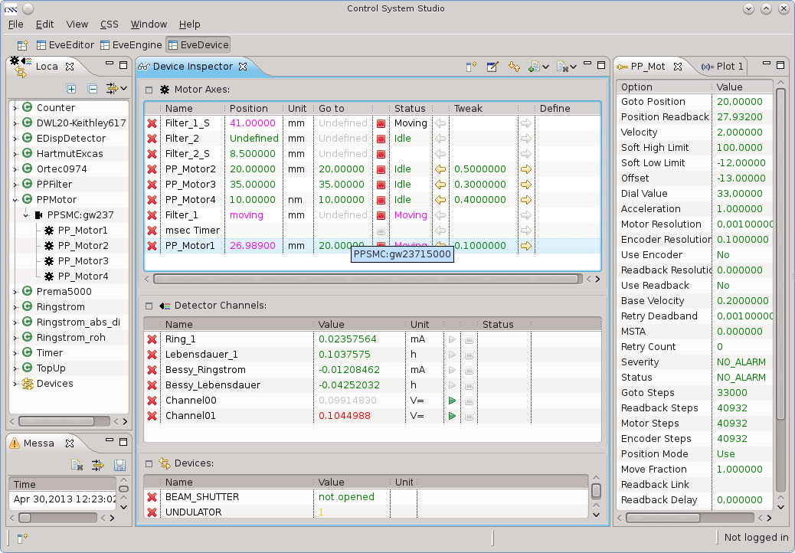
Alias names for PVs
Viewer
Devices may be grouped

Slide 5
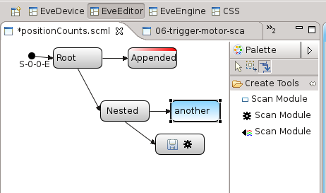
Editor
Scan Sequence is built of Scan Modules
Scan Modules may be appended or nested

Slide 6
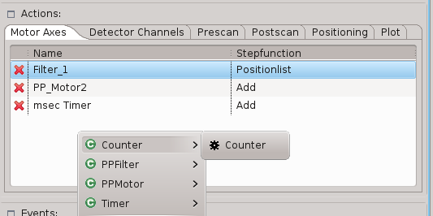
Scan Module
Scan Modules may have
Axes with a corresponding position list
Detectors Channels
Pre- / Post-Scan Actions
Predefined Positioning Functions
Plot Definition

Slide 7
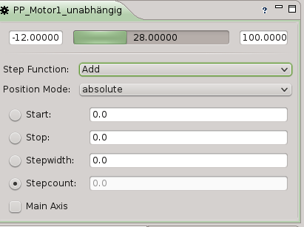
Editor
Define motor axis positions:
Start, Stop, Stepwidth
follow other axis (with offset / factor)
read positions from file
(get positions from position plugin)

Slide 8
Events
Event Sources:
Control Button
Monitor PV ( >, < , !=, == )
Scan Module finished
Detector readout finished
Event Actions:
Start / Stop Scan Module
Skip current Scan Module and proceed with next
Pause / Continue
Trigger Measurement
Repeat

Slide 9
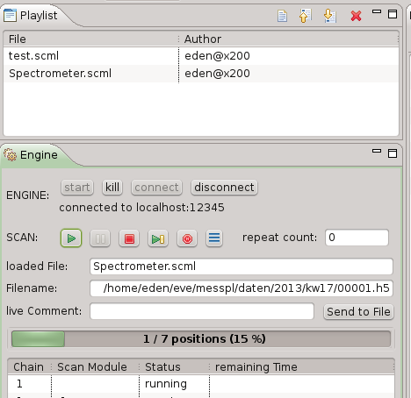
Engine
Live Comment may be entered here

Slide 10
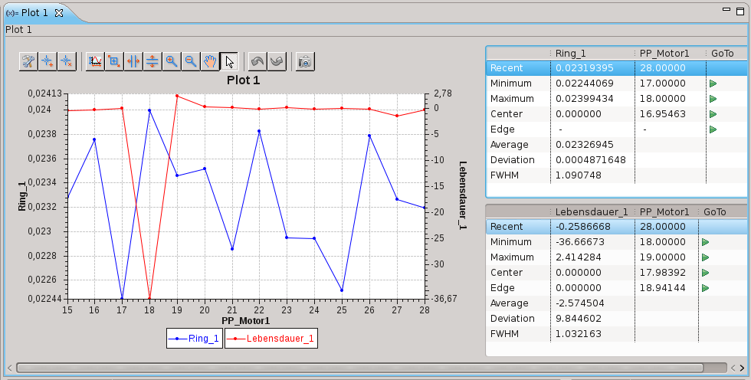
Engine
Devices may be grouped

Slide 11
Engine
Scan Engine features:
Run Standalone (Batch mode)
CLI tool to push Scan Definitions
Several Control Windows may connect to one Scan Engine
Plugin interface for data storage ASCII Data built-in, HDF5 plugin available
Qt Library / C++

Slide 12
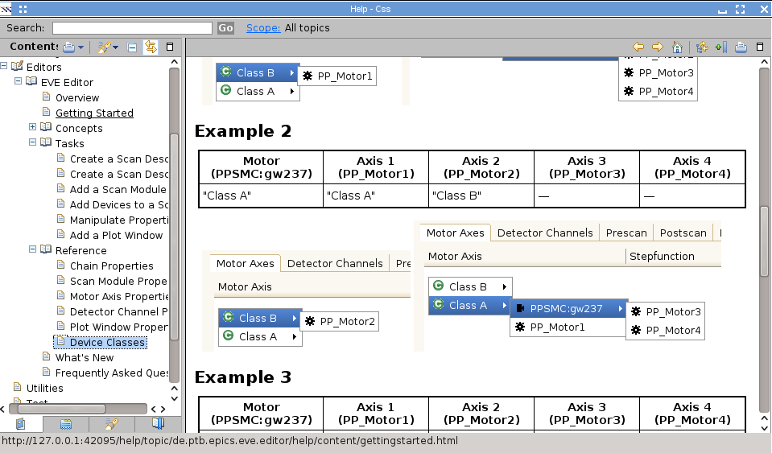
EVE
Eclipse Help Pages
Available at Github soon: www.github.com/eveCSS

