Slide 1
EPICS for Neutron Scattering Beam Lines
Steven Hartman
EPICS Meeting, 2 May 2013

Slide 2
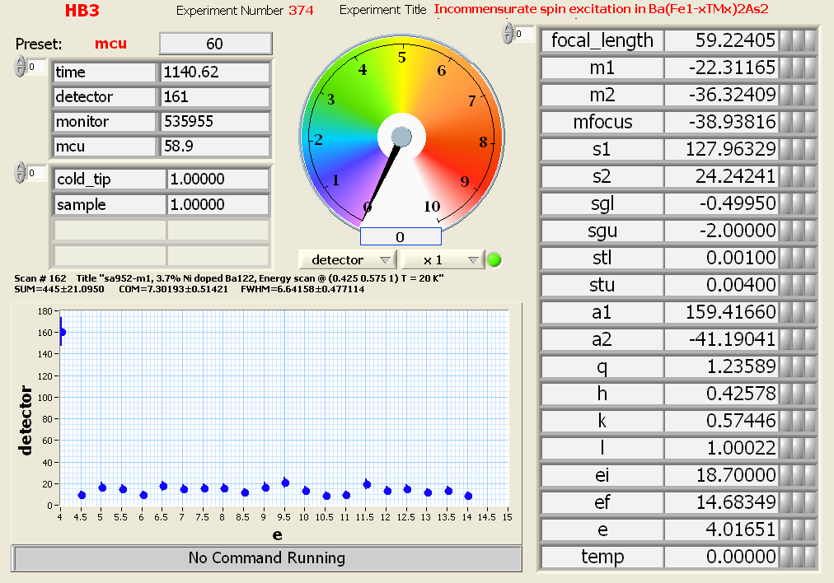
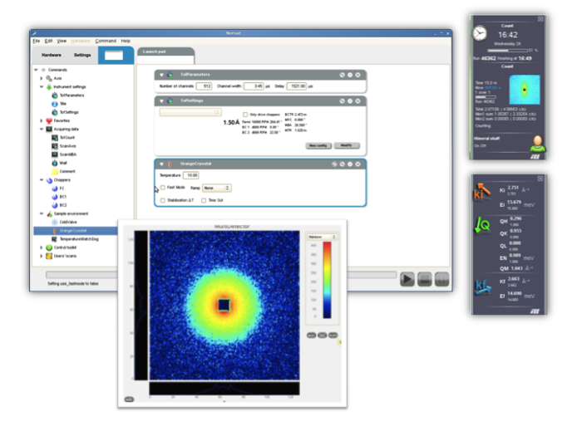
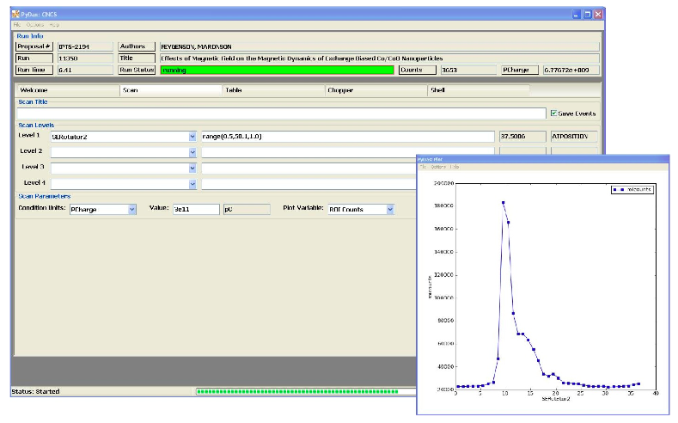
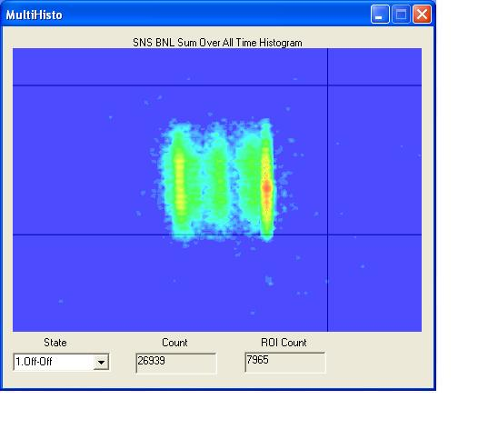

Slide 3
TBD?

Slide 4
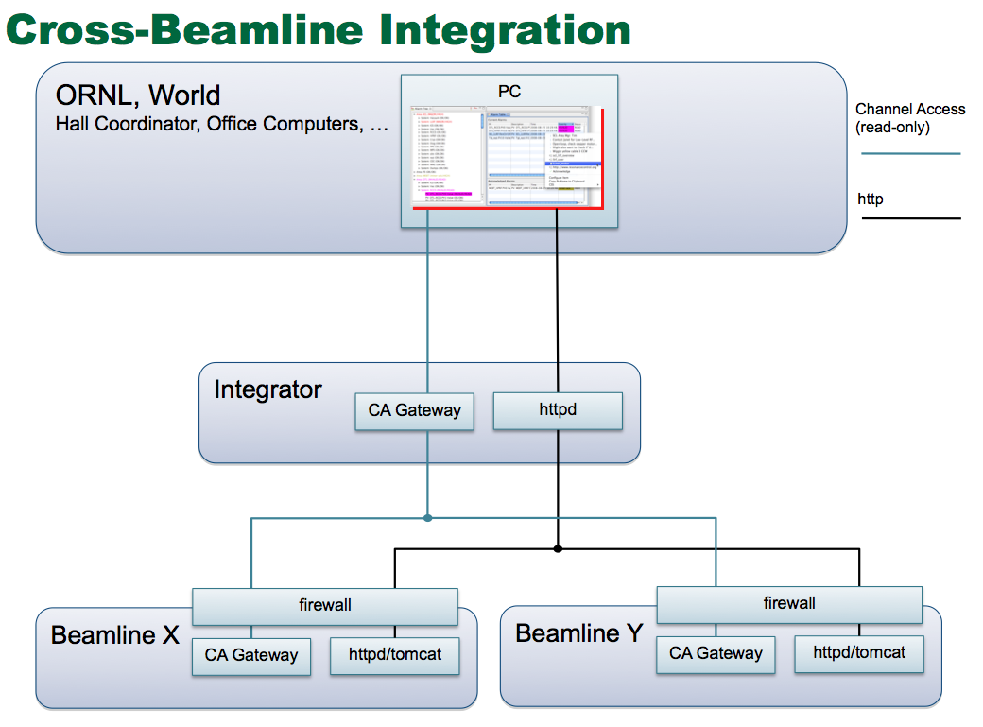
ORNL Admin/OR Networks
sns-core-rtr1 Firewall
BL1b
BL18
OSPF
10.111.0.0DMZ
BL2
BL17
BL3
BL16b
BL14b

Slide 6
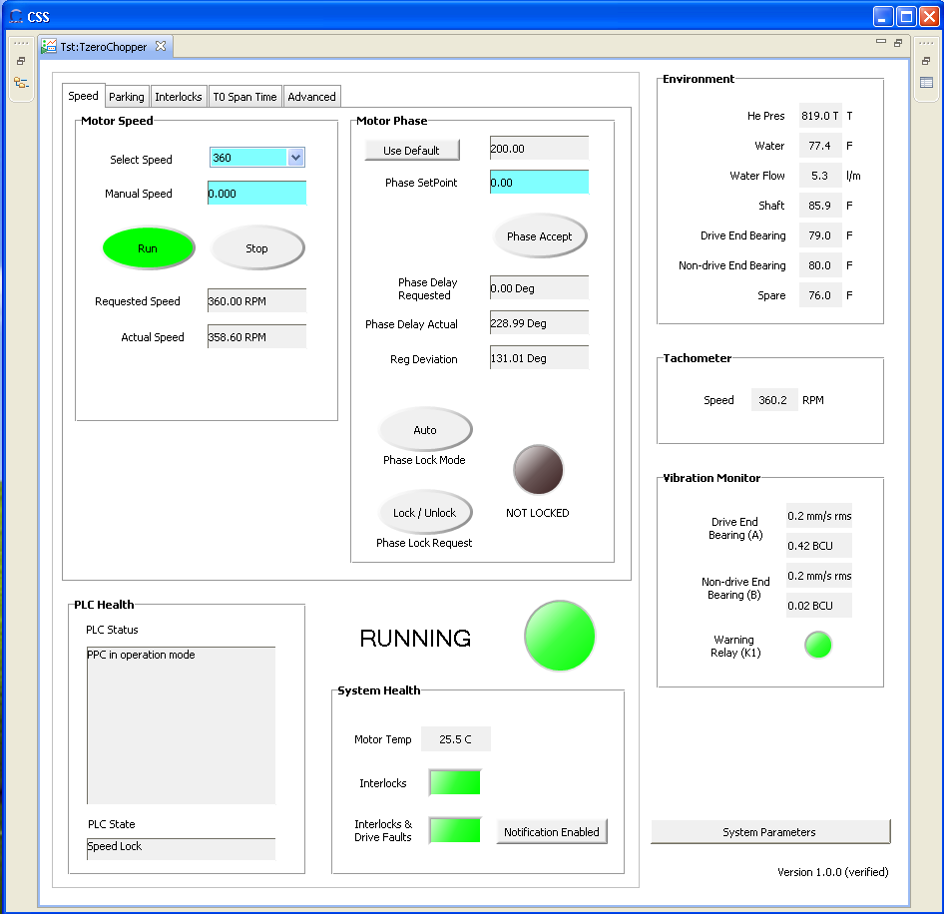

Slide 7
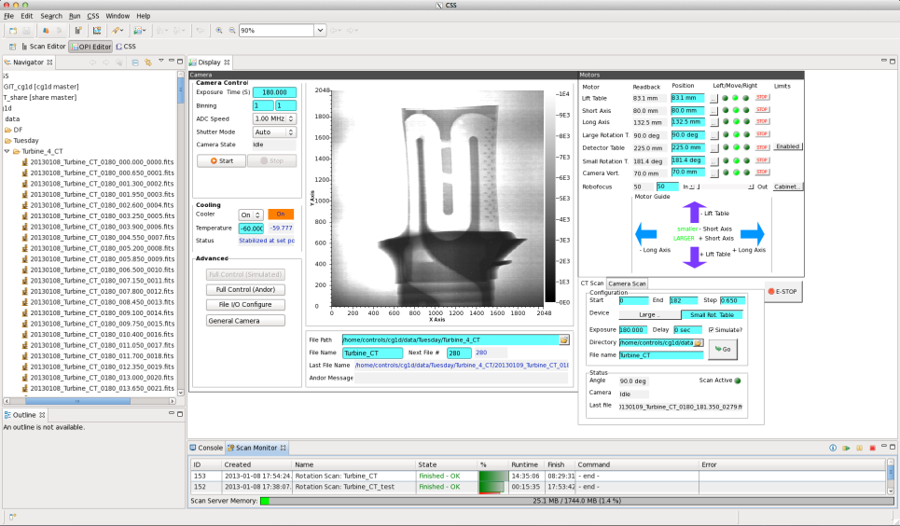

Slide 8
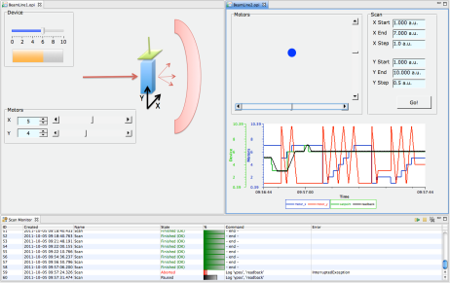
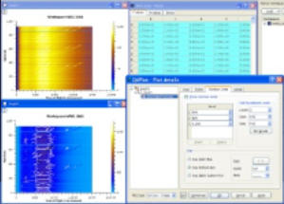
Detector
Streaming Management Service
Neutron Events
Data Stream
Streaming Translation Service
NeXus
Sample Environment,
Beam Line Equipment
PVStreamer
Neutron Statistics
Service
Mantid
Framework
Scan Server
Beam Line Workstation
EPICS IOCs
Channel Access

Slide 9
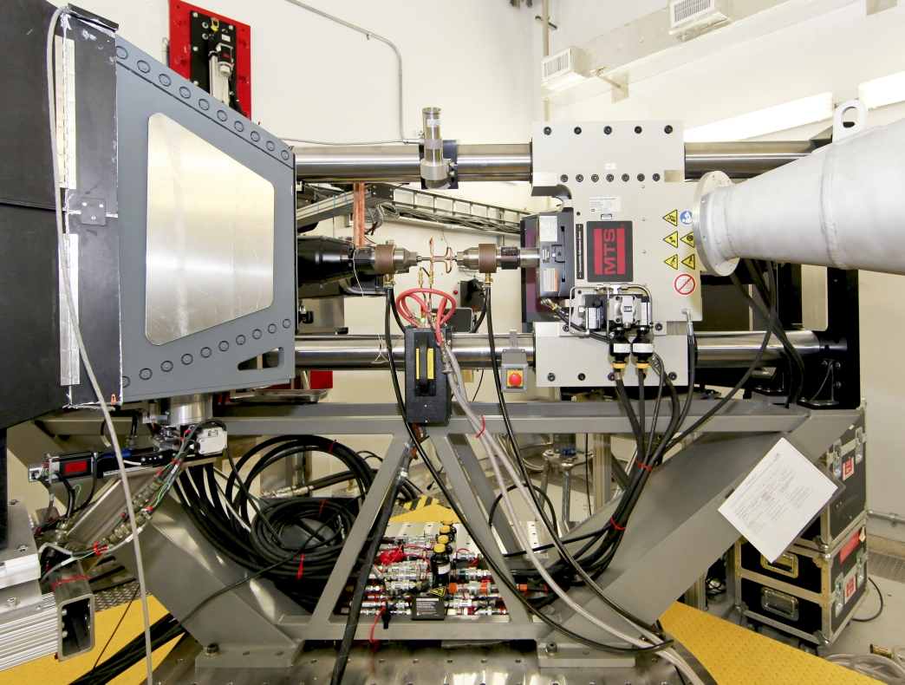

Slide 10
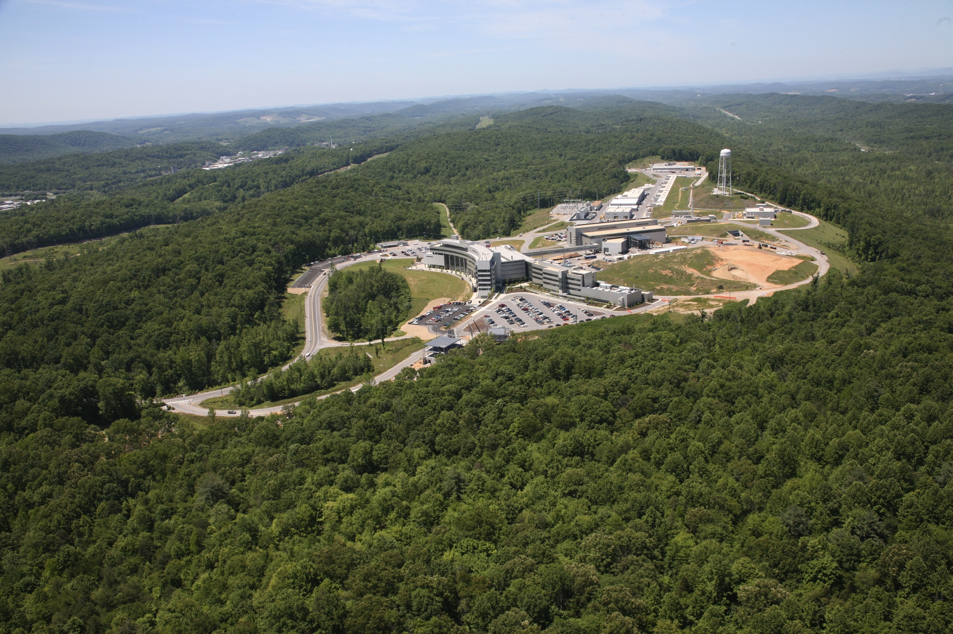
Questions and Comments

