Slide 1
CSS
An integrated development and runtime environment for ITER plant system local controls
ITER Organization - CHD/CSD/CDC

Slide 2
Agenda
Context
A compact development environment
A distributed runtime environment
ITER contribution process to CSS development effort
Future Plans

Slide 3
Context

Slide 4
ITER: a global collaboration
ITER is broken into 34 plant systems (magnet, vacuum vessel, divertor, cryostat, diagnostics…)
ITER construction units are procurement arrangements and 89 of them have control systems. They are developed by the 7 partners
Integration is a challenge
ITER is a research facility (requirements can change) with a long life time
Flexibility and modularity are essential

Slide 5
Risk Mitigation
Definition of standards, specifications and interfaces applicable to all plant system local controls
Development and distribution of a control system framework that implements the standards and guarantees that the local control systems can be integrated into the central one
Control System Studio is an key element of this framework for the operator interface, the alarm system and the engineering archival

Slide 6
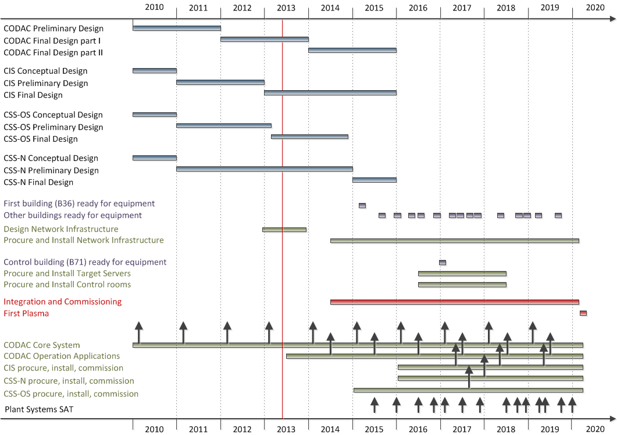
Central Control System Schedule

Slide 7
A compact development environment

Slide 8
CSS Services on one machine

Slide 9
Standardisation of the Operator Interface
Development and run of the Operator Interface
  ITER schema defines the default properties of all widgets to standardise the operator interface
  Color and font definition: users are encouraged to use color and font macro names
  Industrial Symbol Library of ~110 electrical symbols and ~150 fluid symbols
No standardisation for now of the layout

Slide 10
Archived Data
Store all miniscule changes of all the available PV
No compromise during development
But difficult to change afterward: configuration -> db generation -> compilation -> installation -> tests
Cleaning procedure?

Slide 11
Alarms
Alarm levels set within the normal operating range -> nuisance alarms
Baseline of alarms that require no action and train the operator to ignore certain alarms -> stale alarms
Alarms without description: how to respond to them?
Analysis of the alarm frequency to detect nuisance alarms? Measurement of the alarm standing time to detect stale alarms?

Slide 12
CSS Other Tools
SNL Editor
EPICS tools
  Probe, PV Tree, PV Table, CA Snoooper, PACE Editor
  PV Fields Viewer interfaced with db files within the workspace and configuration RDB
Alarm notifier for automated actions such as sending an email when an alarm is raised
Alarm annunciator
Message History
      ~ 130 plugins

Slide 13
A distributed runtime environment

Slide 14
CSS distributed on two levels

Slide 15
First Setup
Only one Plant Group for now and one Plant System
  ~25 OPI files
  5 PLCs
  ~1000 PVs
  ~900 archived PVs
“Manual” installation and configuration as the packaging system targets mainly the development environment and not a distributed architecture

Slide 16
ITER contribution to CSS development effort

Slide 17
CSS Contribution Workflow
Yesterday (3.0) > 1 month – Tomorrow 1 day?

Slide 18
Future Plans

Slide 19
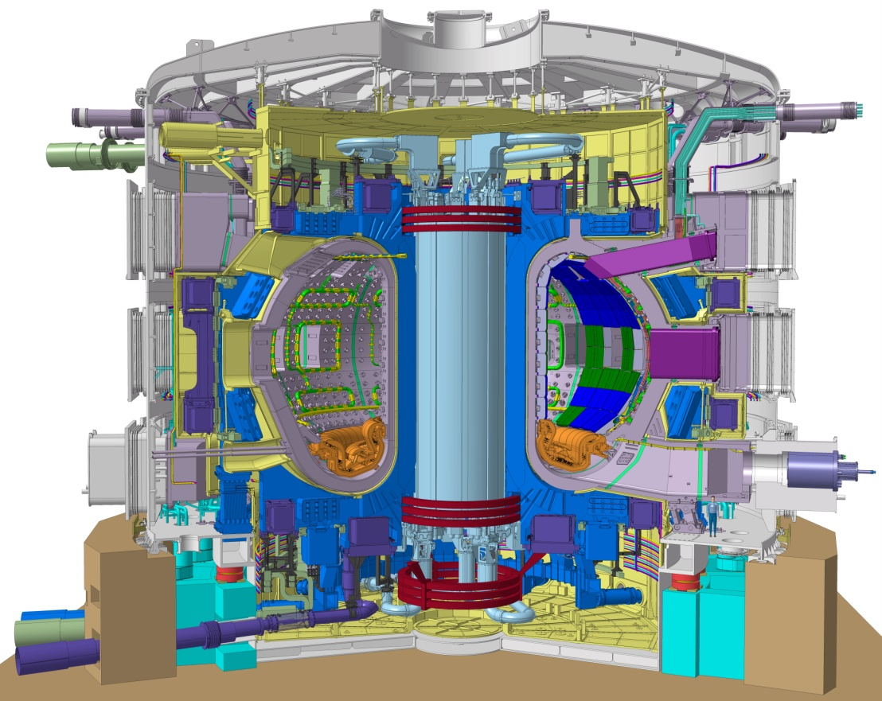
Development Environment Plan
PV name auto completion
  Required by our users during all training sessions
  History
  DB files parsing
  Configuration RDB
eLog entry from CSS
  No Web Interface
3D models in BOY

Slide 20
Integration of a new Group Plant

Slide 21
Web Interface
In addition to Web OPI
Web Data Browser to load predefined plot configuration file
Web Alarm to consult the Alarm table and Message History
  No Edition, no acknowledgment

Slide 22
Web Reports
To produce runtime statistics for acceptance tests
  How many PVs?
  How many archived samples?
  How many alarms triggered?
  …
To focus on what need to be improved before integration on ITER site

Slide 23
Go beyond the basics
Wants to learn more?
Notes:
23

Slide 24
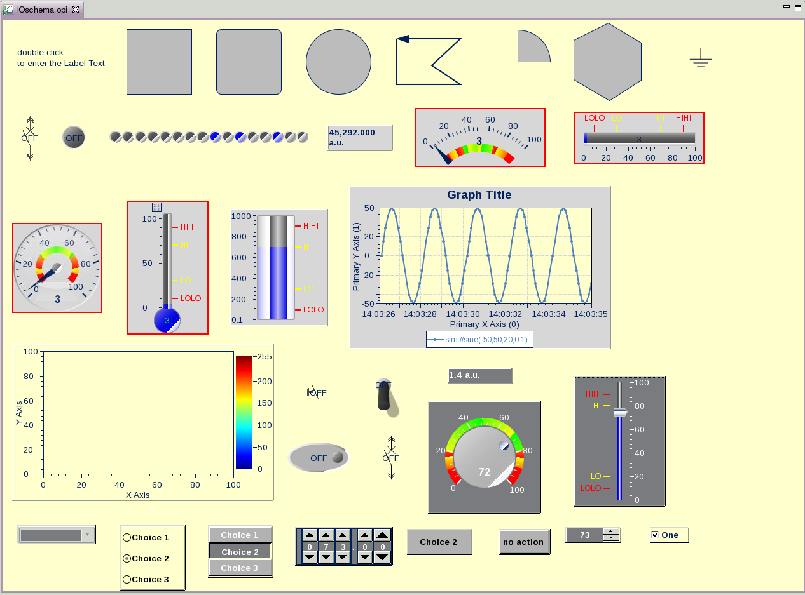
ITER BOY Schema
CODAC schema OPI helps to achieve consistent interface look&feel by defining the default property values used when a new widget is created with BOY Editor
CODAC schema OPI will contain the default definition of all BOY widget types
Notes:
24

Slide 25
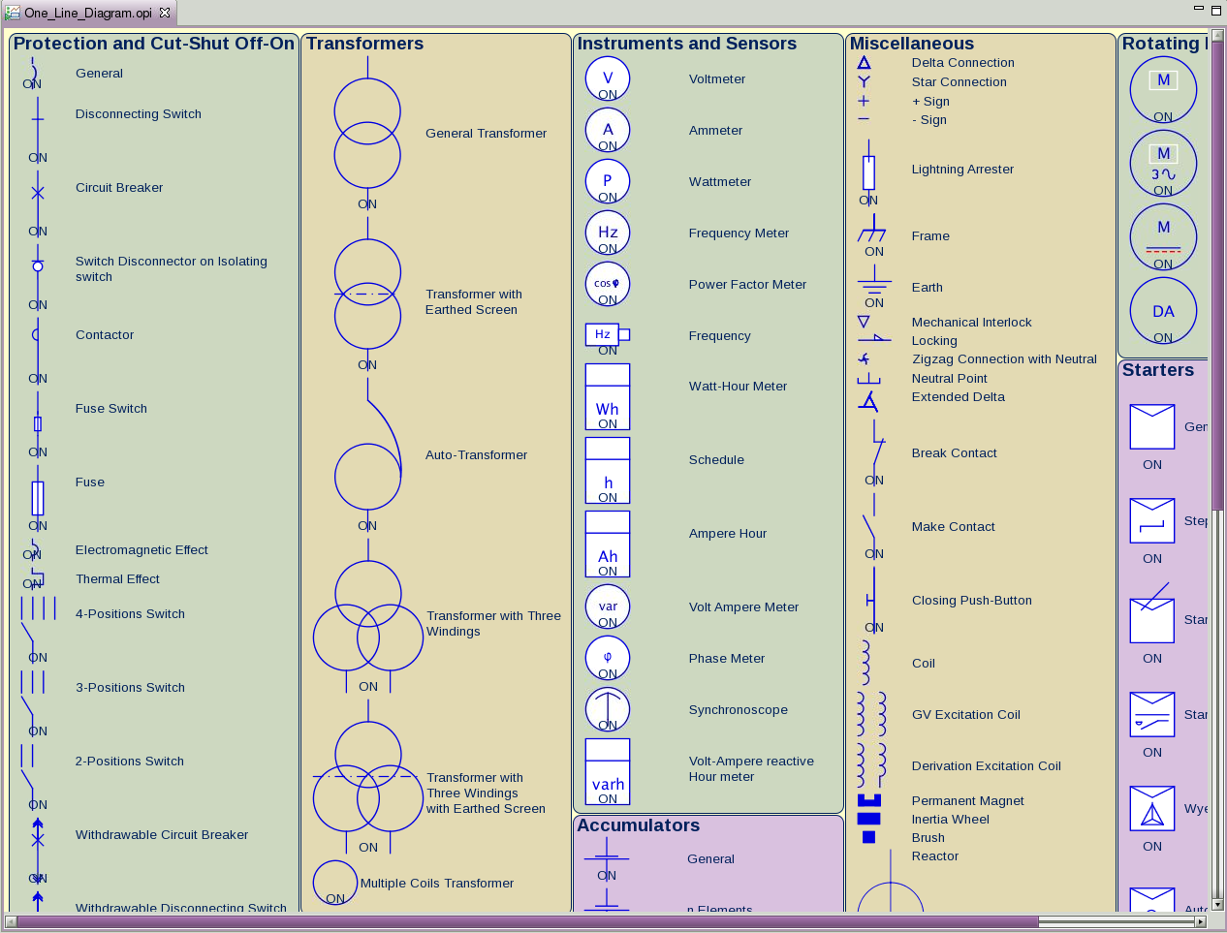
~110 electrical symbols
cs-studio/products/ITER/products/org.csstudio.iter.css.product/resources/One_Line_Diagram.opi
Notes:
25

Slide 26
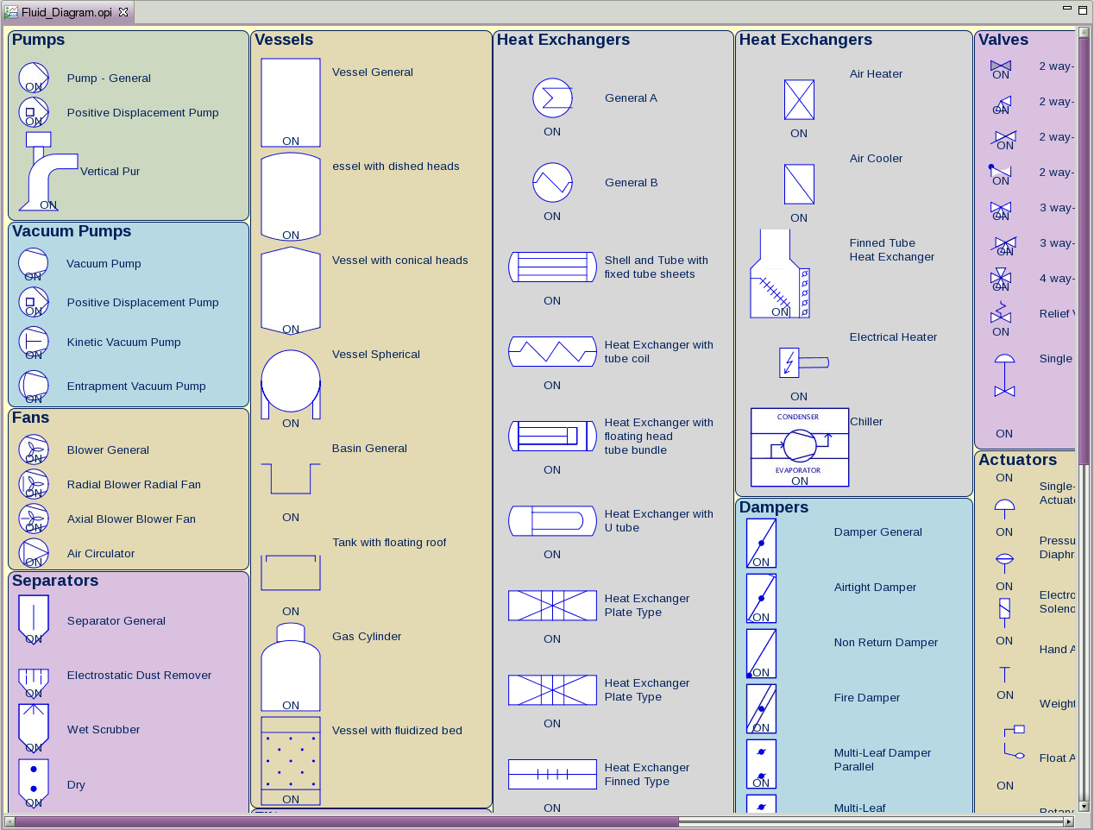
~150 fluid symbols
cs-studio/products/ITER/products/org.csstudio.iter.css.product/resources/Fluid_Diagram.opi
Notes:
26

Slide 27
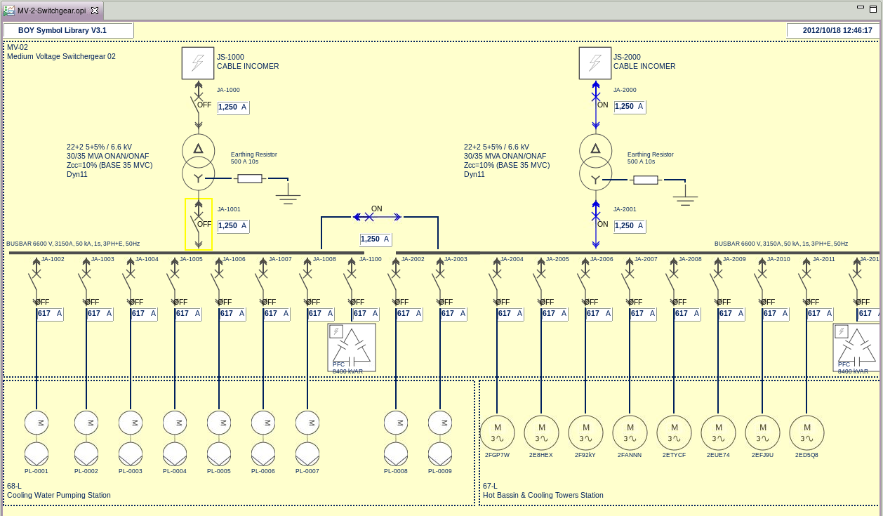
ITER Electrical Use Case
cs-studio/products/ITER/products/org.csstudio.iter.css.product/resources/MV-2-Switchgear.opi
Notes:
27

Slide 28
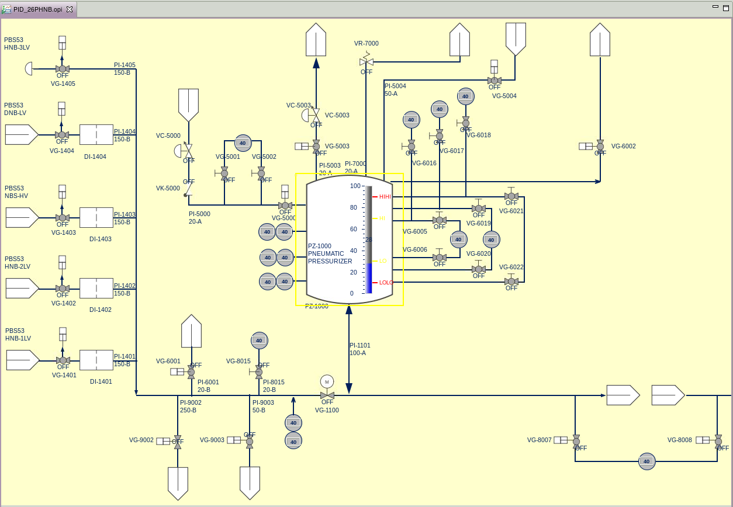
ITER PID Use Case
cs-studio/products/ITER/products/org.csstudio.iter.css.product/resources/PID_Water_Cooling.opi
Notes:
28

Slide 29
CSS BOY Runtime Environment

Slide 30
CSS BEAUTY Runtime Environment

Slide 31
CSS BEAST Runtime Environment

Slide 32
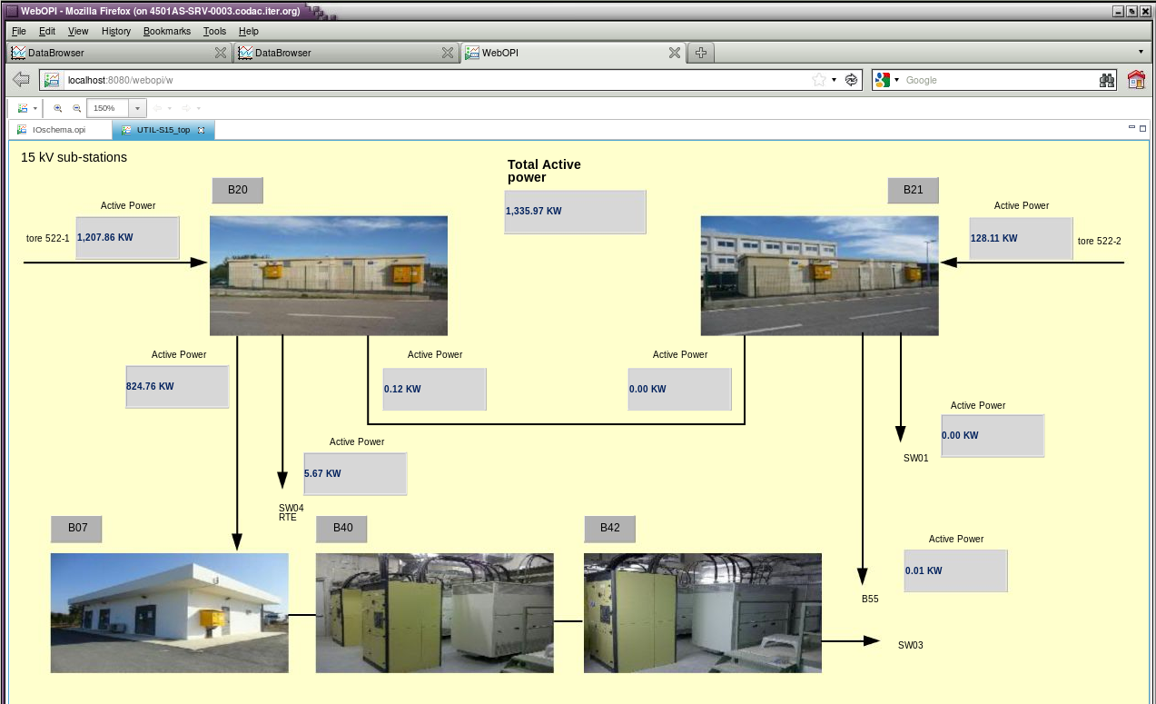
BOY on Web: WebOPI
The dream to bring your control system to web browser come true!
Notes:
32

Slide 33
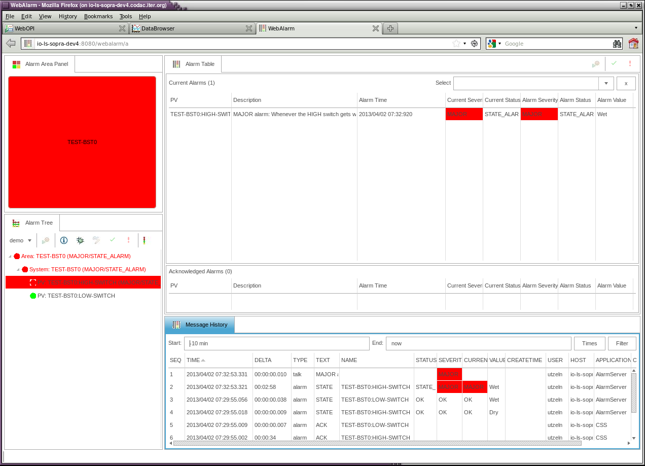
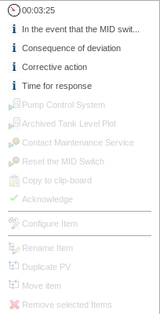
Alarm Table and Message History on the Web
Notes:
33

Slide 34
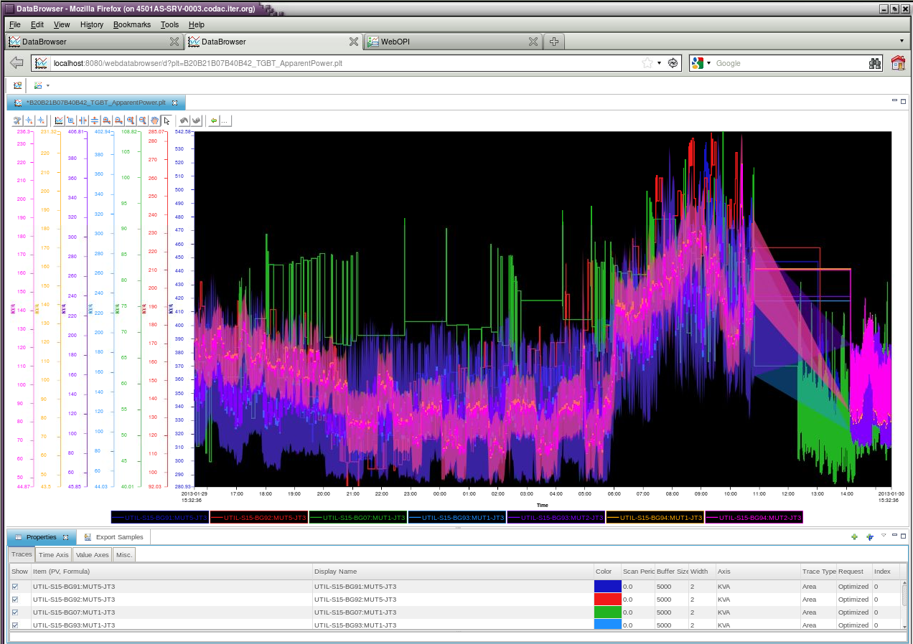
Data Browser on the Web
Notes:
34

