Slide 1
Edm for old eyes
R. Keitel, Triumf
2013-05-02

Slide 2
Some History (boring)
TRIUMF uses EPICS since 1996
Started with edd/dm (anyone remembers?)
Converted to edm in 2005
Right now no resources for anything but edm
Close to 4000 .edl files
900 interactive
3000 script-generated
mostly device control panels (face plates)
Will at least double with ARIEL project

Slide 3
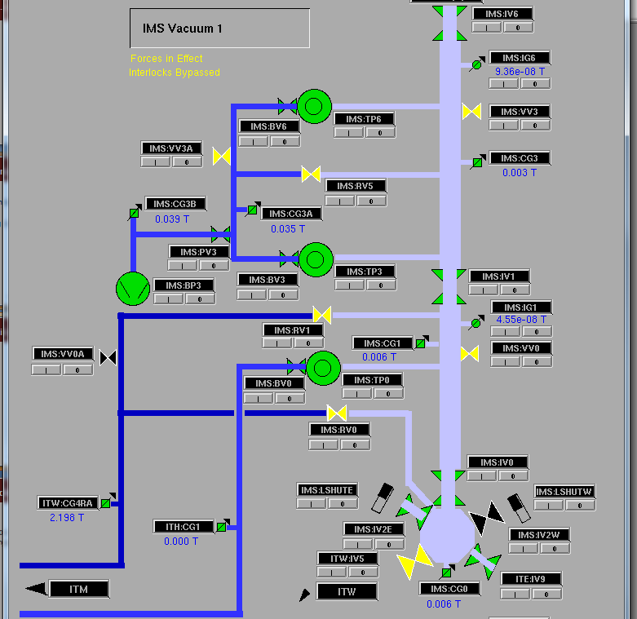
Synoptic displays

Slide 4
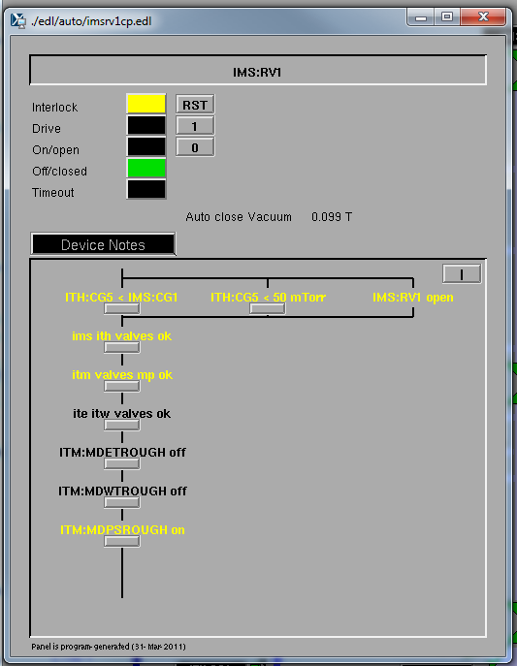
Device Control Panels
Script-generated
Interlock Display:
based on PLC program
also used for logic validation vs specification

Slide 5
dm vs edm
edm is vastly superior
but
….dm allowed re-sizing of windows
edm does not
Our screens were designed for 1280x1024
Moved to 1900x1200 ➔ pixel size changed
➔ edl displays look and feel smaller
Some user / operator complaints
➔ need to offer “something better”

Slide 6
Solution
Perl tool
magnifies .edl files
Related display callups call magnified files
Embedded windows call magnified files
works well – operators are happy
-- does not scale drop-down menu texts

Slide 7
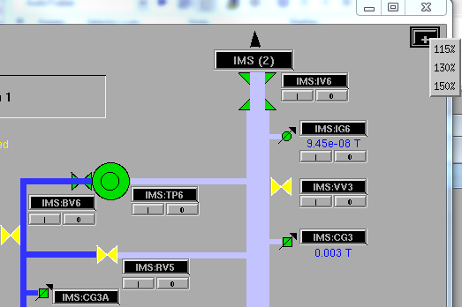
Magnification Button
Low quality screen movie of functionality: http://isacwserv.triumf.ca/epics201305/epics2013.swf.html

